Slide 1
Entry Grades Data 2026 cycle update

Slide 2
Why is the data important?
Applying to university can feel like an aspirational choice, or perhaps even out of reach for young people when looking at entry requirements, especially those from disadvantaged or under-represented backgrounds.
Showing entry grades data in a transparent manner on course pages within our search tool will ensure students understand there is often a level of flexibility between advertised entry grades and the actual results previous students were accepted with, and help them ultimately make informed choices.

Slide 3
What data will be available?
Entry grades data will be displayed on course details pages alongside the published entry grades requirements. Three data points will be included:
Most common grades held by accepted applicants (alongside the highest/lowest grade ranges).
Offer rate – showing the percentage of applicants who received offers.
Students can add their own grades to see a personalised acceptance rate – noting it is historical data.

Slide 4
What data is being used?
Now: UK A levels and Extended BTECs
UK A level and BTEC extended diploma grades of 18-year-olds (or younger) in England, Wales and Northern Ireland across the 2022-2024 cycles - given they represent the most popular qualifications taken by students.
Next…
We plan to expand the qualifications included in the future – and will work with providers ahead of releasing additional qualification data.

Slide 5
Contextualising the content
Students understand more is involved in admissions decisions and there is a space directly about the data for providers to add contextual information at course level. There are two fields you can update in the collection tool:
Free text field: Up to 500 characters to advise students of any key policies, offer-making practices or specific requirements.
URL link: to link to further information on your own website.

Slide 6
Bespoke provider flags
Providers have been given the option to flag:
Courses you feel should not be aggregated to suppress them from displaying.
Alternative aggregation suggestions.
Where we should default course views to more recent application cycles. (Subject to enough data being available).
Courses where a key qualification isn’t reflected in the data, to ensure we display a prominent message to students.
Review and suppress automatically populated grade confirmation rates where appropriate.

Slide 7
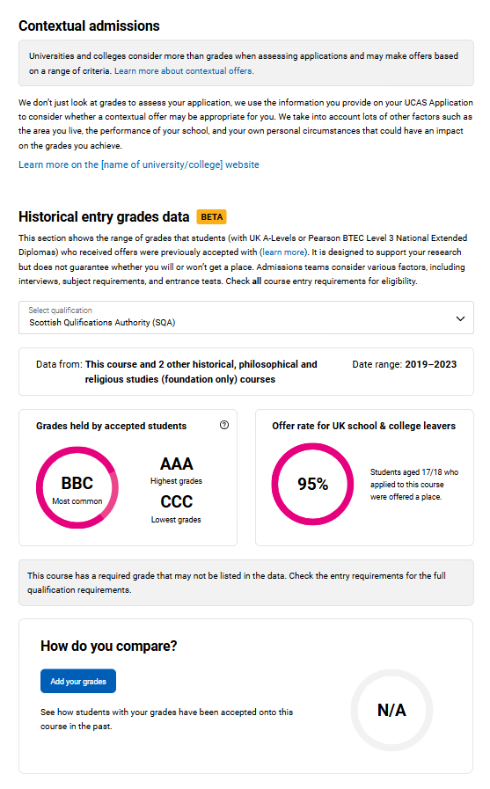
How the tool looks for 2026 cycle
Contextual admissions
Information and link to university/college website – this data can be edited at course level in the collection tool
Data explainer
Section explains the data which is fuelling the feature and allows students to switch qualifications
Offer rate
showing percentage of applicants who received offers
Grades held
Shows highest, lowest and most common grades profiles
Opportunity for students to add their own grades

Slide 8
Timeline
24 Mar – 7 Apr 25
Final file preview to show impact of requested flags
Dec – Feb 25
Provider-level data preview (2022-2024)
May 24
Beta available on course search
24 April 25
Course search updated with 2022-24 dataset
Spring 23
Prototype development. Engagement with Advisory groups | Student usability testing | Provider webinar
2022
Independent research into student requirements
2021
Accepted entry requirements published in Adviser portal
Security marking: CONFIDENTIAL

Slide 9
For more information go to:
https://www.ucas.com/providers/news-and-developments/provider-developments-ucas/entry-grades-data
Or use the feature as it is today in course search!

