Slide 1
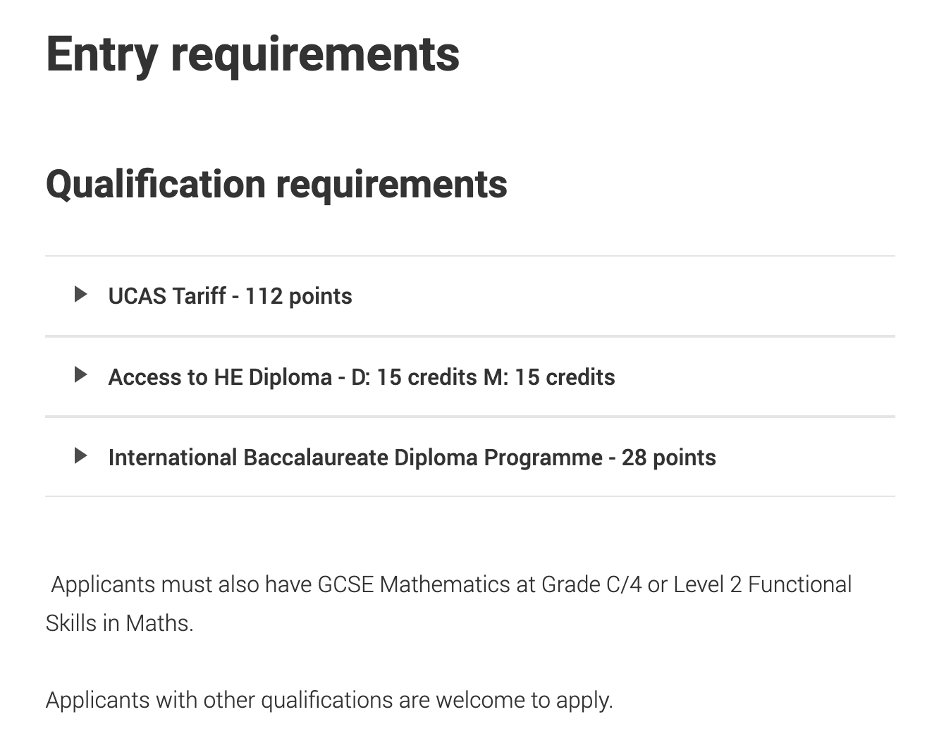
Weighing up your options
Familiarise yourself with course entry requirements and UCAS Tariff points

Slide 2
Weighing up your options
1. Go to your UCAS Hub – www.ucas.com/dashboard
2. Use the Tariff Point Calculator to work out your points and write them down in your worksheet

Slide 3
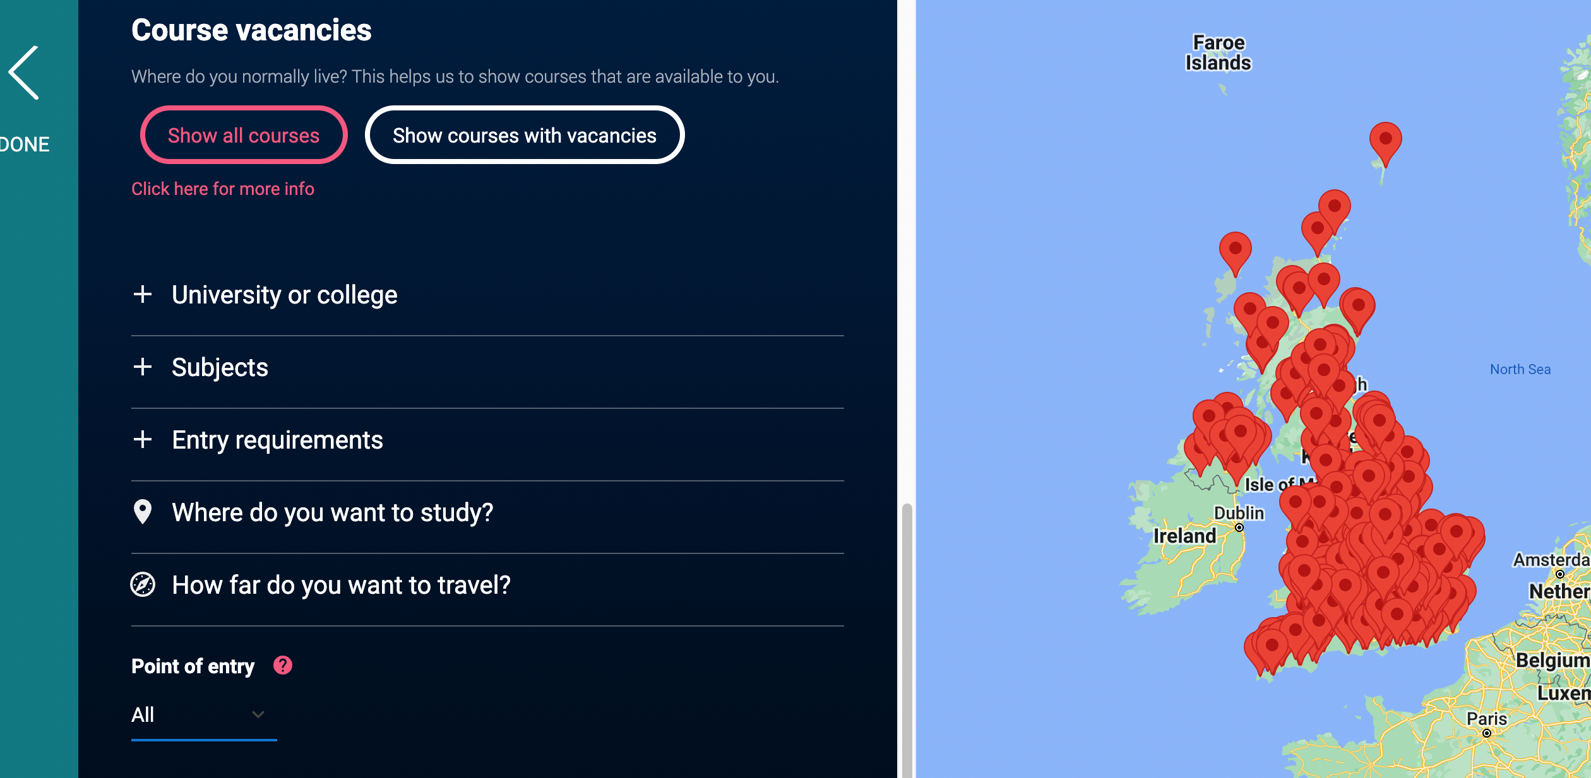
Weighing up your options
Use the ’Entry requirements’ filter on course search and favourite at least 5 courses you might be eligible for.

Slide 4
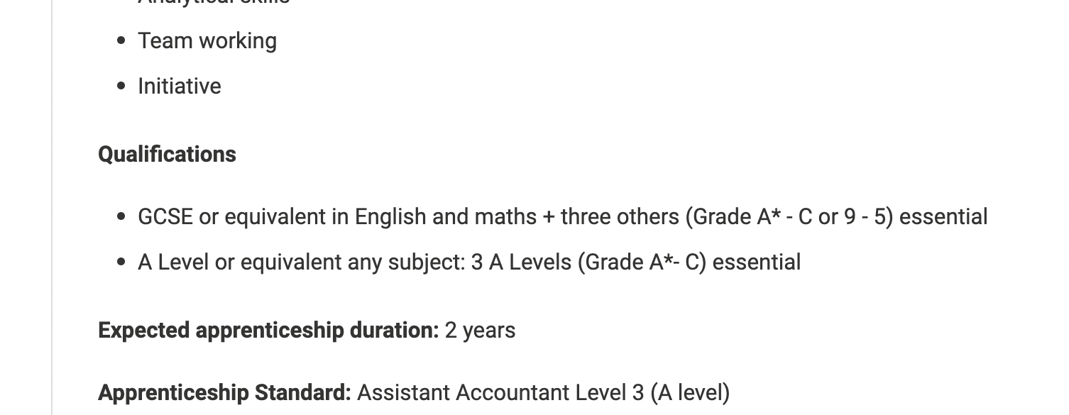
Weighing up your options
Go to UCAS CareerFinder to see qualifications you may need for apprenticeships.
List at least 2 apprenticeships you would be interested in.

Slide 5
Weighing up your options
Write down the answers to these questions.
“Do you want to live close to home when you leave school / college?”
“Do you want to move away?”
“Do you like the idea of being independent?”

Slide 6
Weighing up your options
1. Go to the UCAS location guides – www.ucas.com/explore/search/location
2. Read 2 or 3 location guides
3. Favourite at least 1 location you would be interested in studying in

Slide 7
Weighing up your options
1. Go to your UCAS Hub – www.ucas.com/dashboard
2. Using the ‘For you’ recommendations, favourite at least 5 courses

