Slide 1
VISITOR INFORMATION GUIDE
DATE: EVENT DATE
VENUE: VENUE NAME

Slide 2
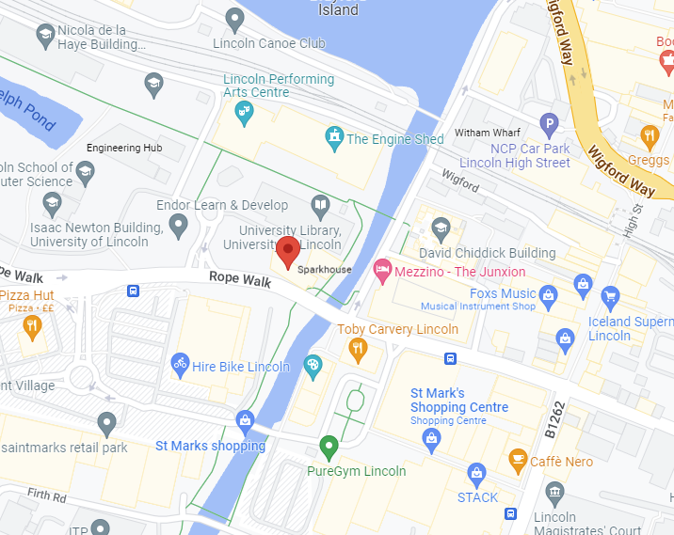
GETTING HERE
GETTING HERE
The venue location with a satnav postcode.
You can link here to venue or campus maps if needed.
TRAVELLING BY CAR OR COACH?
Please enter here instructions for coaches. Will passes be sent out prior to the event?
PLEASE NOTE, HERE IF COACH PARKING IS NOT AVAILABLE.
If you have any info about car parking, you can add it in there.

Slide 3
WHILST YOU’RE HERE
WHEN YOU ARRIVE
On arrival, please head to the main entrance
located..... Please have your ticket ready for inspection. If you don’t have a ticket on arrival, please report to the registration desk please enter location of onsite registration.
Your exhibition ticket is personal to you and should not be
passed on to other group members, as this could compromise the security of your data. To comply with data protection regulations, it’s essential that individuals at our exhibitions use their own ticket – both on entering, and when visiting exhibitors’ stands. Anyone found to be in breach of this will be asked to leave the event and register again to be readmitted.
Please be aware, the venue may be conducting random bag and wand searches. We thank you for your patience while this takes place.

Slide 4
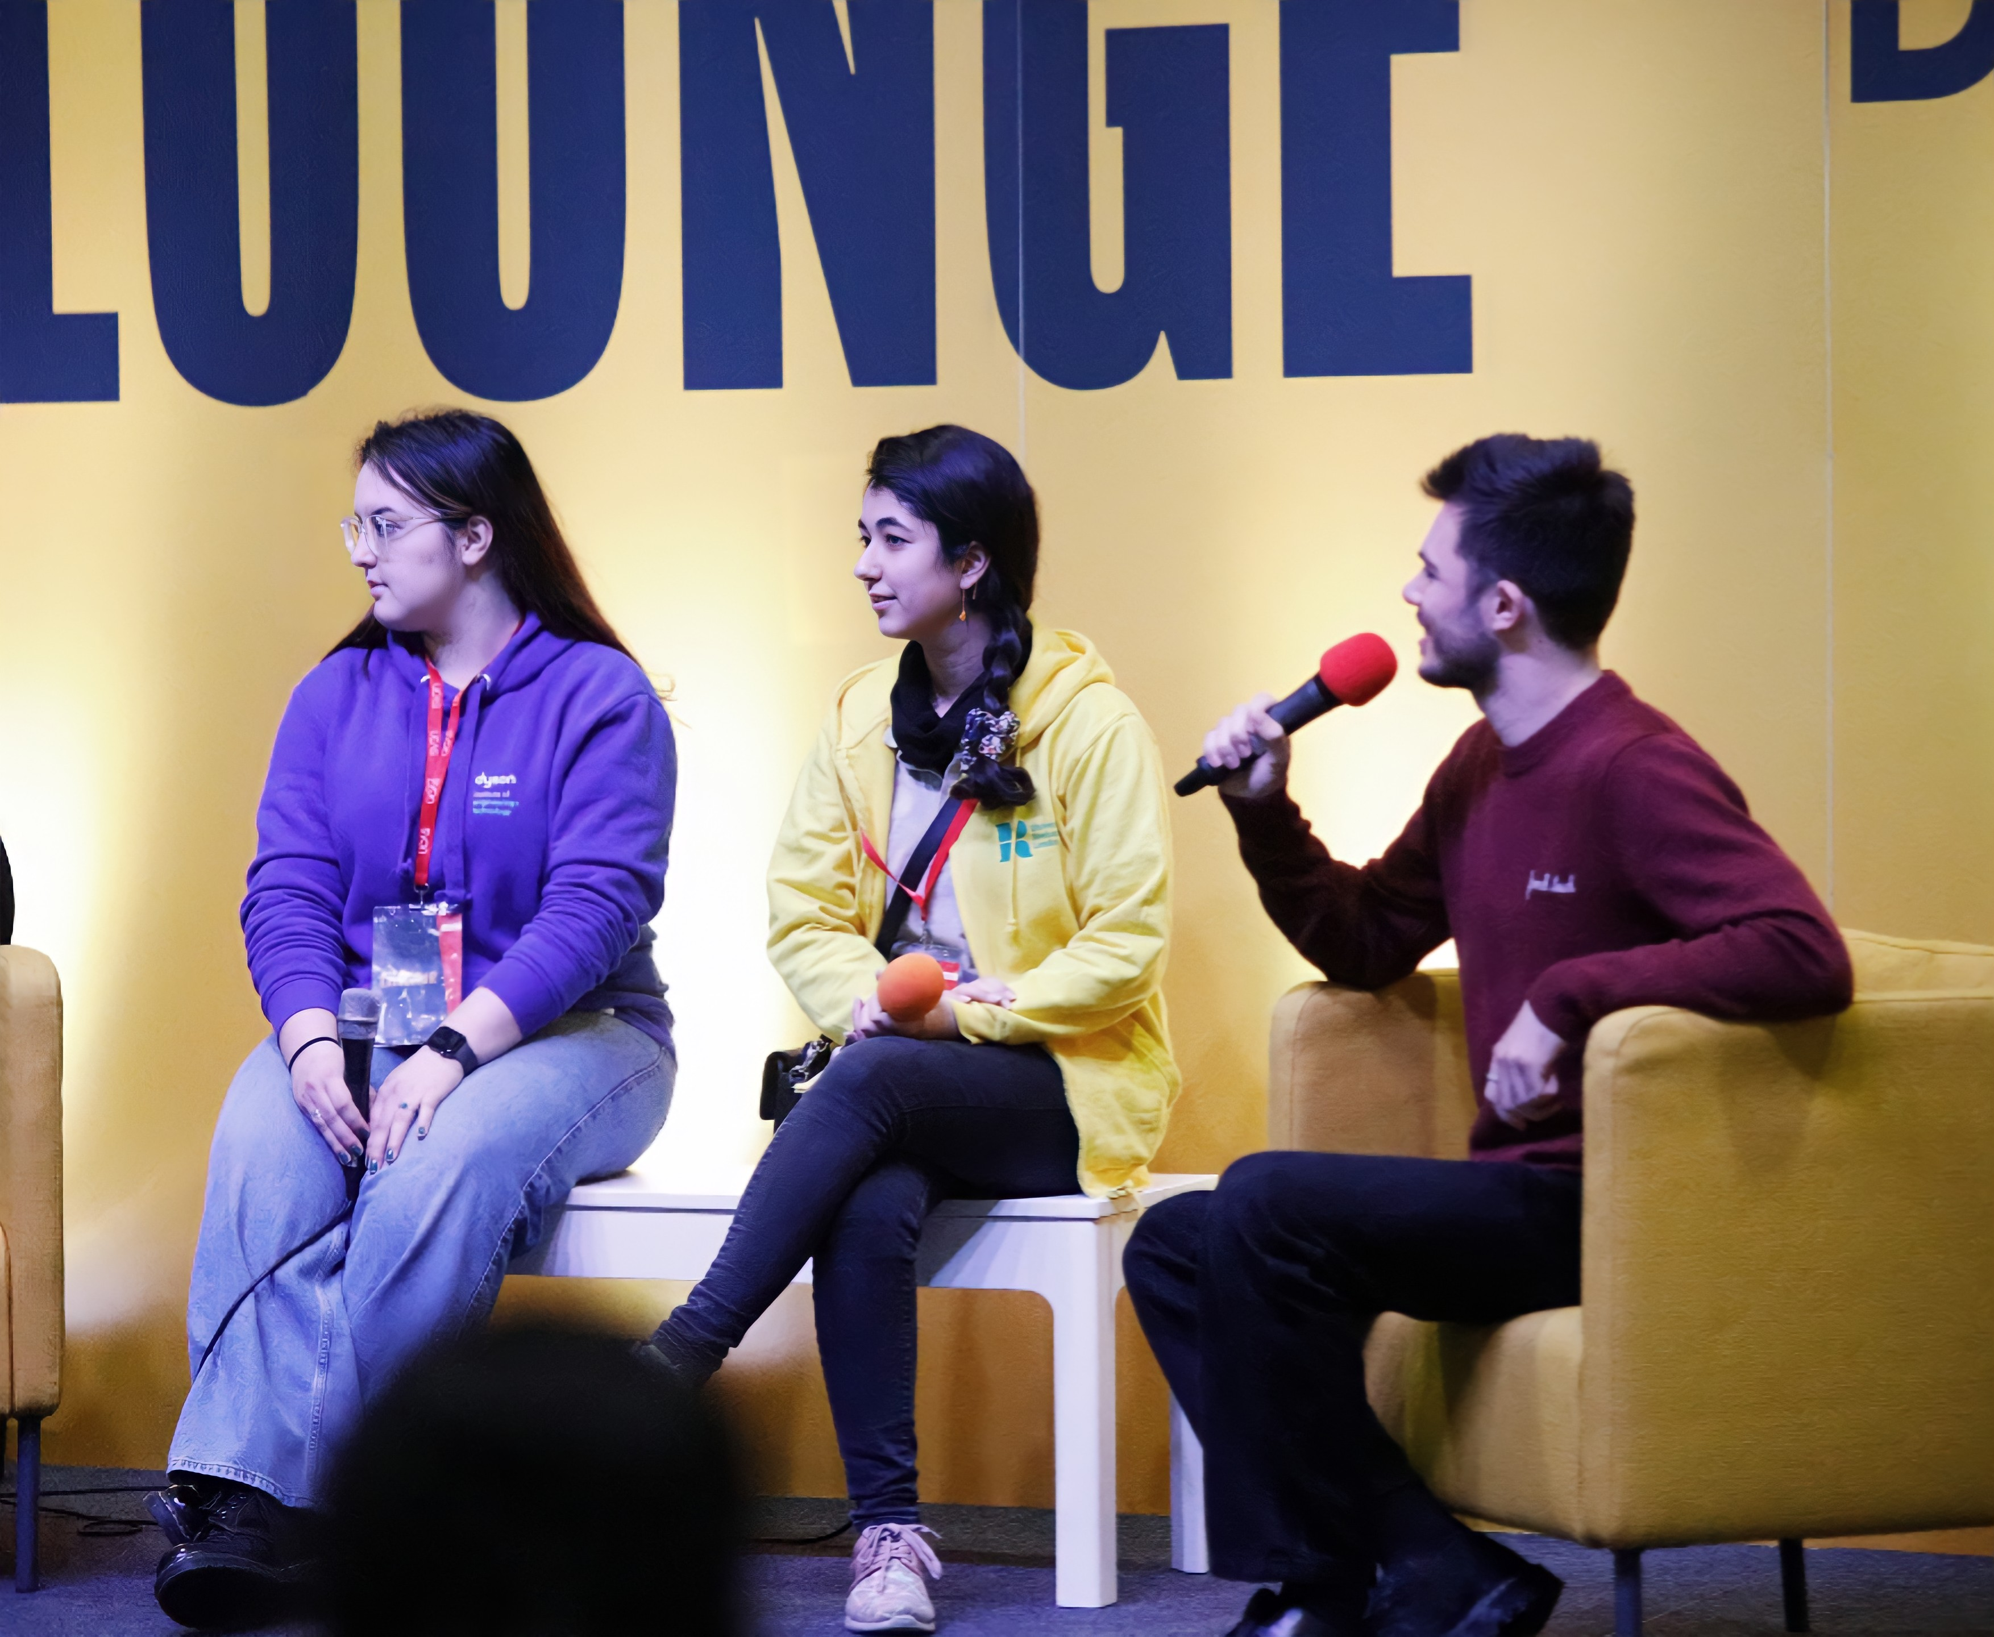
WHILST YOU’RE HERE
The Big Q&A and Subjects Talks
Student talks, workshops, and performances will run throughout the event within our Main stage and Mini Stage. These can all be found in the main hall and will be signposted. A full programme of events can be found on the event webpage.
ACCESSIBILITY
Please enter if disabled access details and where suitable toilets are located.
WIFI
Please enter wifi details
EVENT STAFF
For general queries during the event (e.g. directions to facilities), ask any of the event staff, who can be identified by their UCAS-branded t-shirts.
CATERING
Please enter location of catering details.

Slide 5
JUST IN CASE
ORGANISERS
If you wish to speak to the event organiser, they will be based in the exhibition venue, and can also be identified by UCAS branded t-shirts. If you need to speak to the organiser by phone prior to the event, please call enter telephone number.
ACCIDENTS & NEAR MISSES
If you are involved in, or witness an accident or near miss while on-site, please report it enter where to report it.
EMERGENCY PROCEDURES
Should an evacuation of the building occur, please follow the instruction of the event staff, and leave the build via the nearest exit.
FIRST AID
Where can visitors find first aid if required?

Slide 6
FREQUENTLY ASKED QUESTIONS
WHAT INSURANCE IS IN PLACE FOR THE EVENT?
The organiser has adequate public and employee liability cover. While the organisers take every precaution to protect visitors’ property during an event, they are not responsible for any loss or damage. All group leaders should ensure they have adequate public and employers’ liability cover, in line with the booking terms and conditions.
WHAT HAPPENS TO ANY LOST PROPERTY?
Please enter lost property policy.
CAN I SMOKE/VAPE ON SITE?
Please note, throughout the build-up, duration, and break down of the exhibition, there is a strict policy of no smoking/vaping or drinking of alcohol on the University campus.
WHAT SECURITY IS THERE?
Security is present at the event throughout. If you are a victim of theft, please report it to the event manager immediately.
WHERE CAN I GET A COPY OF THE RISK ASSESSMENT FOR THE EVENT?
The organiser has completed a risk assessment for the event and this will be uploaded to the group bookers enet account.

Slide 7
CONTACT DETAILS
VENUE
Name
Email
Telephone
ON SITE GENERAL ENQUIRIES
Event ambassadors, wearing UCAS t-shirts, will also be available to offer help and advice if you have any queries
CONTACT DETAILS
Prior to the exhibition 01242 544 808 or email events@ucas.ac.uk
Thank you for registering to attend the Event UCAS Discovery exhibition.

