Slide 1

Accommodation Marketing
Services
A unique and trusted media ecosystem built around the student journey

Slide 2
For an audience searching for a place to belong, accommodation is fundamental
1/3
Accommodation is the third biggest driver of university selection.
Finding accommodation is high on the priorities of students – in part because of the fundamental role it plays in their experience of university.
Offering private accommodation in the current climate comes with a vast range of challenges – and all too often it comes down to chasing students in the final moments of decision-making and resorting to expensive incentives.
But the need students have for accommodation – and the fact it is often a source of some anxiety – means there is huge opportunity in reaching those audiences early and offering much needed support in finding the right place for them.
£641
Average UK spend per month
on rent.

Slide 3
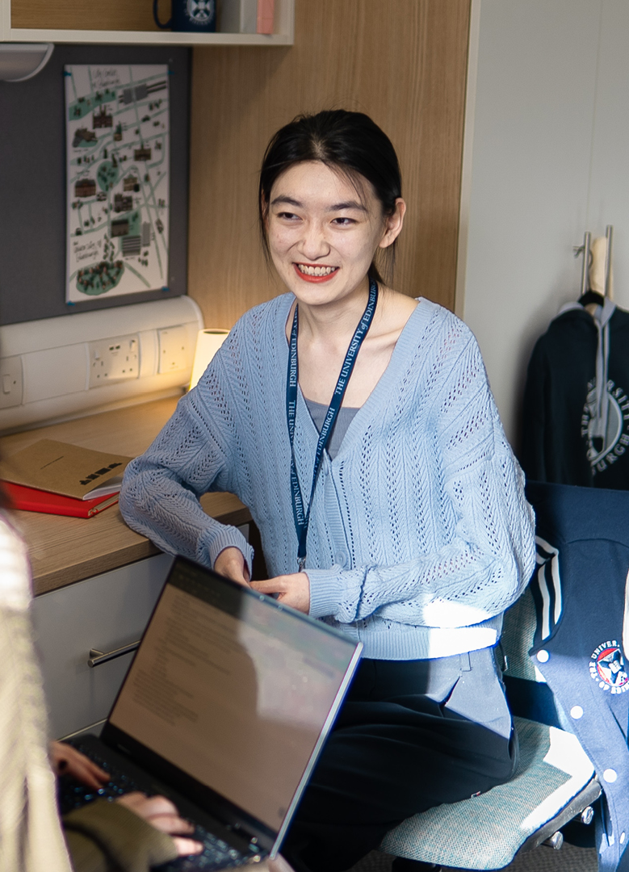


Every year over 1.5 million students and young people depend on ucas to explore their options
It is their first major life decision and the choices they make now will have a far-reaching impact on their future.
UCAS is more visited for than Google educational resources
UCAS’ positive reputation among young people places it on a par with the NHS, and ahead of the BBC
ZENITH OPTIMEDIA | UCAS 2022

Slide 4



For accommodation brands looking to engage the next generation, UCAS is uniquely placed to reach young people and their influencers
We have unrivalled access to verified data that is both extensive and high quality, proven by our strong engagement rates
And because we are a charity, every pound spent with UCAS today, is an investment in widening access to education and career paths for more young people tomorrow
Our understanding of the youth audience is unparalleled, with in-depth insight into their career/higher education choices, preferences and commercial behaviours
Our audience has a huge
amount of trust in our brand

Slide 5


HOW CAN UCAS HELP YOUR BUSINESS?
Insight
As a partner of UCAS, you can be at the forefront of the changing landscape - understand what young people think, feel and do in the moments that matter. Access the latest data and trends to understand the market and inform your strategies.
And there is so much more we can do together - understand student and sector trends, review your performance and deliver high performing campaigns.
Consultancy
Campaigns

Slide 6



Reach the right audience for your property
Our verified student audiences include those looking to make their applications, those that have applied, have accepted and are at university, as well as their biggest influencers – their parents and advisors. This means we can harness any student audience that best aligns to your objectives.
applicants
Influencers
1M+
750K
70K
30K
Pre-applicants
Applicants
Clearing applicants
Parents, teachers and advisors
Students
Students
570K+
1M+
150K+
Placed at uni
Current students
International students

Slide 7
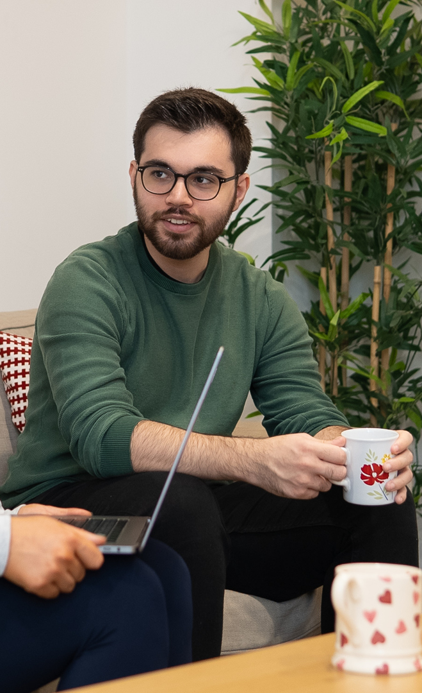


Targeting
Using our advanced targeting options, you can define and engage the right audience for your campaign based on hundreds of data points. So, that means we can create specific pools of students for your property, based on your objectives.
With UCAS you can:
Reach placed students in specific cities as they research their 2nd and 3rd year accommodation
Target students by application status to reach them as they become placed to a University within your city of focus, by where they are right now
Focus your campaign on those going to a specific tariff university to apply your market research
Data Governance
All our first-party data is GDPR compliant and is managed by rigorous data governance procedures.

Slide 8
Shaan Clarke,
Marketing Director, Collegiate UK
UCAS's marketing campaigns have been a game changer for us! Three months in and the digital media campaigns, especially on social media in our targeted cities, have shown impressive success rates. We're seeing click-through rates of 8-10%, a number we're genuinely proud of.
Beyond traditional email campaigns, UCAS understands that the Gen Z market thrives online. Their approach has significantly improved our top-of-the-funnel strategy, resonating with the online-centric Gen Z audience.

Slide 9
Belinda Ling,
The grove media
We have seen great open rates and click-through-rates, especially from emails, and were well above UCAS benchmarks. From other products (display& paid social),we also saw great number of clicks. When there are multiple campaigns running, we also see higher engagement on our own paid search channels and paid socials.

Slide 10
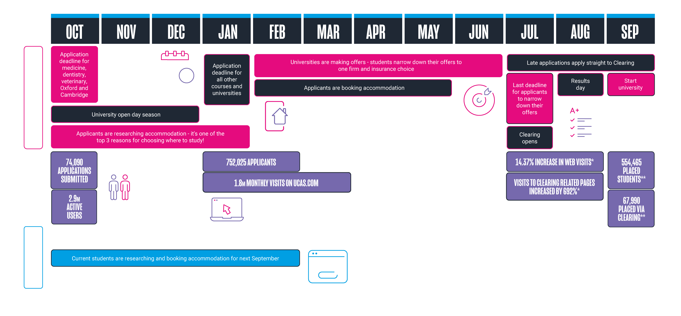
UCAS ACCOMMODATION CYCLE

Slide 11

INSIGHT AND CONSULTANCY
The data we hold offers a unique view into what young people think, feel and do. That data can be extracted for the targeting or enhancement of UCAS campaigns, or explored for deeper insights into your audience.
For organisations that would benefit from more guidance - or who have complex issues to solve - we offer specialist consultancy that brings together the depth and breadth of the UCAS ecosystem.

Slide 12
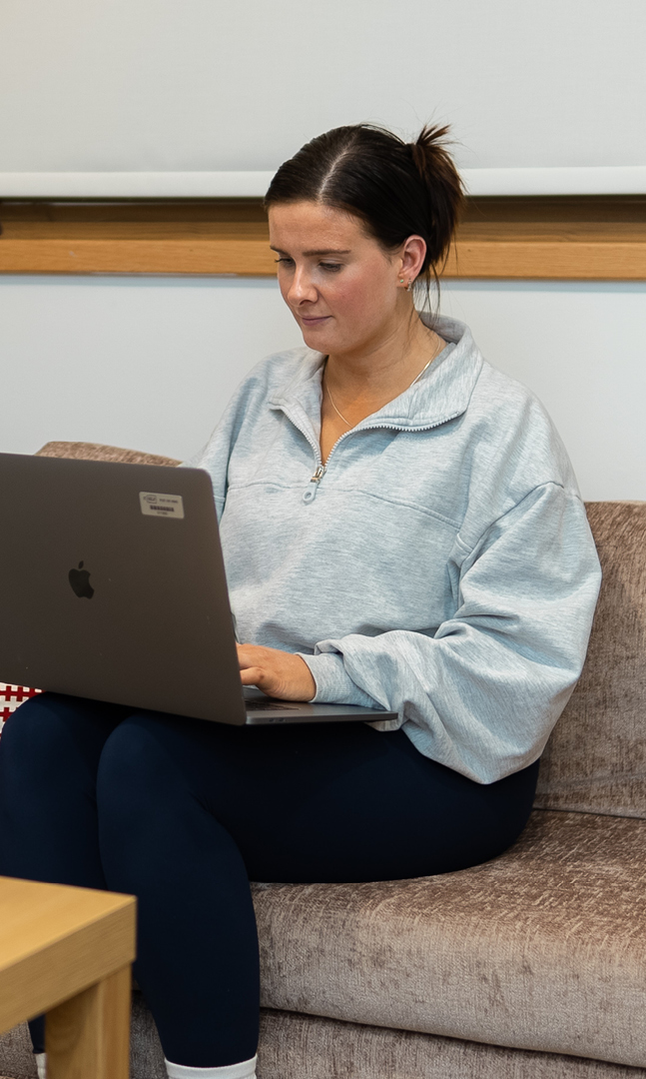
EXACT
Gain deeper understanding and confidence in your next investment
Higher education sector experts providing evidence-based recommendations for your accommodation investment
EXACT is UCAS’ bespoke data service that delivers CSV datasets to a particular specification. Using the rich UCAS data, EXACT answers your questions, helping you gain insight and understanding of trends, market size, growth, decline and demand – and the makeup of that data.
Understand the local student market
Understand the true value of your investment
Gain the confidence that your investment will pay off
Identify the risks, challenges and opportunities to shape your next steps
Combine quantitative data with qualitative analysis

Slide 13

CONTENT, CAMPAIGNS and Events
Whether it’s presence at a UCAS event, multi-channel campaigns across direct, digital and social, or bespoke content within our channels, we’ll work with you to define the most effective outcome.

Slide 14




Multi-channel campaigns
Promote a consistent message across our multi-channel offering. Our experts will work with you to understand
your unique objectives to ensure you are targeting the right person, at the right time, with the right message using
their preferred channel.
Email
Get your message into student inboxes, reliably and consistently, via our trusted email campaigns.
Events
Exhibit your brand and
meet future customers in person with UCAS events.
Website
Target users with display ads throughout their research and decision phase on UCAS content pages and the Hub.
PAID MEDIA
Reach Gen Z on their favourite platforms, using our verified student opt-ins with paid media.
Direct Mail
Showcase your brand experience, not just your message, by getting it through the letterboxes of young people, students, and potential new customers.

Slide 15

EMAIL
More students would trust UCAS with their private data than their high street bank
get your message into student mailboxes, RELIABLY AND CONSISTENTLY, VIA OUR TRUSTED EMAIL CAMPAIGNS
77% of students have said they trust the communications we send on behalf of our partners
Commercial businesses have seen a 66.8% average open rate, with top rates reaching 90%
Drive awareness of your brand amongst our audiences, who are uniquely engaged with the
emails we send, demonstrated by our unparalleled open rates.
Communicate directly with your target audience with sophisticated filtering and the ability to segment subscribers
Clearly measure your results
Personalise your message
With the ability to send standalone, dynamic or multiple trigger-based automated email campaigns you can maximise the opportunity and take advantage of our highly engaged database.
Source: 2022 campaigns data

Slide 16
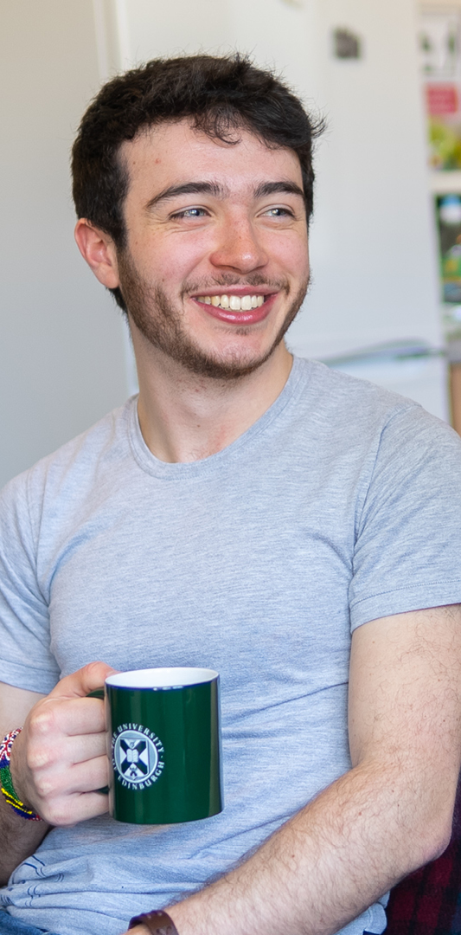
EVENTS
Event sponsorship drives brand engagement with 98% of consumers
EXHIBIT YOUR BRAND AND MEET FUTURE CUSTOMERS IN PERSON
Over 9 months, UCAS events visit more than 40 towns and cities across the UK. This provides brands with ample opportunity to connect with and make a lasting connection on young people.
Increase brand awareness
Interact with potential customers face-to-face
Network and explore partnerships
Create loyal customers
Over 160,000 attendees across 40 cities
Our commercial partners generate 596 leads on average

Slide 17

WEBSITE
Be seen by 1.8 million monthly visitors on UCAS.com
ENGAGE WITH YOUNG PEOPLE ON UCAS.COM
AT KEY MOMENTS IN THEIR DECISION-MAKING PROCESS
Target 700,000 students within their university application
Personalise your ads to targeted audiences and generate 10x more clicks
Position your brand at the forefront of young people’s minds by securing a prime spot on UCAS. This is the place where big decisions are made – and where your brand could sit front and centre for young people and their influencers.
Create a visual impact
Target millions of potential new customers
Increase brand awareness
Whether it be targeted display, sponsored content, programmatic or peer-to-peer engagement, we have an opportunity to promote your brand.

Slide 18

PAID MEDIA
Use insight to target the right student, at the right time, on the right channel
REACH GEN Z ON THEIR FAVOURITE PLATFORMS
Our research suggests that youtube is one of the most engaging platforms
Whether you’re building strong brand awareness or encouraging direct action, our paid media is a smarter solution to the growing demand for personalised, relevant advertising.
Precisely define your ideal audience based on
their HUB favourites and UCAS.com searches
Increase your reach to a verified
student audience group
Remarket to users you know are
interested based on their activity
Retarget users on the platforms
they are most engaged
71% of young people say that they would prefer ads that are tailored to their interests and habits
With UCAS paid media, we
have the ability to target precise, verified audiences based on your specific objectives. Our high match rate allows us to connect with these audiences on their preferred platforms
and channels.

Slide 19
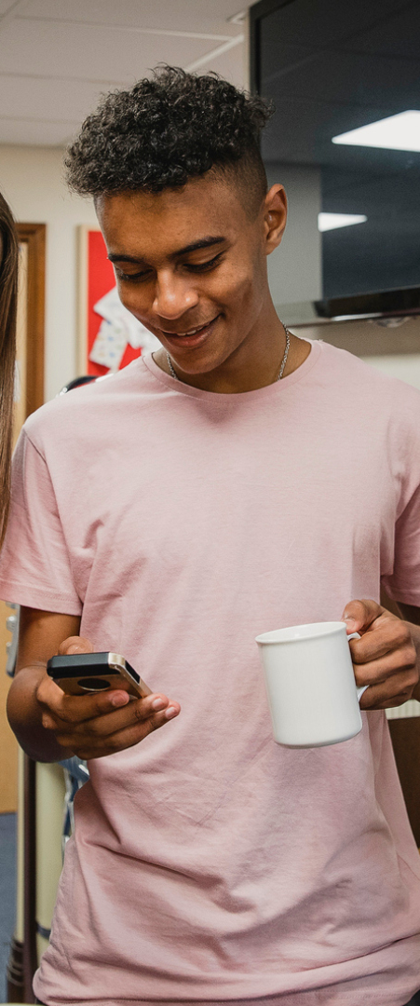
Direct Mail
3.85 TIMES
a month is the average number of interactions young people have with a particular piece of direct mail – including opening, reading, pinning to notice board or passing it on to someone else.
Showcase your brand with gen z & their influencers, direct to their door
Get your message across in a format which has fantastic cut-through with students, is kept longer than other forms of communication and is more
likely to be seen by parents and family too.
Cut through the digital noise
Differentiate your brand
and stand out in the market
Get in front of young people
and their influencers
10.4 Days
is the average time direct mail is kept in the home by young people before being thrown or filed away – more than 2 days longer than the general average.

Slide 20


VIDEO
SPONSOR VIDEOS ON UCAS’ MOST ENGAGING PLATFORMS AND ESTABLISH YOUR BRAND AS A TRUSTED AUTHORITY
Over 600,000 followers across UCAS’ social media platforms
Average engagement rate of 3.7% compared to 2.9% industry average
Our innovative video service allows brands to host videos on UCAS’ channels, directly engaging with a vast audience of digital natives on their favourite platforms. Tap into UCAS’ trusted brand with authentic, organic content that young people are actively looking for.
Differentiate your brand and stand out in the market
Establish yourself as a thought leader
Flex your creative muscle
We’ll work closely with you to understand your campaign objectives – from in-studio filming at UCAS to site visits to bespoke solutions, our teams are on standby to ensure a seamless collaborative experience
Source: 2022 campaigns data

Slide 21
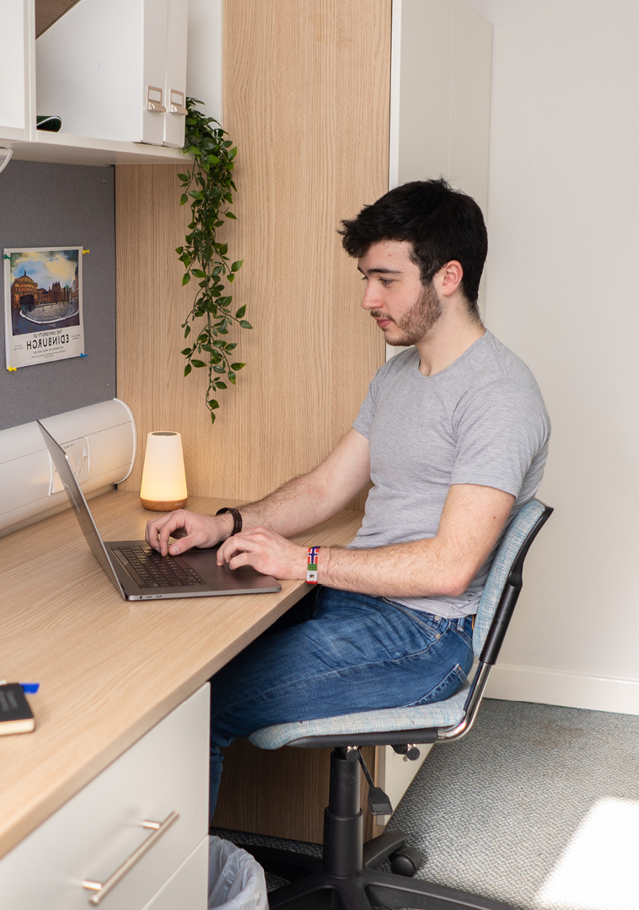
Accommodation marketing packages
Our data and channels can be combined to create a bespoke campaign that meets your own business objectives; however, we have also crafted a simple, powerful multi-channel package designed to amplify your brand and maximise the number of high-impact touchpoints.
Email | 4,500 names over 2 emails | £2,500
Paid Media | 2 channel, 4-week brand awareness campaign | £7,500

Slide 22




Get in touch with the most trusted brand in education. With unique access to over 2 million applicants, current students and graduates, we’re uniquely positioned to help you connect with the next generation.
CONTACT US
Accommodation@ucas.ac.uk
ucas.com/accommodation-solutions
Real Estate LinkedIn
Stephen Cleal
Senior Sales Manager
S.Cleal@ucas.ac.uk
Steph Butcher
Key Account Manager
S.Butcher@ucas.ac.uk
Alice Jago
Key Account Manager
A.Jago@ucas.ac.uk

