Slide 1
Building the foundations

Slide 2
Ready set go...
List as many achievements, personal experiences or skills you have
You have 3 minutes
Go!

Slide 3
So what?

Slide 4
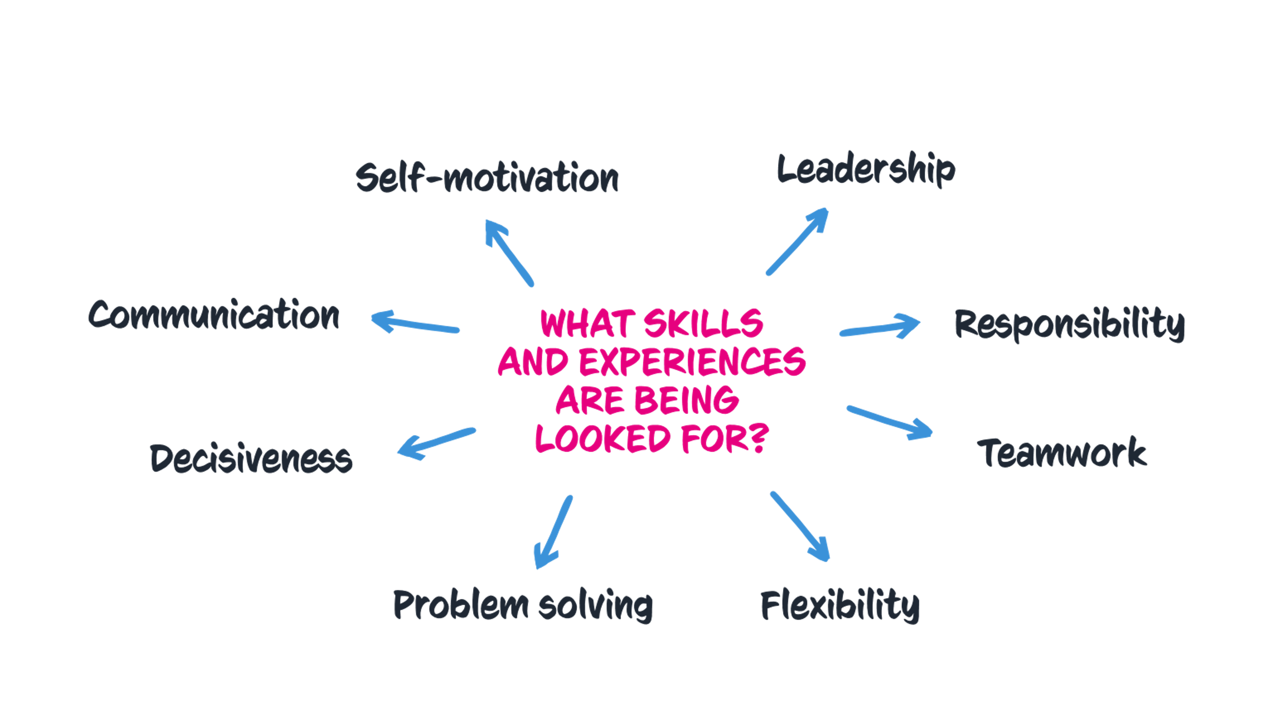
Pick and mix

Slide 5
Pick and mix
?
?
Is everyone looking for the same skills or experiences?
How can you find out what skills or experiences are specifically required?
Why would it help to know?
Do you think admissions tutors might ask ‘So What’?
?
Notes:
Remember this could be very obvious, e.g. for veterinary science you should love animals. But, these skills could also be transferable e.g. law needs the ability to deal with research and attention to detail but also compassion/people skills particularly in areas like family law - perhaps something like mediating between your siblings!

Slide 6
Research what to pick
Read university or college course information on UCAS
Read the course content information on uni or college website
Look at how a course might be assessed
Chat to a student ambassador on Unibuddy who already does the course
Take a subject spotlight session on UCAS
Take a uni or college subject taster session
Ask questions of subject lecturers at an open day
Research job adverts of careers you might be interested in the future
Take the UCAS careers quiz and look at the skills listed for each result
Interview someone already in a career you're interested in

Slide 7
Remember to peel
Point
Make your point
evidence
Back it up with Evidence and examples
explain
Explain how the evidence supports your point
Link
Link it back to the course(s)/subject
All illustrations designed by Storyset on Freepik.com

