Slide 1
Admissible evidence

Slide 2
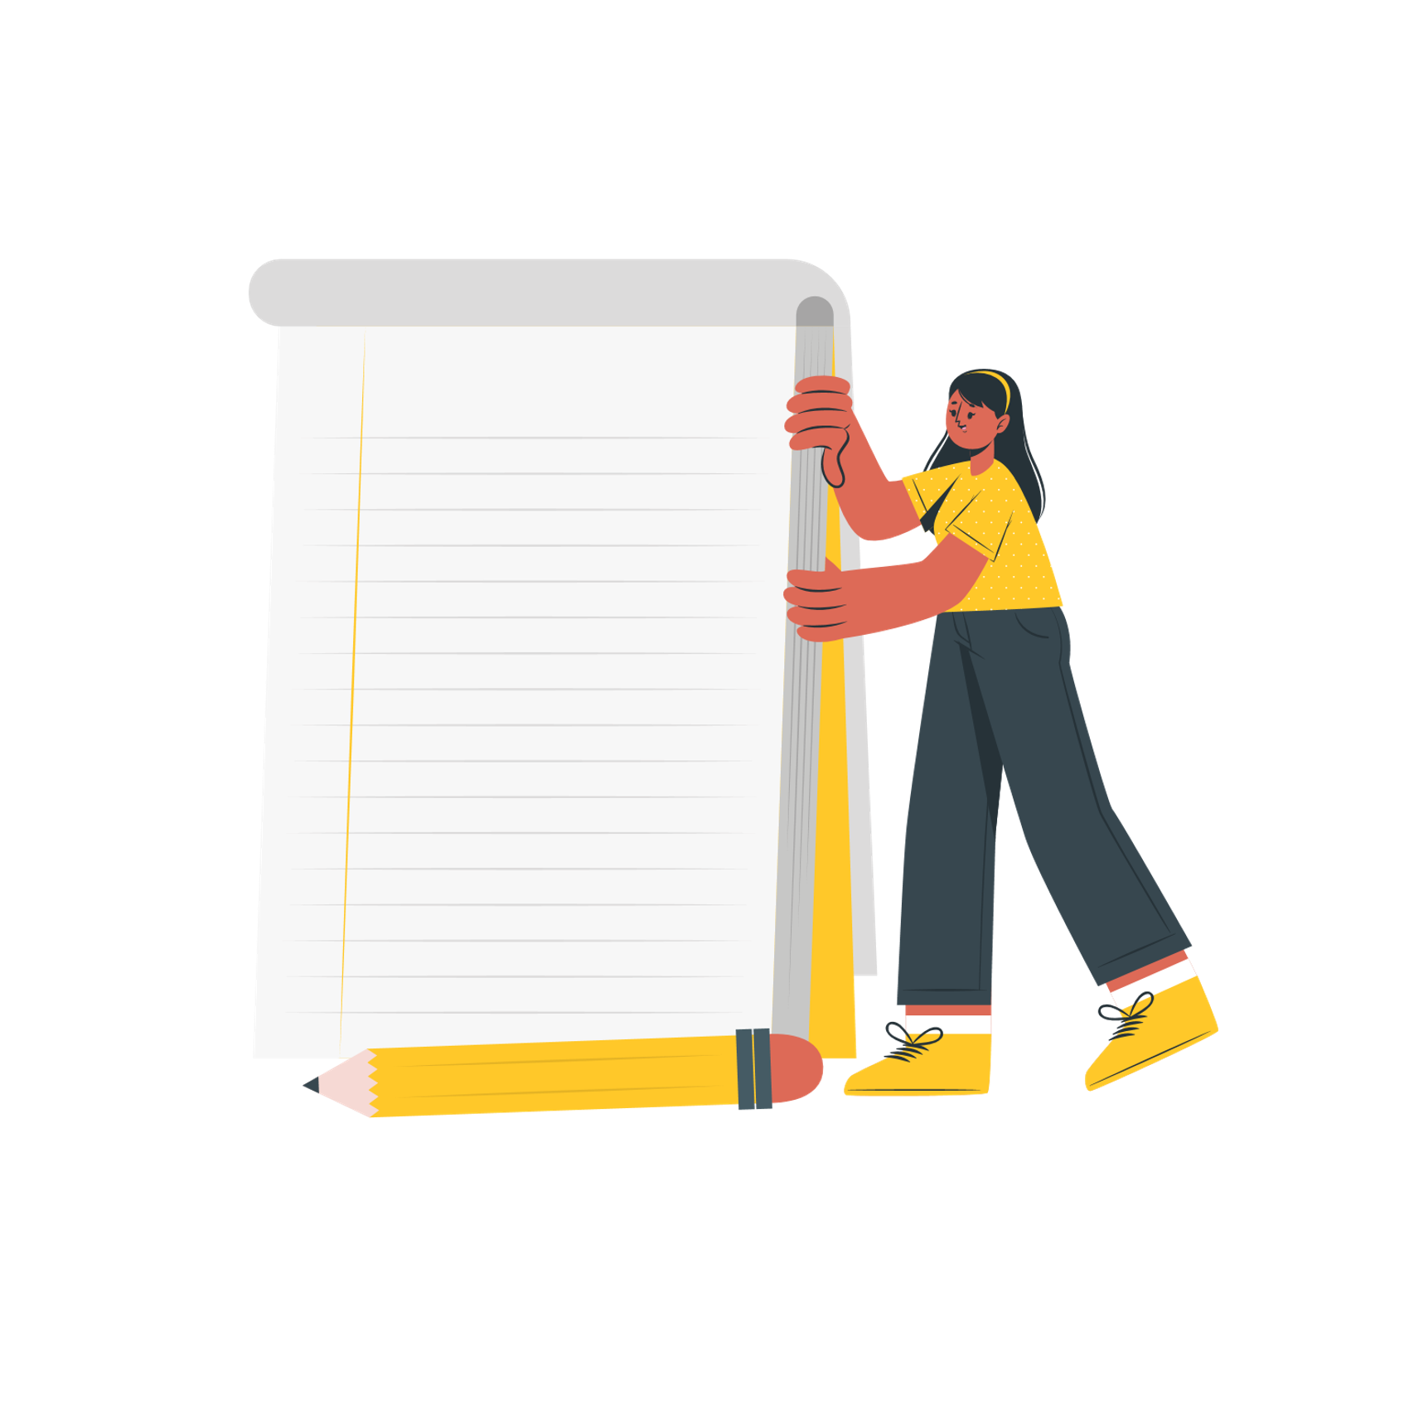
Consequences
Take turns contributing sentences to the following story.
On a piece of paper write your answer, fold your paper to hide your answer and pass it to the next player.
Be as silly or serious as you like.
Have you ever played consequences?
No? then here it is - with a twist!

Slide 3
Consequences
(choose a name)
wanted to study (name a subject)
so, they listened to (give an example)
and they read (give an example)
which led them to interview (name a person)
next they decided to research (what did they research)
and finally wrote a blog on (title of blog)
the consequence was (what happened)
COMPLETE THE STORY BY ADDING YOUR chosen examples:

Slide 4
Consequences
Now read out your story
[Name] wanted to study [subject/course] so, they listened to [example], and they read [example] which led them to interview [name] next they decided to research [example] and finally wrote a blog on [title of blog] the consequence was [what happened].

Slide 5
Dictionary definition
‘evidence’
1. Oxford English dictionary: The available body of facts or information indicating whether a belief or proposition is true or valid
2. Cambridge English dictionary: Facts, information, documents, etc. that give reason to believe that something is true
3. Dictionary.com: Ground for belief or disbelief; data on which to base proof or to establish truth or falsehood
4. Collins dictionary: Evidence is anything that you see, experience, read, or are told that causes you to believe that something is true or has really happened
Evidence will help to back up examples you want to share.

Slide 6
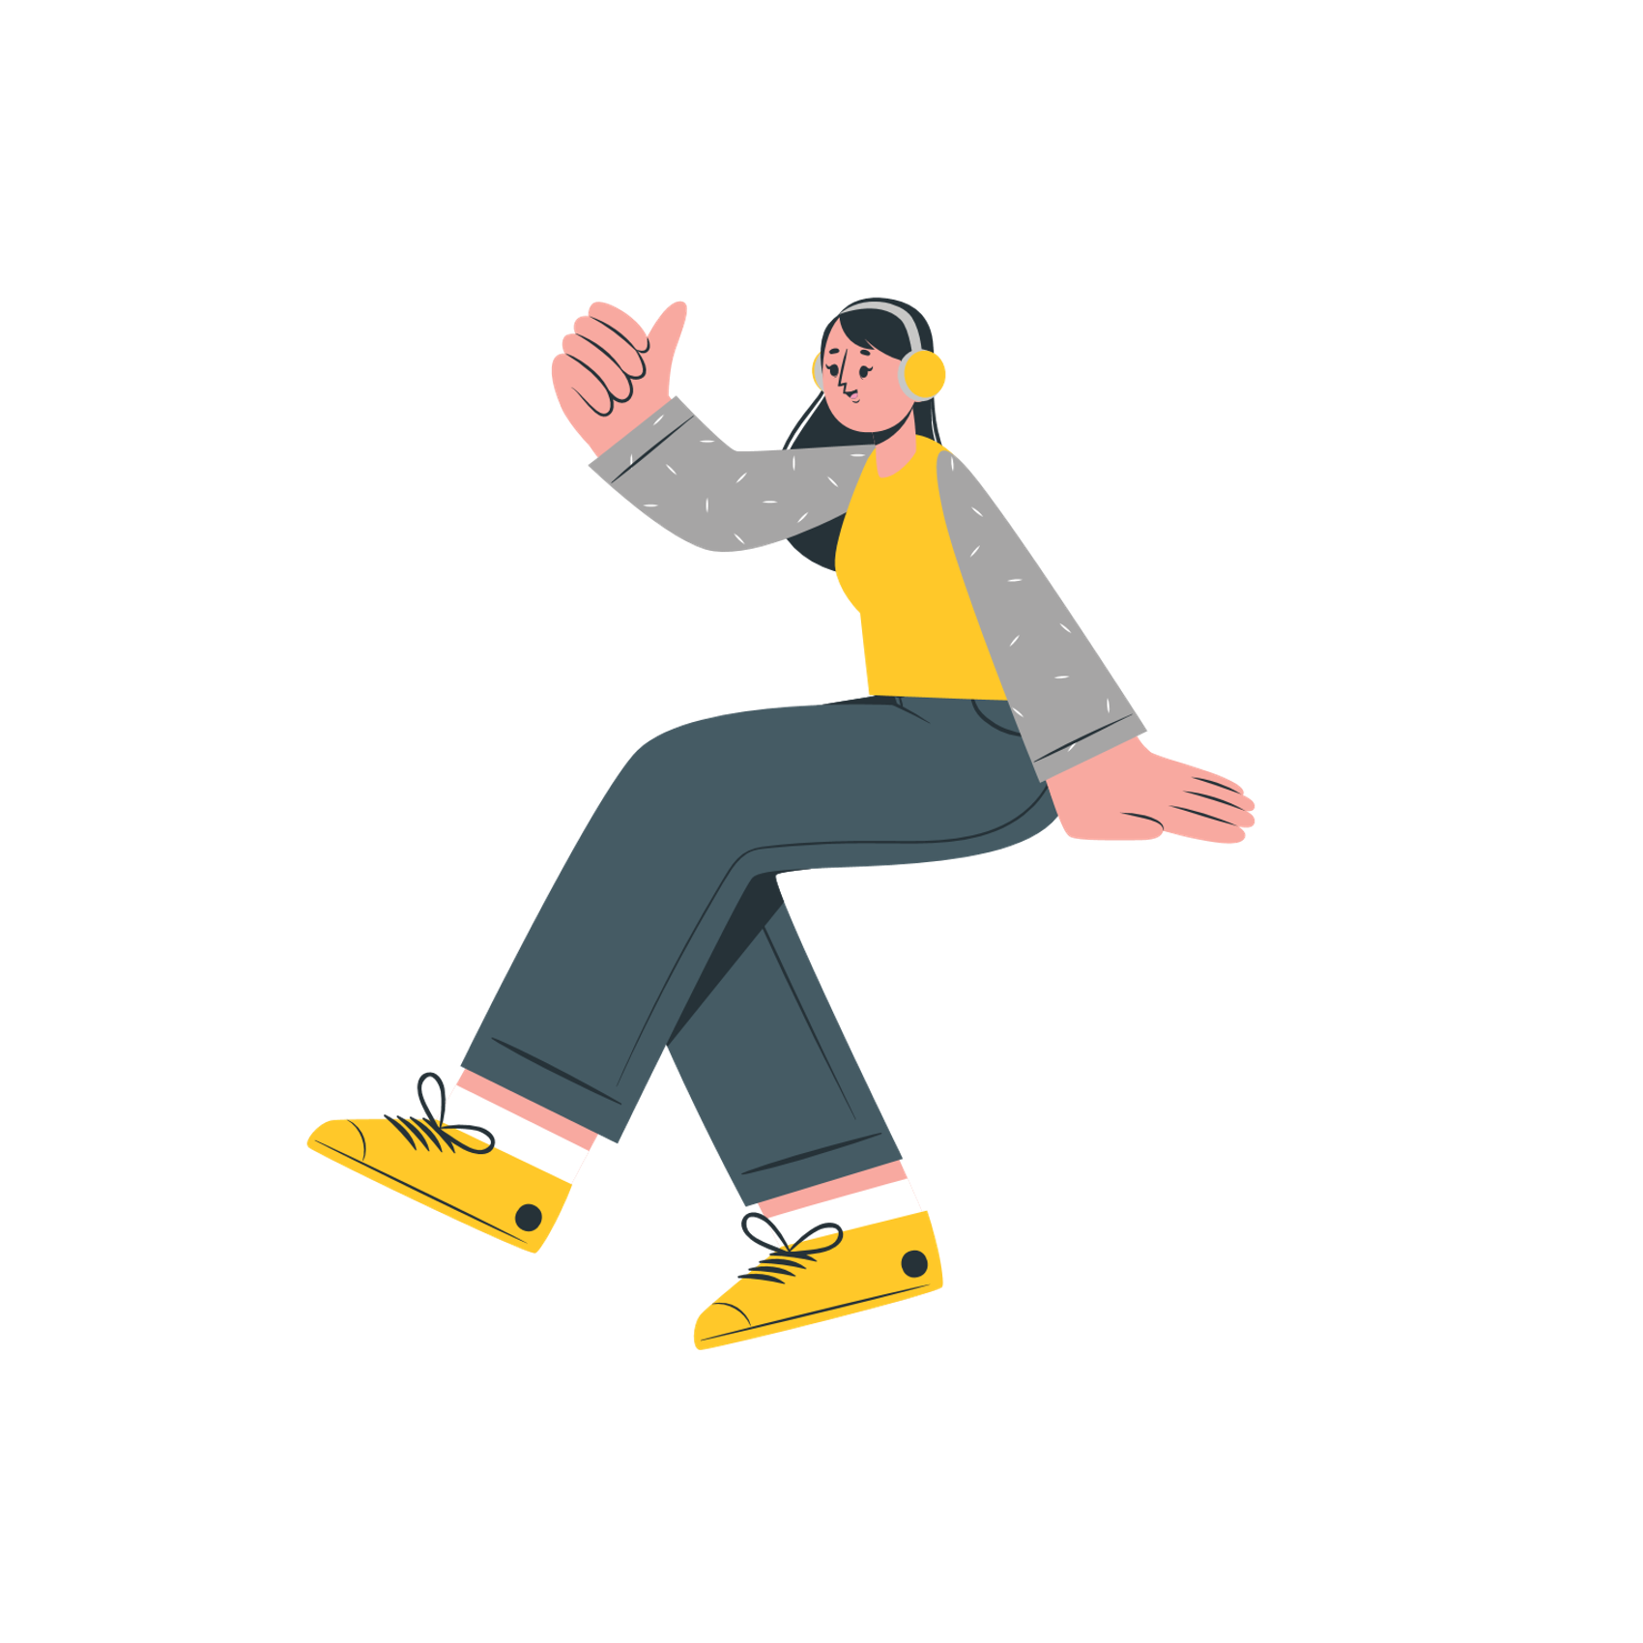
Think far and wide
In person work experience | Blogs & vlogs | Positions of responsibility | Projects or essays | Mentoring
Virtual work experience | Documentaries | Awards | Books | Tutoring
Work shadowing | Podcasts | Challenges | Influencers | Online subject courses
Paid employment | TED Talks | Personal life experiences | Hobbies | Trips or visits
Volunteering | Articles | Work based learning / training | Clubs | Competitions

Slide 7
It’s a jigsaw!
Ultimately, think of completing your personal statement as if it is a jigsaw, built of pieces of evidence.

Slide 8
Browsing history
Go through your online history (or YouTube, social accounts, browser history) for the last two weeks.
Make a note of how many things you have viewed, watched, read or listened to link to a subject or career area you might be thinking about for your future.
How many link directly?
How many link indirectly?
How many are because you've been researching a specific topic in your current studies vs how many are just because you came across it?
Start thinking about the most interesting, most surprising or new things you've learnt.
If you have none then this is your chance to start thinking about that evidence!
Notes:
Think outside the box with this - sometimes things might not directly correlate. Perhaps you saw an interesting dress at the Met Gala, researched the designer and this led to you discovering sustainable fashion and environmental studies; perhaps a travel influencer's account made you research a location, you started reading about the cultures of that region and this led you to anthropology!

Slide 9
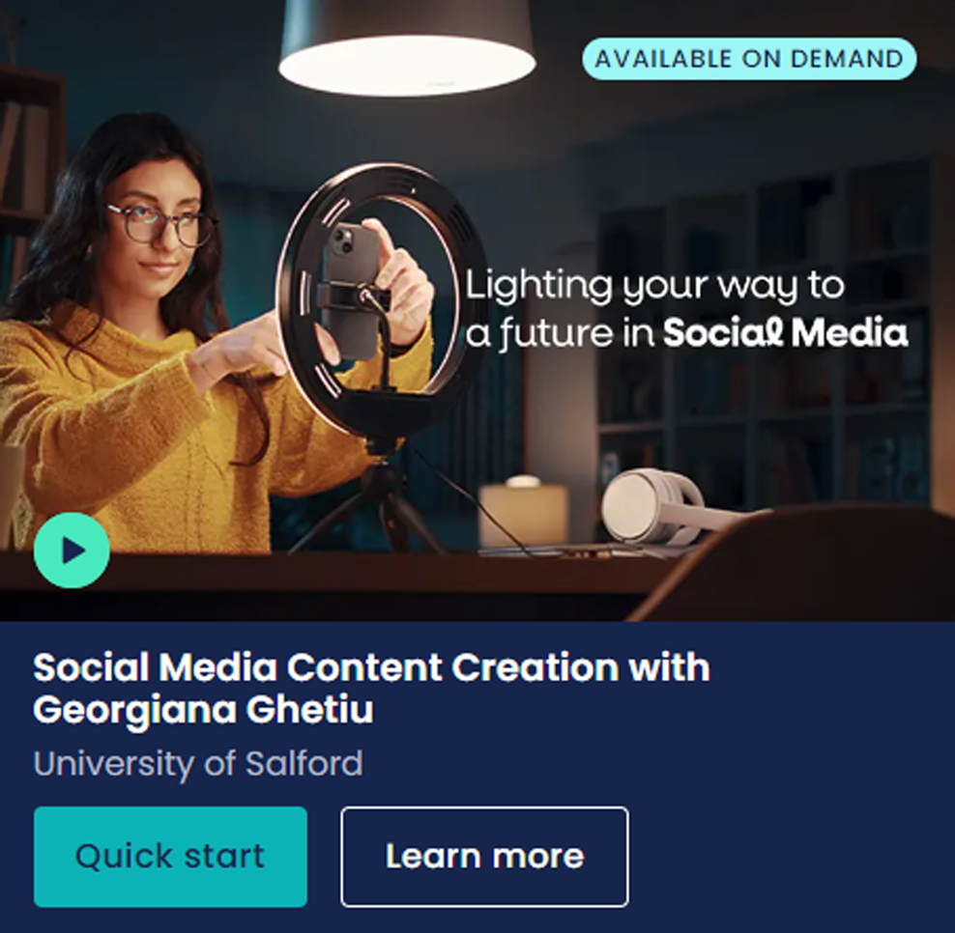
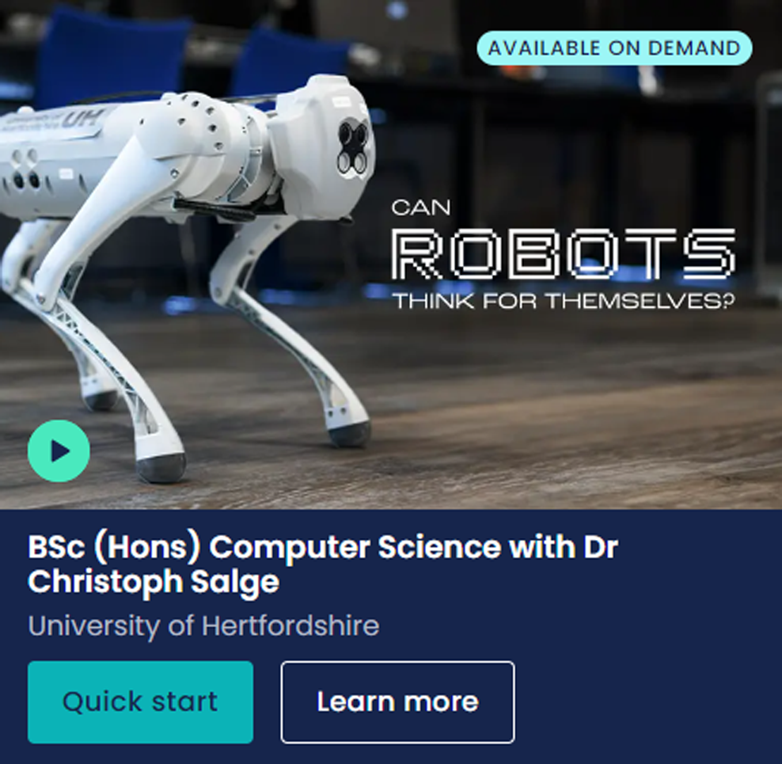
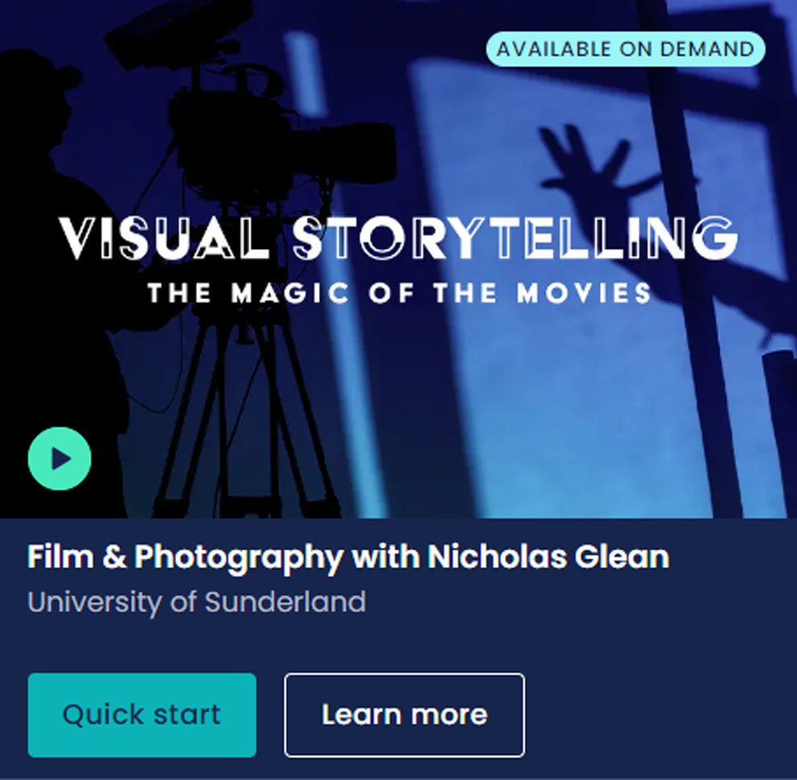
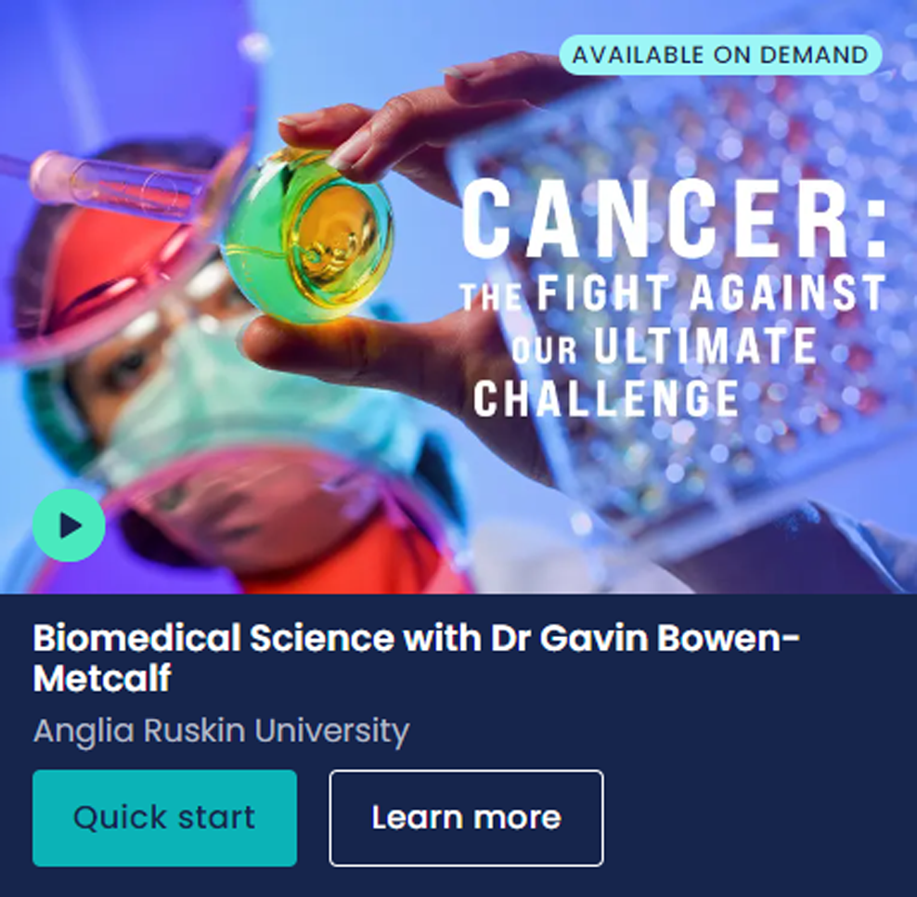
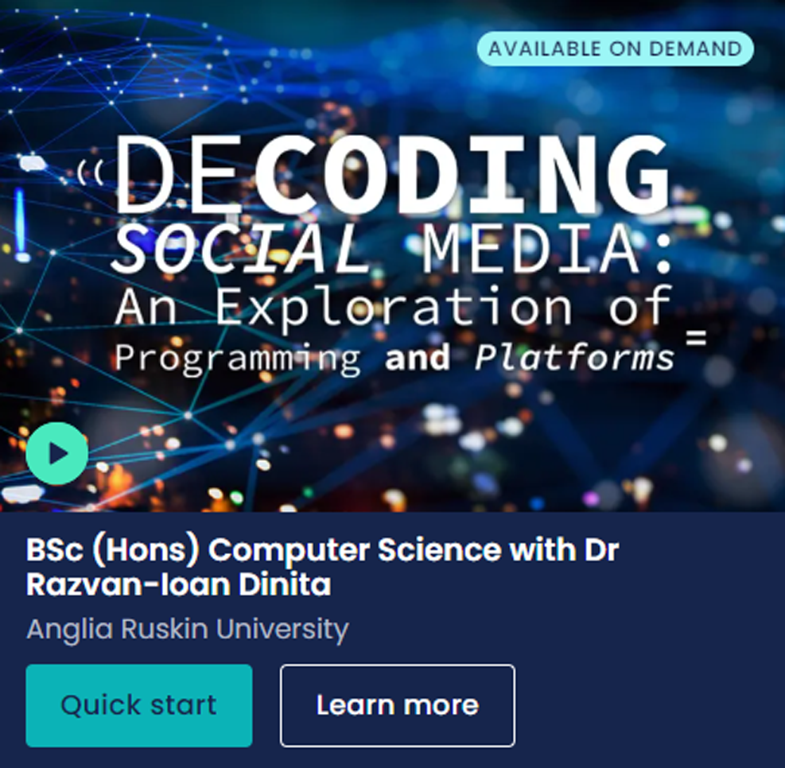
What sort of subject spotlights are available?

Slide 10
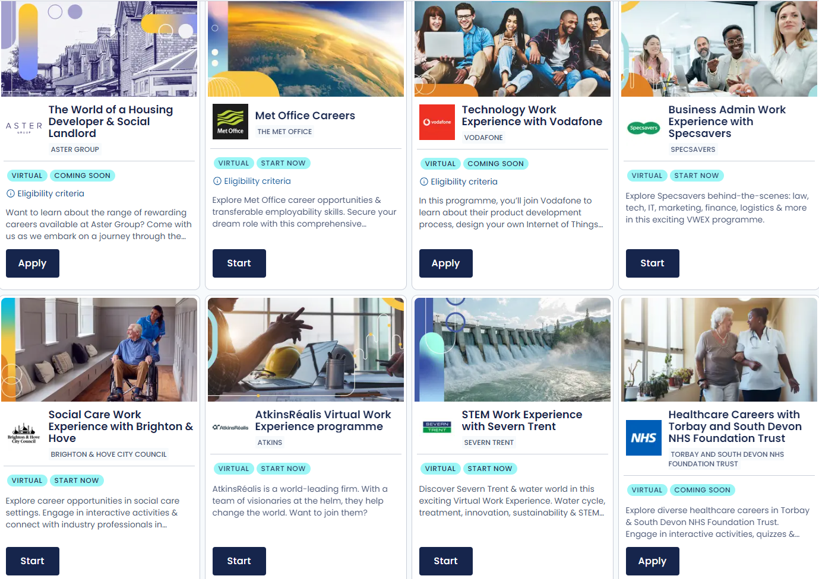
What sort of virtual work experiences are available?
All illustrations designed by Storyset on Freepik.com

