Slide 1
Free School Meals (FSM) Guidance for Registered Centres 2025 Cycle
Updated 14/11/2024
Updated 14/08/2024

Slide 2
Using this deck
This presentation deck has been designed to support you through the introduction of the Free School Meal (FSM) application fee waiver process and highlight how it would work at your centre.
Please note only students with a UK home address are eligible.
You can copy and paste slides into your own materials and guides, and use to support staff training and CPD.
We’ll continue to communicate key operational changes to you through our monthly newsletters. Please encourage all colleagues who advise applicants to sign up to receive them.
NOTE: images shown are correct at the time of publication please see date stamp on the title slide. Images are shown are for Desktop/laptop users. Mobile users may see a different layout for some sections.

Slide 3
Review your payment method | Payment option 1: UCAS sends centre an invoice for all applicants excluding eligible FSM students | Payment option 2: All applicants pay by card N.B. APPLICANTS WILL NOT BE ABLE TO APPLY WITH THE FSM WAIVER | Payment option 3: Some applicants pay by card; UCAS sends centre an invoice for remaining applicants excluding eligible FSM students
Pre-submission | Applicants answer FSM question in the “More about you” section (slides 4-8) Adviser can check answers on in-progress applications and email students for more information Applicants review and submit forms (slides 9-12)
Payment | No further action needed by applicant | You may choose to temporarily change the payment fee method to option 3 if you are with eligible FSM applicants at the point of submission. | Applicant has three options to choose from: Apply with waiver Paying your centre Pay by card – this cannot be reversed and the fee waiver cannot be applied after this process completes.
 |  | Applicant pays – applicant has not applied with FSM waiver. This cannot be reversed and the fee waiver cannot be applied after this process completes.
Adviser agreement | Once the application is submitted to the centre, advisers will need to provide a response to confirm eligibility if the applicant has selected “Yes” to the FSM question. If you do not agree, then the centre will be charged for this application. You can return the application at this point. For all other applicants, you may want to check they have selected the correct FSM answer as the waiver cannot be applied retrospectively. | No further action needed – the FSM waiver cannot be applied retrospectively. | Once the application is submitted to the centre, advisers will need to provide a response to confirm eligibility if the applicant has selected “Yes” to the FSM question and chosen “Apply with waiver”. If you do not agree, then the centre will be charged for this application. You can return the application at for the payment method to be updated For all other applicants, you may want to check they have selected the correct payment option. You can quickly check applicants who are allocated an invoice in the Adviser Portal.
Click on underlined text to jump quickly to the relevant part of the slide deck

Slide 4
Student actions
The following slides outline the actions a student will need to take to apply for the UCAS Free School Meals (FSM) application fee waiver.
For full guidance on how this process will work, please read the Adviser Guide and online FAQS.

Slide 5
Eligible students who want to apply with the FSM application
fee waiver must share that they are, or have been, in receipt of
free school meals in the ‘More about you’ section.

Slide 6
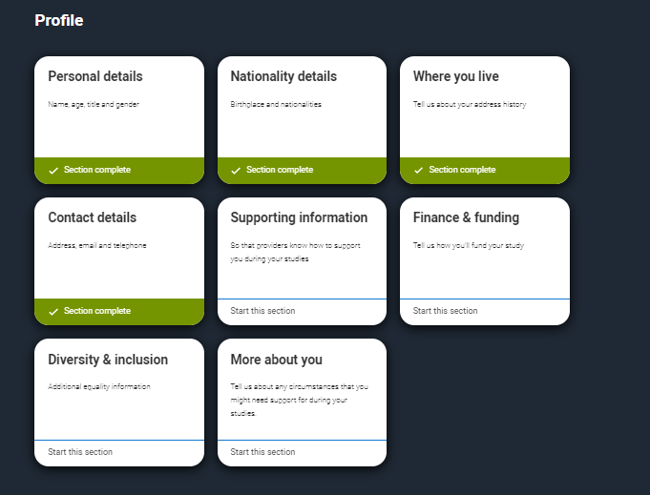
Go to the ‘More about you’ section of the application.

Slide 7
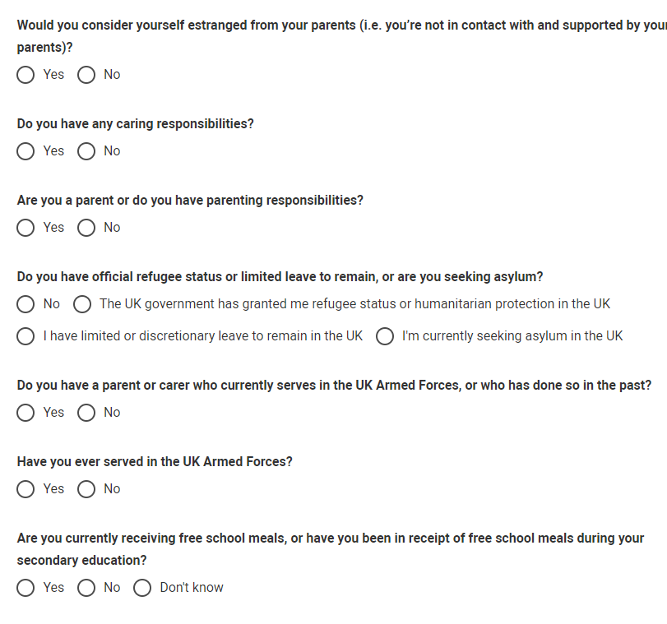
Step 1: go to the ‘More about you’ section of the application
You will see a range of questions all intended to connect you to the right support for your needs.
You might feel uncertain about sharing personal circumstances, please feel reassured this information is confidential and will never negatively impact your application.
You will only see these questions if you have a UK home address.

Slide 8
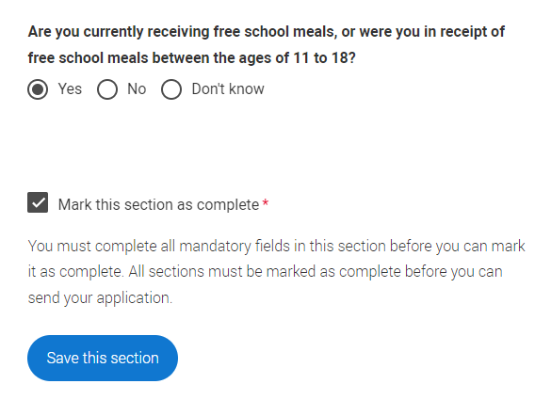
Step 1: go to the ‘More about you’ section of the application
You need to answer, ‘Yes’ to this question in ‘More about you’ to identify you are eligible for the free school meals application fee waiver.
Check if you’re eligible to have your application fee waived.
Your school/college/centre will need to agree to your eligibility when reviewing your application and may require you to evidence this.

Slide 9
Review and submit
All applicants will go through the application review process before being able to submit.

Slide 10
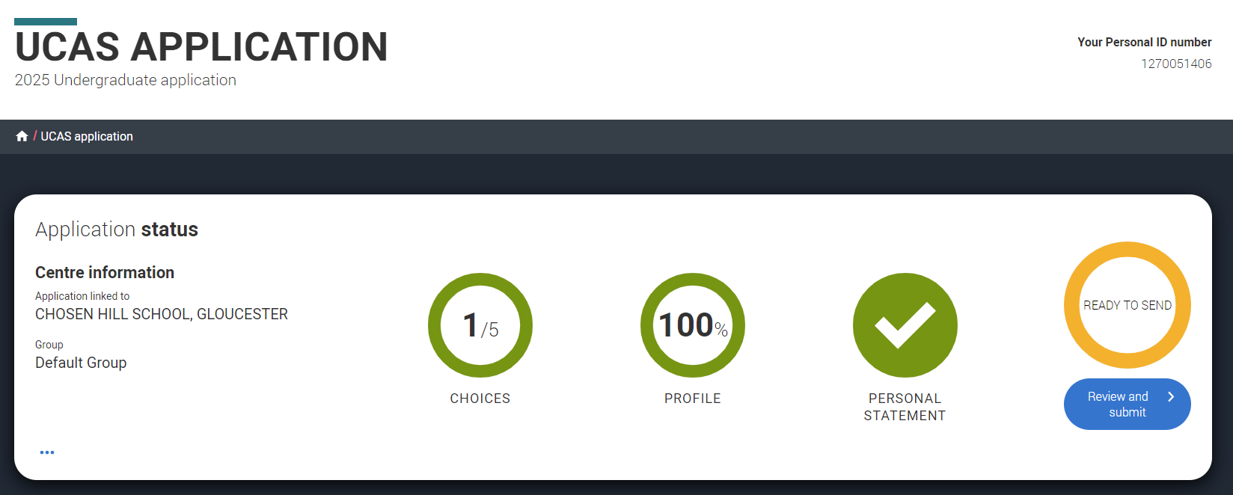
Your profile must be complete and showing 'Ready to Send' before you can review and submit.

Slide 11
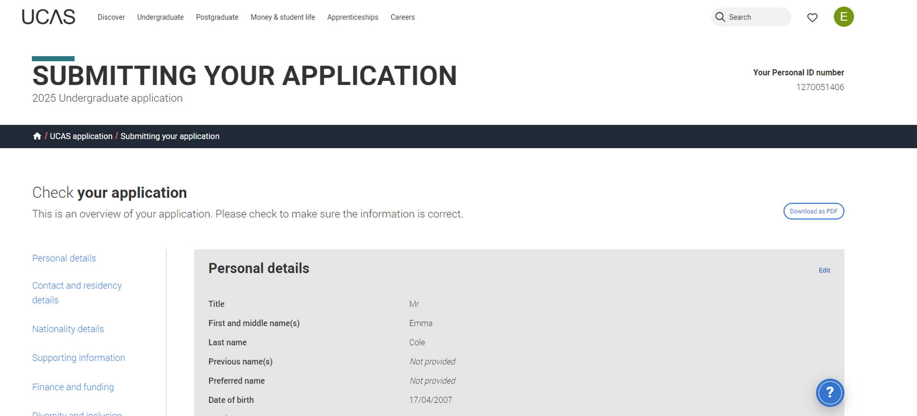
When you review your application, you'll see all of it onscreen, but you can download it as a pdf (in the top right) to help you check it.
At the bottom of the application, click Accept and proceed (or return to application if you want to make changes).
Security marking: PUBLIC
| 11

Slide 12
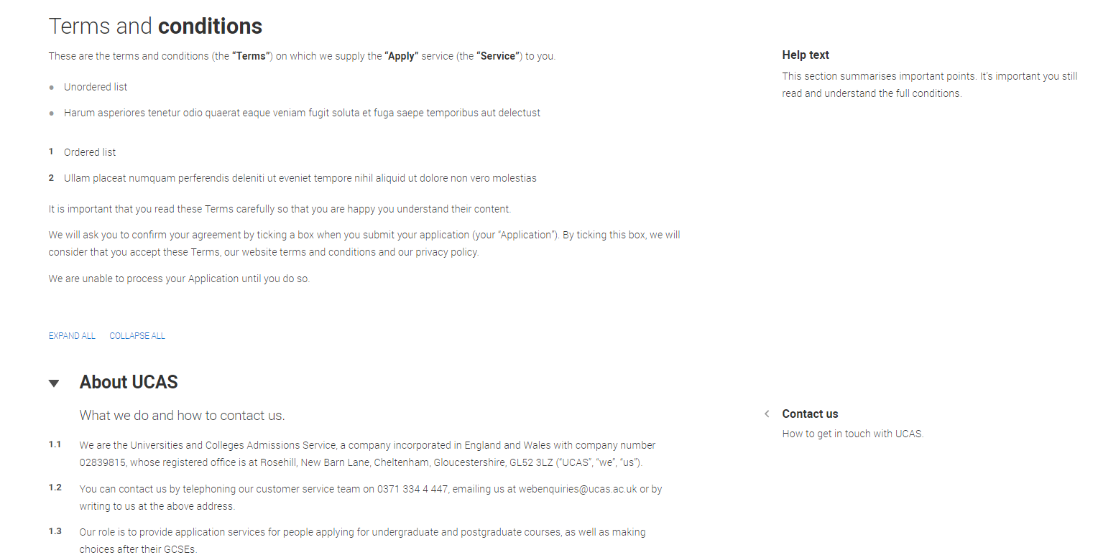
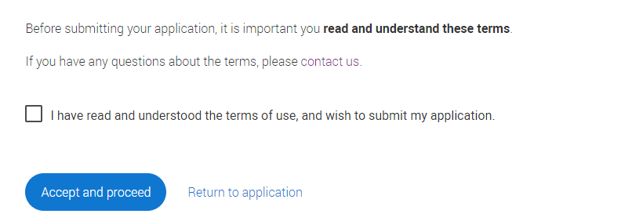
You must tick the box at the bottom of the page to confirm you have read and understood the terms and conditions.
You can collapse these sections by clicking the .
Then click Accept and proceed, or you can return to application.
Security marking: PUBLIC
| 12

Slide 13
Pay and submit
Please note options will vary depending on the application fee payment method chosen by the Registered Centre. These are shown in following slides. You may wish to tailor these slides before sharing with students.

Slide 14
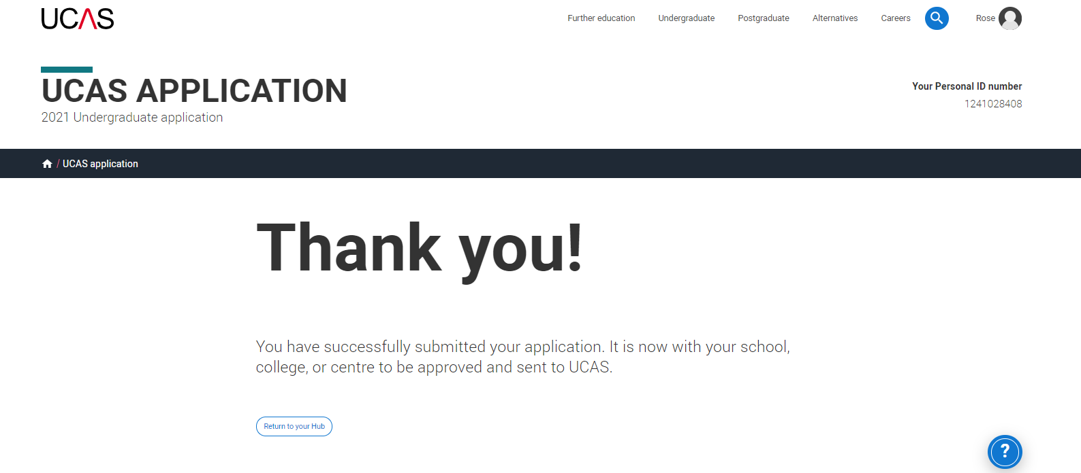
Application Fee payment method : UCAS will send your centre an invoice.
If your school/college/centre will pay for your application, and
you are eligible for the free school meals waiver; you don’t need to do anything further.
Your school/college/centre will agree to your eligibility when reviewing your application and may require you to evidence this.
Notes:
This application fee payment method means UCAS will generate invoices as usual for all applications from your centre but will remove any confirmed FSM students who have declared in ‘more about you; and you have agreed are eligible in the adviser portal.

Slide 15
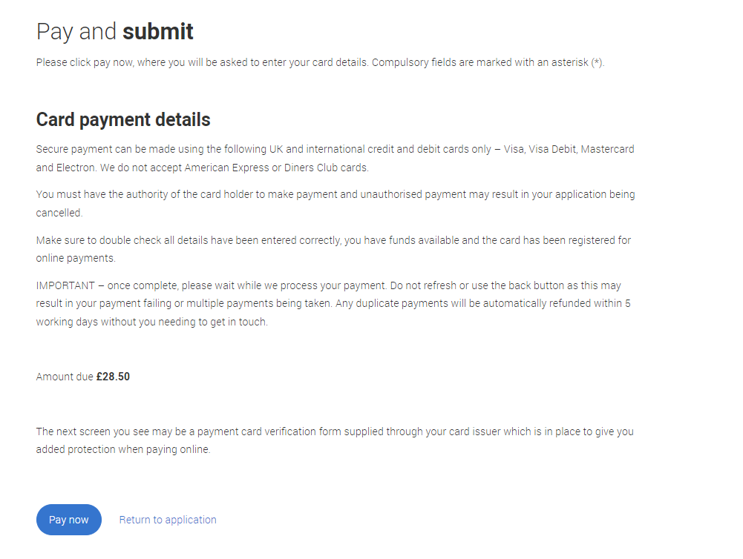
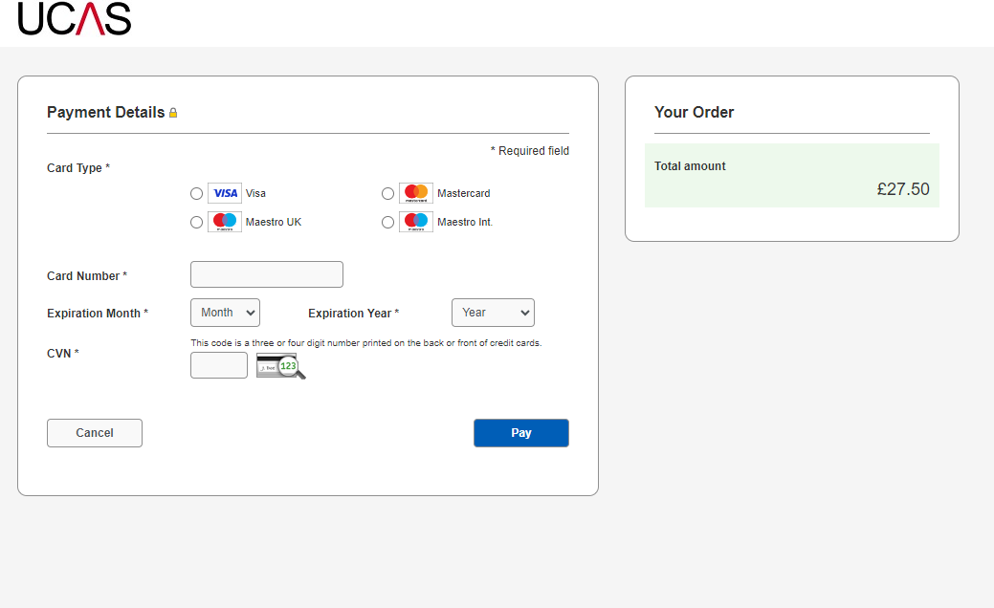
Application Fee payment method : All applicants pay by card.
If you think you are eligible for the FSM application fee waiver, check with your school/college/centre BEFORE entering any card details when you ‘Pay and submit’.
Once you pay by card (even if you are eligible), this cannot be reversed; a fee waiver cannot be applied after you have completed the pay and submit process.
Security marking: PUBLIC
| 15

Slide 16
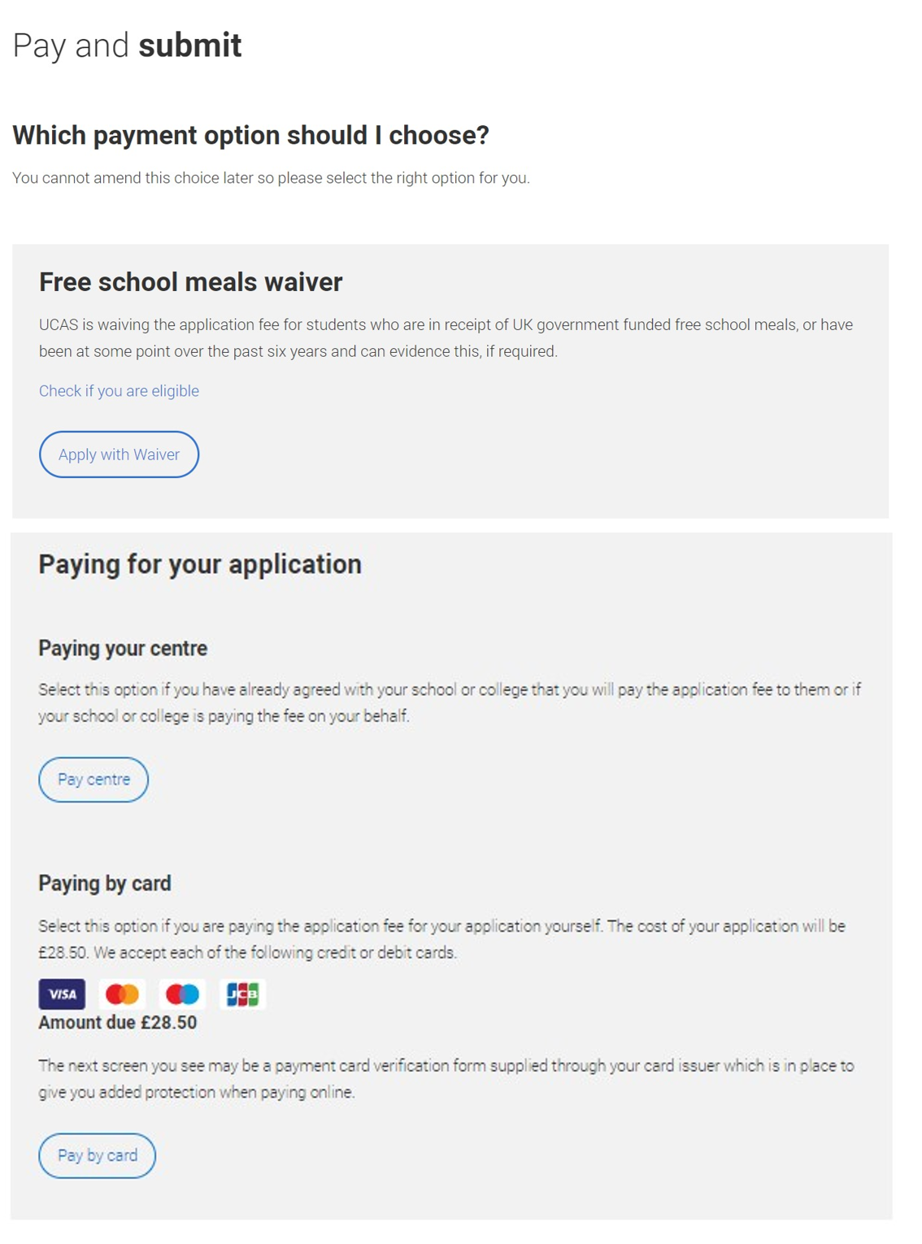
Application Fee payment method : Some applicants will pay online by card, UCAS will provide an invoice for remaining applicants (the invoice will be paid by your centre).
If you are eligible for the free school meals waiver you need to choose ‘Apply with waiver’, when you ‘Pay and submit’.
There may be instances when your school/college/centre pay your application fee on your behalf. If this is the case, select ‘Pay centre’. Only choose this option if you have been told to.
If you are paying for your application yourself, select ‘Pay by card’ and enter your card details.

Slide 17
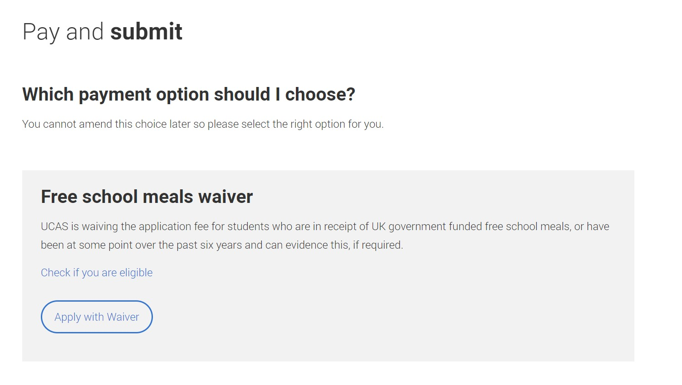
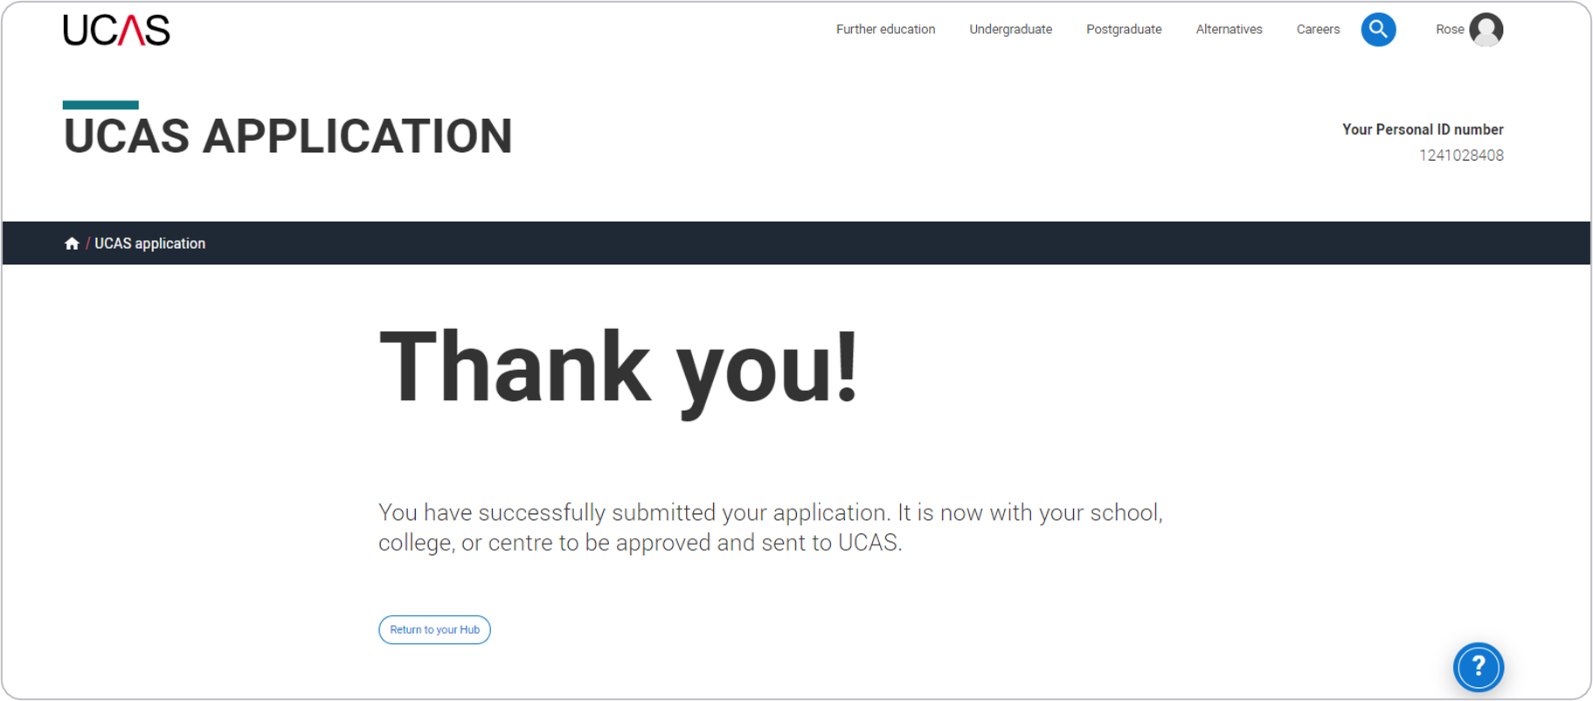
If you are eligible for the free school meals waiver, you need to choose ‘Apply with waiver’, when you ‘Pay and submit’. You won't need to enter any payment card details.
Your school/college/centre will agree to your eligibility when reviewing your application before the waiver is applied. They may require you to evidence this.

Slide 18
There may be instances when your school/college/centre pay for your application on your behalf. If this is the case and you have been told to use this option, select ‘Pay centre’.
If you are eligible for the free school meals waiver, you need to use the ‘Apply with waiver’ option to ‘Pay and submit’.

Slide 19
If you are paying for your application yourself, then follow the guidance for ‘Paying by card’.
Click ‘Pay by card’ and enter your card details.
Remember, if you think you are eligible for the FSM application fee waiver, check with your school/college/centre BEFORE entering any card details when you ‘Pay and submit’.
Once you pay by card (even if you are eligible) this cannot be reversed. A fee waiver cannot be applied after you have completed the pay and submit process.

Slide 20
Registered Centre actions

Slide 21
Reviewing your payment method
Check your application fee payment method in ‘Centre Management’ is set to a method that activates an invoicing option.
This ensures UCAS can apply the fee waiver to eligible students, and they do not need to pay when they submit their application.

Slide 22
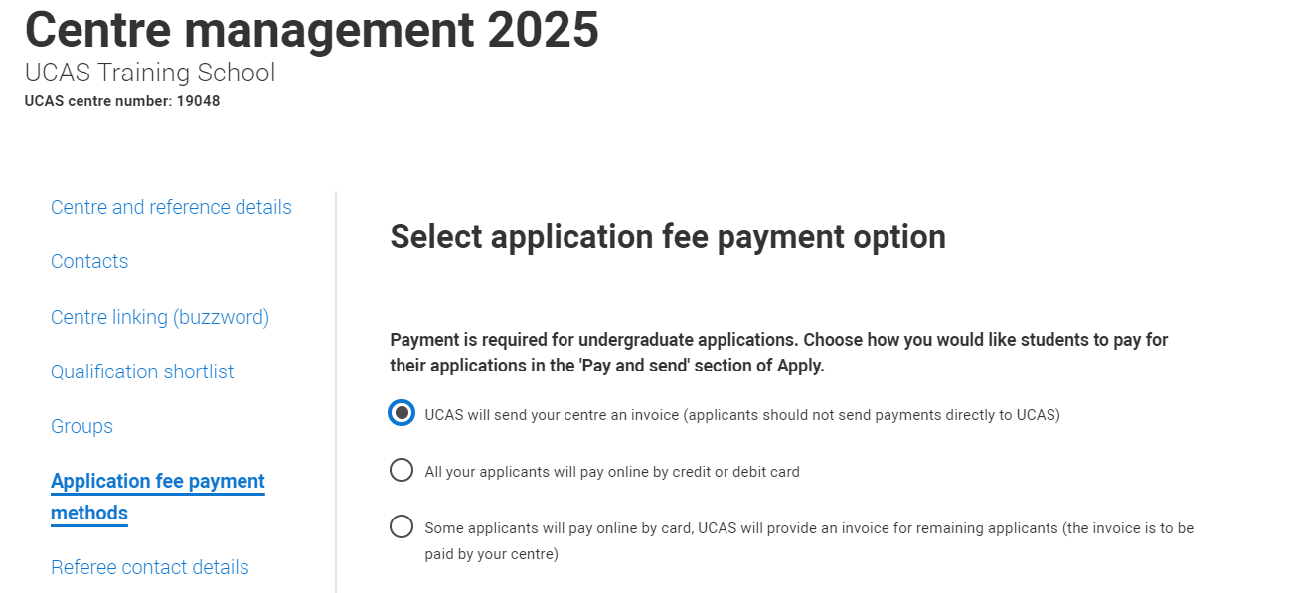
Option 1 – UCAS will send your centre an invoice:
For full guidance on how this process will work see please read the Adviser Guide and online FAQS.
Important points to note:
UCAS will generate an invoice (sent monthly) as usual for all applications but will remove any confirmed FSM students and waive the application fee for these students.
Advisers can return the application to the student as normal and if required students can update the answer to the FSM question in the ‘More about you’ section.
Once a centre has sent an application to UCAS the application cannot be returned to the student, the payment option cannot be changed, and application fee cannot be retrospectively waived.

Slide 23
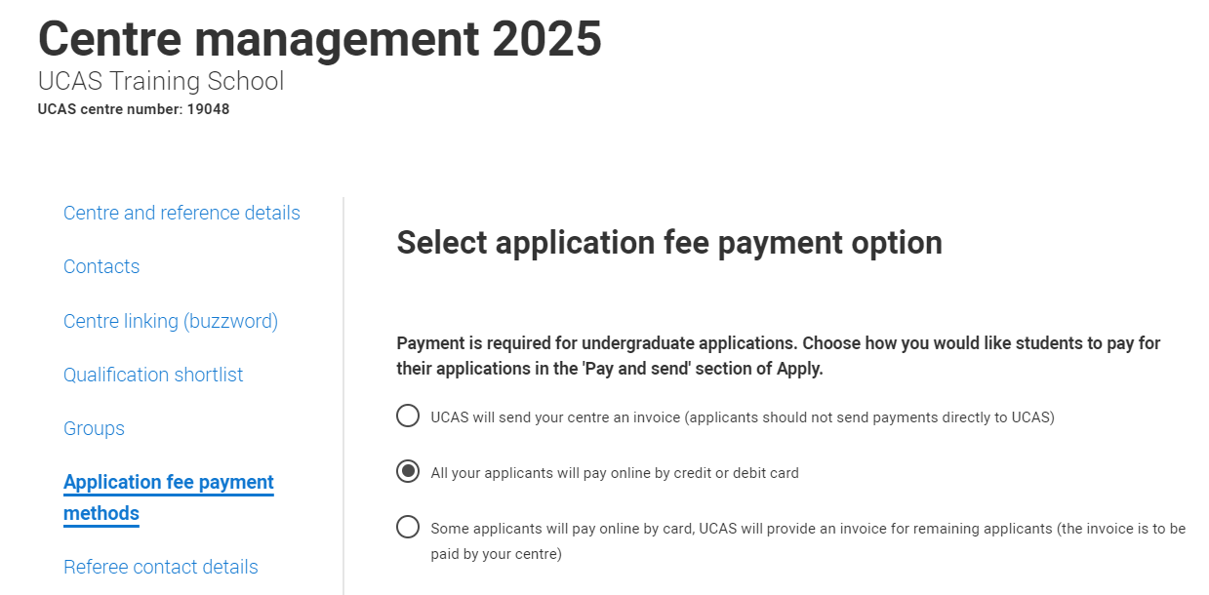
Option 2 – all your applicants will pay online by credit or debit card
Important points to note:
This payment method option will not enable UCAS to apply the FSM fee waiver.
Some centres (e.g. those with a small cohort of eligible students) may choose to temporarily change the payment fee method to option 3 (some applicants pay online, UCAS provides and invoice for remaining applicants) when they are present with eligible FSM applicants.
Advisers will then need to remember to switch the application fee payment method back to ‘All your applicants will pay online by credit or debit card’ for any remaining applicants.
If you do not change the application fee payment method and eligible students ‘pay by card’, the fee waiver cannot be applied retrospectively.
For full guidance on how this process will work see please read the Adviser Guide and online FAQS.

Slide 24
Option 3 - Some applicants will pay online by card, UCAS will provide an invoice for remaining applicants (the invoice is to be paid by your centre).
Important points to note:
If students who are not eligible for the FSM waiver have accidently chosen the ‘Apply with waiver’ option (which will generate an invoice) advisers can return the application and ask them to choose the right payment method and ‘Pay by card’ to rectify this before sending to UCAS.
Once a centre has sent an application to UCAS the application cannot be returned to the student and the payment option cannot be changed.
Once payments have been made by card it is not possible to apply the fee waiver retrospectively.
For full guidance on how this process will work see please read the Adviser Guide and online FAQS.

Slide 25
Agreeing in Adviser Portal
You will need to provide agreement in the Adviser Portal for those students who have shared that they are, or have been, in receipt of Free School Meals in the last six years.
Your school/college/centre will not be invoiced for eligible FSM students that you provide agreement for in the Adviser Portal.

Slide 26
Application details – in progress application
You will see answers to the FSM question as soon as students have linked to your centre, so you can start to identify eligible students.
Please note: the FSM agreement tick box and further details link will only appear when a student has completed the ‘Pay and submit’ process.

Slide 27
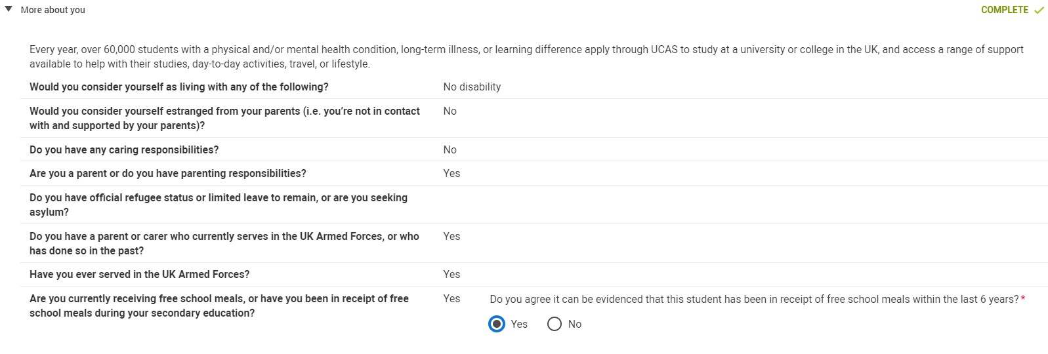
Application details - submitted to centre
For eligible students answering ‘Yes’ to FSM question:
Advisers will need to provide a response to agree eligibility for the UCAS application fee waiver to be applied.
If you select ‘Yes’ in the Adviser Portal, UCAS will apply the fee waiver, and the school/college/centre will not be invoiced.

Slide 28
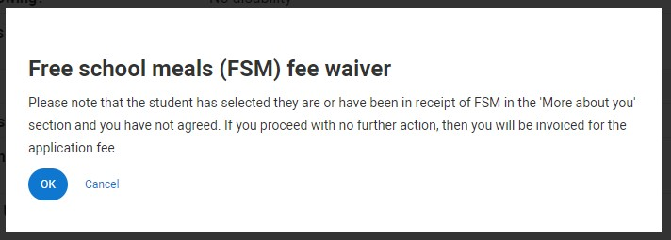
Application details - Submitted to centre
If a student selects ‘Yes’ to the FSM question, advisers are required provide a response.
1. If you do not agree that the student is eligible for the FSM application fee waiver, a warning message will appear to explain if this application is sent to UCAS, an invoice will be generated for it.
2. At this stage you can return the application to the student to:
review their answer
update their payment option and ‘Pay by card’

Slide 29
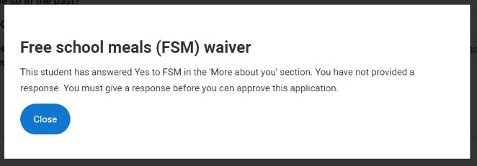
Approving an application – warning message
If a student has selected ‘Yes’ to the FSM question and a response has not been provided, a warning message will prompt a review of the answer.

Slide 30
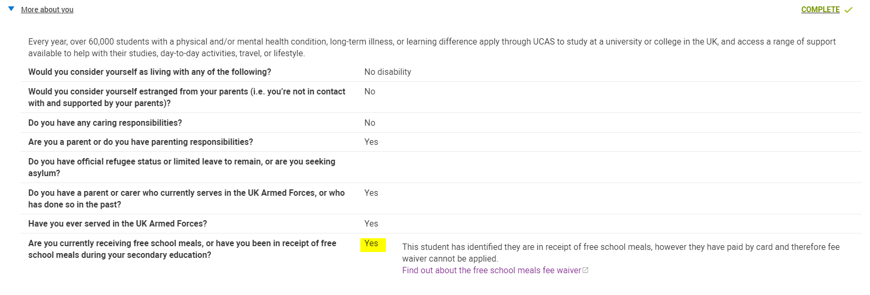
Submitted to centre – ‘Pay by card’
You’ll see a flag if a student selected ‘Yes’ to FSM but chose to ‘pay by card’ when submitting their application.
Advisers will not need to agree eligibility.
UCAS are unable to apply the FSM fee waiver retrospectively; no further action is required.

Slide 31
Application details - submitted to centre
For students who have selected, ‘no’, ‘don’t know’ or not answered the question:
Advisers will not need to agree eligibility in the Adviser Portal.
You may want to check these students haven’t chosen the ‘Apply with waiver’ or ‘Pay centre’ option by mistake using the ‘Payment options’ column (to avoid invoices being generated to the centre).
A link to further details on FSM is shown for reference only.

Slide 32
Warnings and Checks using filters and columns
In addition to the warnings and flags, you can use the filters and columns in application management to carry out some checks before applications are sent to UCAS, to prevent any errors.

Slide 33
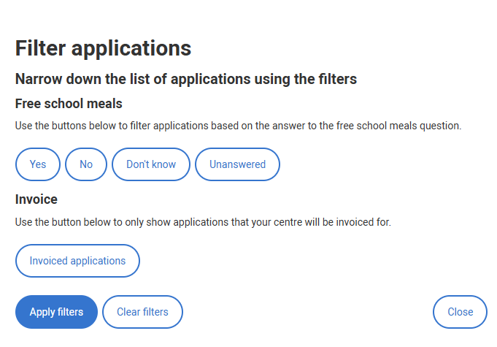
New FSM Filter – added 14.11.2024
Use the added Advanced filter in Application Management
to identify those students who have selected ‘Yes’, ‘No’, ‘Don’t know’ to FSM question, or left the question unanswered
to identify applications your centre will be invoiced for
Results will show you applicants in all application statuses (in progress, awaiting approval, returned to applicant, etc).

Slide 34
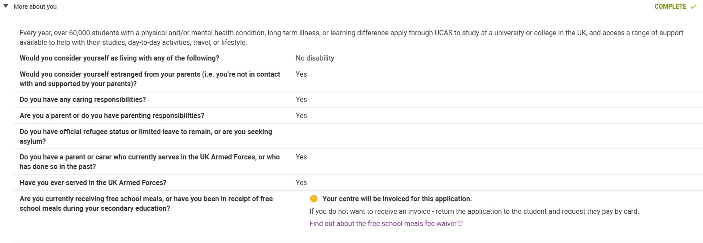
New warning message – added 14.11.2024
An ‘invoice warning’ has been added within the Adviser Portal for students who have answered ‘no’ and ‘don’t know’ or left the FSM question unanswered
The student has also picked the ‘pay centre’ or ’FSM fee waiver’ option and submitted to the centre

Slide 35
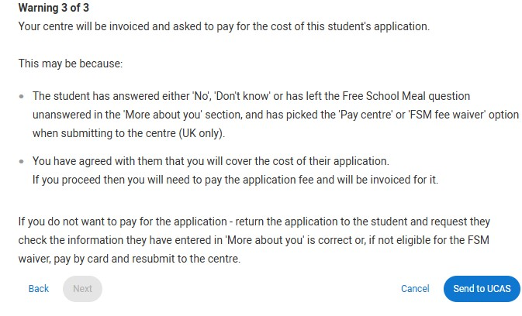
New warning message – added 14.11.2024
A new warning message has been added to the Adviser Portal when you submit an application to UCAS to highlight your centre will be invoiced if the student has:
answered ‘no’ and ‘don’t know’ or left the FSM question unanswered
picked the ‘pay centre’ or ’FSM fee waiver’ option and submitted to the centre

Slide 36
New FSM Filter
Use the new 'Free school meal applicants' filter in Application Management to quickly identify those students who have selected ‘Yes’ to FSM question.
Results will show you applicants in all application statuses (in progress, awaiting approval, returned to applicant, etc).

Slide 37
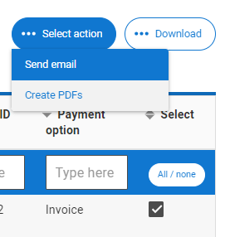
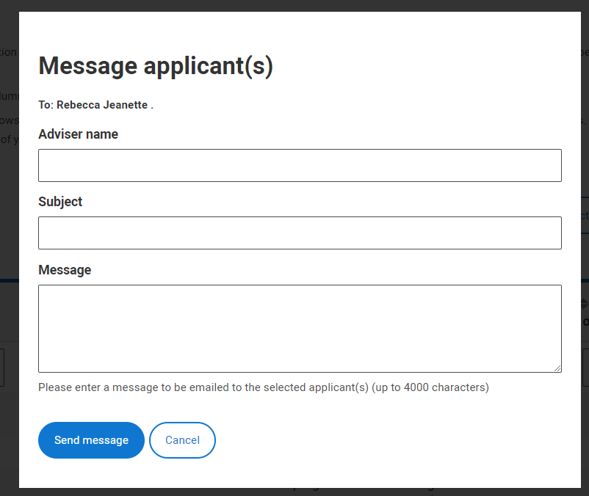
Using the email function
If you have students who have answered ‘Yes’ to the FSM question you can use the new filter to identify them. If you need to double check this or ask for more details, you can use the email function.
You can email individual or multiple groups of students.

Slide 38
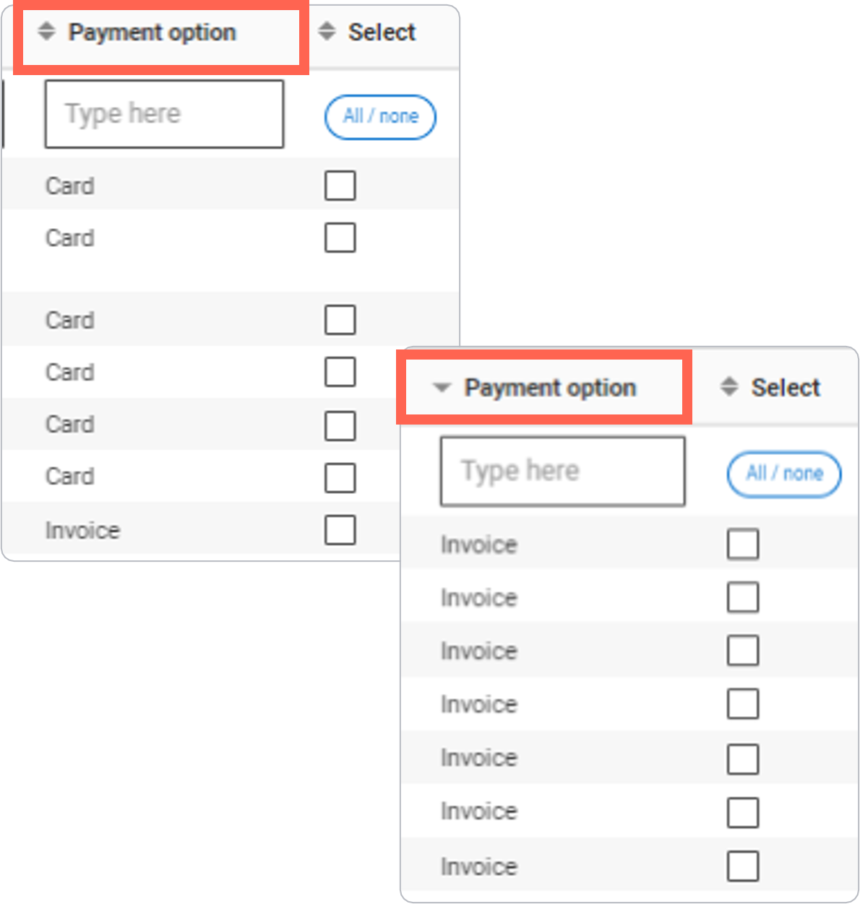
‘Payment options’ column
You can quickly check students included in your invoice using the sort function on the ‘Payment option’ column.
Your centre will not be invoiced for eligible FSM students that you provide agreement for in the Adviser Portal.
If you identify students who incorrectly used the ‘Apply with waiver’ or ‘Pay centre’ option, you can return their application and ask them to resubmit with ‘Pay by card’.
Please note: this column is only populated once students have completed the pay and submit process.

Slide 39
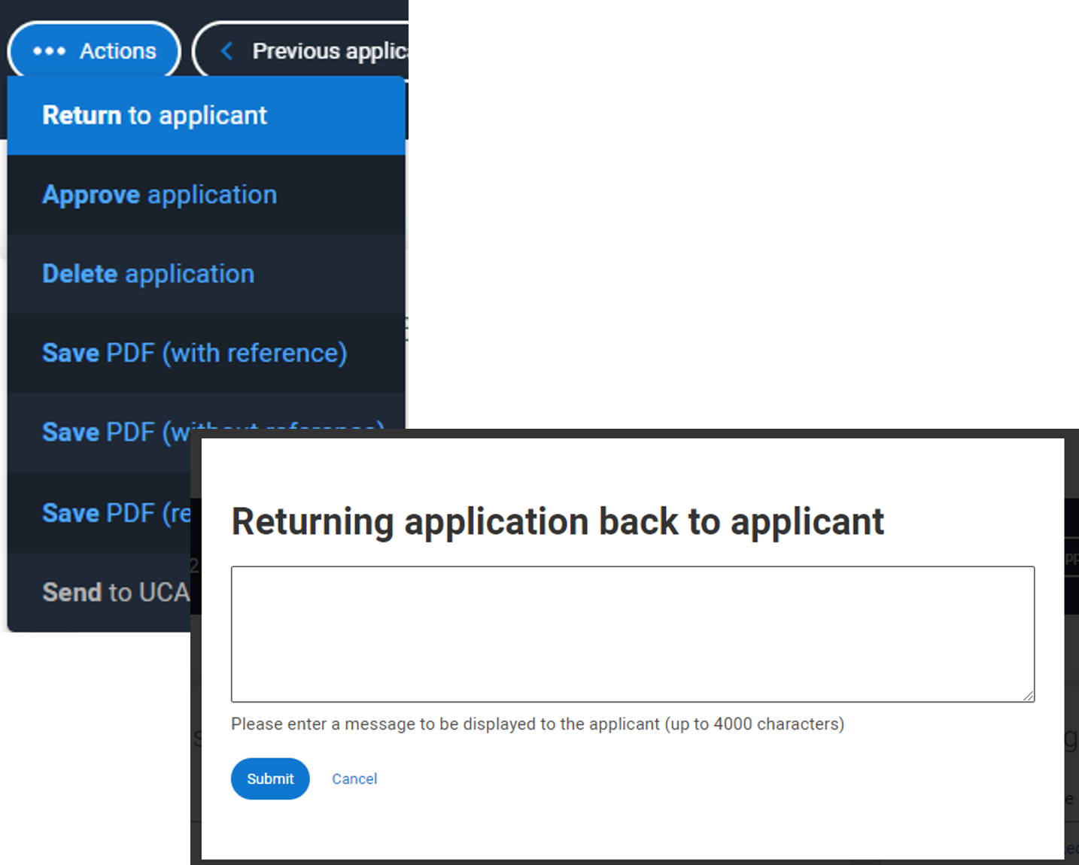
Return to applicant
You can return applications to any students who have incorrectly used the ‘Apply with waiver’ or ‘Pay centre’ option and ask them to resubmit with ‘Pay by card’.
IMPORTANT
Once a centre has sent an application to UCAS:
the application cannot be returned to the student
the payment option cannot be changed
the fee waiver cannot be retrospectively waived
Students who pay by card accidently cannot have the application fee waiver applied retrospectively.

