Slide 1
Springpod Virtual Work Experiences

Slide 2
What are virtual work experiences?
On-demand virtual work experience programs
Led by industry professionals
Immersive, interactive experiences that incorporate real workplace activities

Slide 4
What are the benefits of virtual work experiences?
Boost your personal statement, CV and apprenticeship applications
Gives you an authentic insight into what a career would be like in different industries
Will help you decide if a career is right for you or not
You can filter and search by employer or job title
Fit the experience around your schedule
Gain a certificate of completion

Slide 5
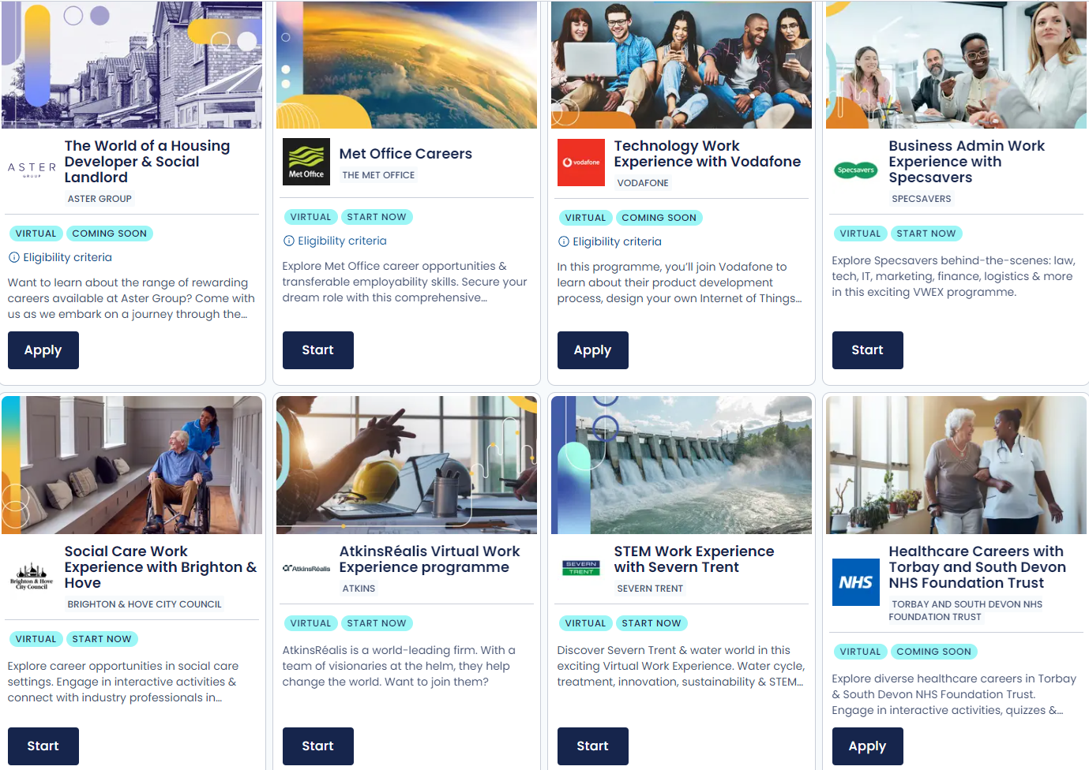
What sort of virtual work experiences are available?

Slide 6
How do you access virtual work experiences?
Find them on ucas.com: You can search and filter by employer or industry to see suggested Virtual Work Experiences in our search tool. Subject Spotlights are also found on industry guides.
In the Hub: Once you have signed up and logged in to the Hub, you will be able to start any Virtual Work Experience after you complete the Springpod sign up.
Favourites and For You: You can favourite a Virtual Work Experience in order to start it later - this will appear in your Hub dashboard in the Favourites section. Relevant Virtual Work Experiences are also in your personalised For You section.

Slide 7
Step-by-step guide
1
Choose your Virtual Work Experience and click on ‘apply now’ or ‘start now’. Some Virtual Work Experiences are on-demand, and some have a future start date.
2
Register or sign in to your UCAS Hub account, then click ‘Accept’ to share your UCAS account with Springpod.
3
Complete your Springpod sign up, confirming your personal details, communication preferences, education details, and interests.
4
Sit back and enjoy your Virtual Work Experience – remember you can favourite as many as you like to watch later.

