Slide 1
Confirmation and Clearing
What you need to know

Slide 2
Key dates
30 June
Applications received are entered into Clearing*
4 July
Last date to apply for a course in Extra
5 July
Clearing Opens
15 August
Level 3 results day (JCQ)
25 September
21 October
Last date to add 2024 Clearing choice
6 August
Final date for 2024 applications
Scottish results days (SQA)
* from 18.00

Slide 3
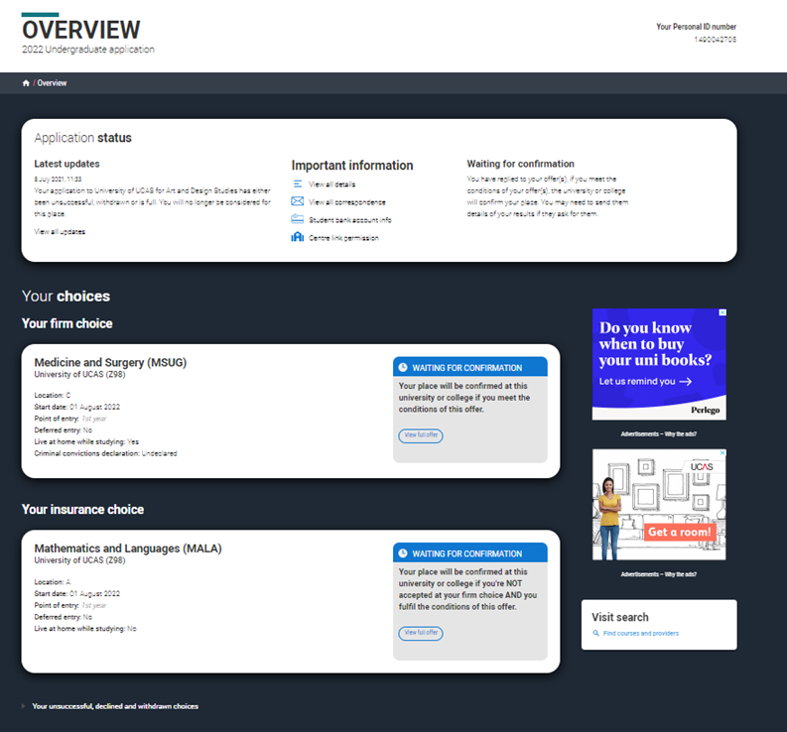
What is Confirmation?
Confirmation is the period when universities and colleges receive your qualification results.
They check if you have met the conditions of your offer and then record a final (confirmation) decision.

Slide 4
Application status
The status bar at the top of your application confirms your eligibility for Clearing.
Latest updates will reflect the latest action.
It will display your Clearing number (six digits).
You will also have your ten-digit Personal ID (PID) and should be able to quote both.

Slide 5
What could a Confirmation decision be?
You met your conditions
University/college confirms you have got your place.
You don’t meet your conditions
University/college may opt to confirm your place if you just missed out.
University / college may offer you a change of course offer.
You met and exceeded your conditions
If you want to look for a new opportunity, you can decline your confirmed place and enter Clearing.
University/college confirms you have got your place.
You are not placed at the university / college.
Head to ucas.com for more info on
what your application status means.

Slide 6
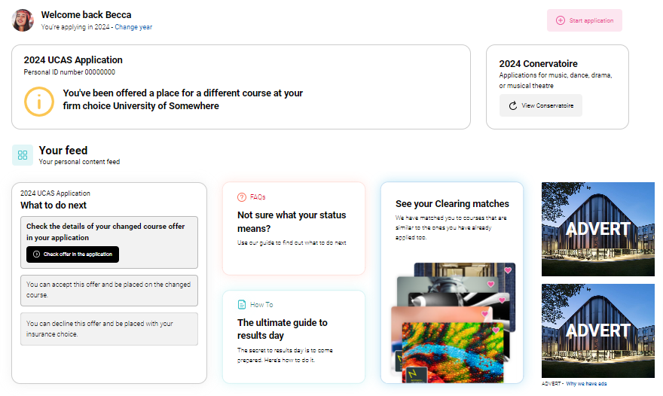
What is a change of course offer?
If you find your chosen university/college has offered you a place on a different course (or with changes to what you originally applied for), don't panic.
Your chosen university or college still wishes to make you an offer, it's just for a different course, or it could be the same course with a different start date or point of entry.
Read our advice on what to do next in your feed on the Hub and carefully check the details of the changed course offer in your application.

Slide 7
What is a change of course offer?
You have five calendar days to accept or decline a course change (in your application).
Make sure you read our advice on what to do next if you get a change of course offer.
If you have any questions or concerns about the change, you need to speak to the university or college to find out why they’ve made this change.

Slide 8
Still waiting for a decison?
You may find that a university or college hasn’t been able to make a confirmation decision yet.
We’ll tell you in your application, and there may be a reason given to explain why your offer hasn't been confirmed yet.
For example, it could be because you need to send your qualification results/transcript directly or you have outstanding conditions for example a GCSE result.
If you have any concerns, you should contact the university or college to discuss.

Slide 9
Clearing summary
Clearing | If you become unplaced and still want to apply elsewhere to start your studies this year.
Clearing Plus | If you’re eligible for Clearing you can find courses you’ve been matched to through the ‘My matches’ button in your application.
Decline my place | Use this button to release yourself from your confirmed place into Clearing.

Slide 10
What is Clearing?
Your chance to find a new opportunity; Clearing runs between 5 July – 21 October.
To use it you need to have:
applied before 30 June and have no offers
applied before 30 June and declined any offers received
didn’t meet your entry requirements of your firm or insurance choice
applied after 30 June (a new application; you haven’t applied yet)

Slide 11
How Clearing works
Researches vacancies
Contact universities to discuss
If unsuccessful, you can start again.
Enter choice in UCAS application
University or college considers application
Placed on course

Slide 12
Adding a Clearing choice
You can only use Clearing when you become eligible from the 5 July.
It’s likely to be when you've got your qualification results
On the main UK results day, you can only add a Clearing choice from a set time:
10.00 on SQA Results Day (6 August)
13:00 on JCQ level 3 results day (15 August)

Slide 13
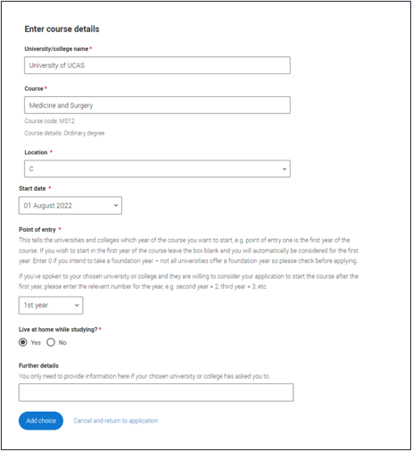
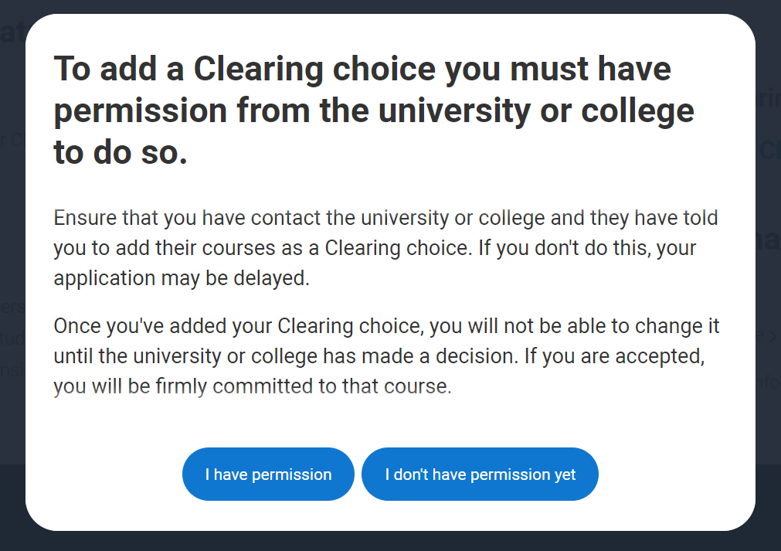
Adding a Clearing choice

Slide 14
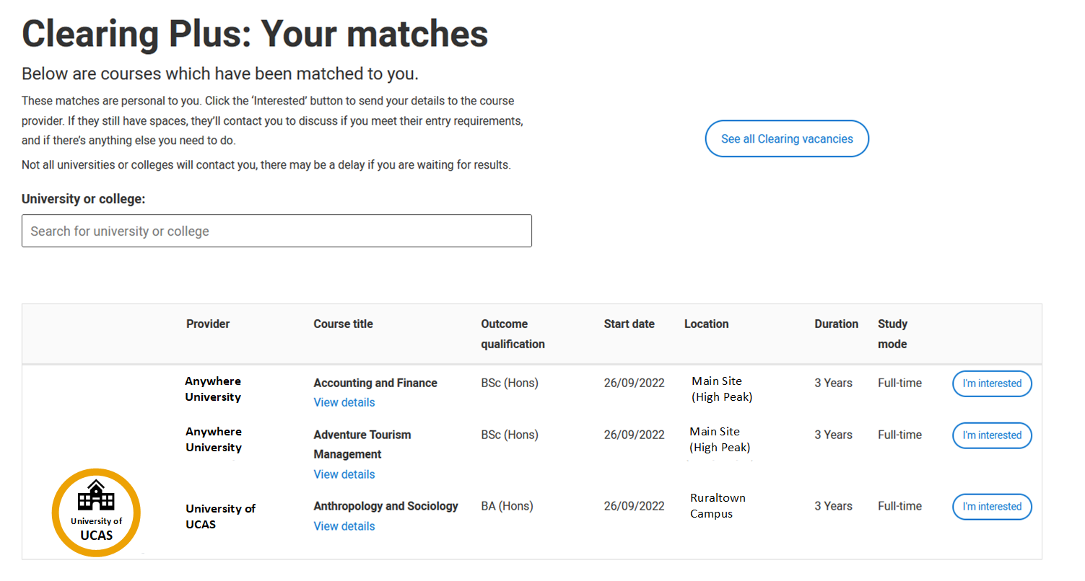
How does Clearing Plus work?
We match you to courses you might be interested in; using what we know about you from your application, and what universities and colleges are looking for.
You’ll have a matches button if you're eligible.
You’ll see your top 50 course matches; unique to you and updated.
Select ‘I’m interested’ to let universities and colleges know you’re interested in the course. They might then contact you to discuss.
We’d recommend you also look for courses in Clearing using our search tool.

Slide 15
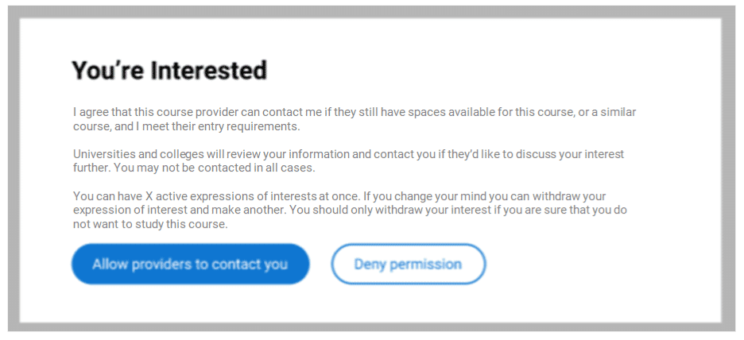
What happens if I use Clearing Plus?
It’s your choice if you want to use Clearing Plus; it might help you find courses you hadn’t thought of.
You can only have 5 active interests at any one time.
It’s not your only option. If none of the matches take your fancy and you want to apply for something different you can find courses available using the UCAS search tool.
Remember you might not be contacted by a university or college you express an interest in. You should still look for courses with vacancies.

Slide 16
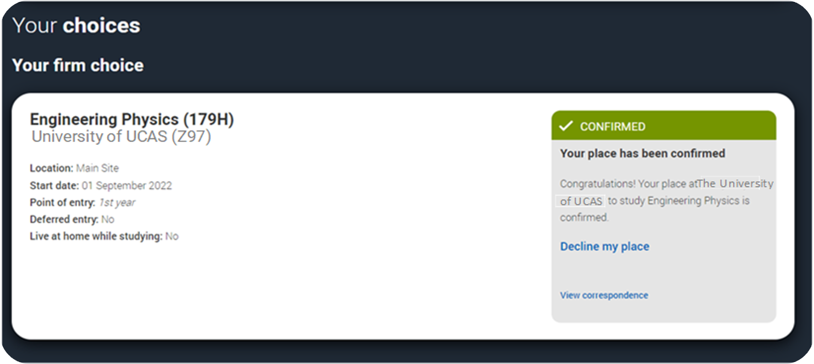
What is ‘Decline my place’?
From 5 July, if you’re holding an unconditional firm place, you can release yourself into Clearing, by using the ‘Decline my place’ button.
You then follow the Clearing process.
This is available until
4 September 2024, after this date direct contact with the university or college will be required.

Slide 17
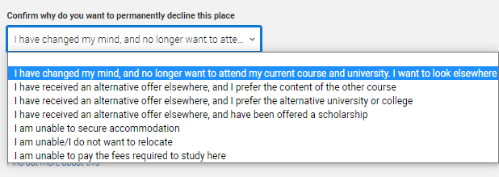
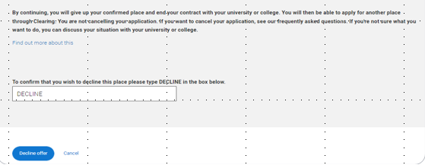
When should I use ‘Decline my place’?
Only use it if you no longer want your place at your confirmed firm choice; your place will be declined and your contract with the university or college will be cancelled.
You’ll need to confirm why you want to permanently decline your place; it might not be your only option. We give you advice based on what you say.
If you want to remain at the same place, but swap course, you must speak to your university/college first.
Declining you place means any arrangements you’ve made for accommodation or scholarships will also be cancelled.

Slide 18
Can I swap between my firm and insurance?
No, you can’t swap your firm and insurance choices.
Your insurance choice is automatically declined if you are confirmed at your firm choice.
If you want to go to your insurance choice, you need to go through Clearing.
You need to check with your insurance choice that they can accept you in Clearing, and then use 'Decline my place' to enter Clearing.
Do not decline your place until you are sure your insurance place can offer you a place.

Slide 19
How to prepare

Slide 20
Plan your plan B!
Plan for different outcomes
Research universities and courses before you get your results
UCAS Search
University and college websites.
Chat to students on the UCAS Hub
Social media
Revisit places you have already applied – would you consider still going there if the course was available?
Create a list of top choices you could refer to on the day.
Research these choices again including entry requirements.
Consider other factors such as accommodation, sports, fun, campus tour
What about an apprenticeship?

Slide 21
Create a checklist
University and College’s will usually have their Clearing information online
Research phone numbers and opening times
Identify the best way to contact each of your preferred choices.
Think about your finances and accommodation.
Prepare your questions for the day – what’s important to you?
Do they run campus tours?
What accommodation is available
How long do I have to accept this offer?
Are there any bursaries available?
Use all this to create a crib sheet for the day so you feel confident.

Slide 22
On the day
Pause. Think. Take time to reflect
Double check entry requirements and speak to universities about these if you are unsure– remember these can change during Clearing.
Have all the information you might need to hand
UCAS PID number
Clearing number
Personal statement
Qualification results
If you’re still waiting for confirmation, check to see why – contact your choices if you're not sure.
You can’t add a choice until 10.00 on SQA results day or 13.00 on JCQ results day.
Check how long you have for any offers made to accept these.
Remember you may need to wait.
Universities and colleges want to speak to you, not your parents or anyone else.

Slide 23
UCAS support
Head online:
Ring us:
0371 468 0 468
From outside the UK:
+44 330 3330 230
Monday to Friday
08:30 – 18:00 (UK time)*
*opening times extended over results periods.
Drop us a line on social:
ucas.com/Clearing for top tips and more info.
Check out ‘The Ultimate Guide to Clearing’.
@ucas_online
@ucas_online
@ucas_online
Security marking: PUBLIC
17 April 2024
| 23
Security marking: PUBLIC
17 April 2024
| 23

