Slide 1
Your UCAS journey
Last updated April 2024

Slide 2

By the end of this, you will be able to:
identify the tools to help you
explain how to apply to a UK university or college
list key application dates
know how to track your application

Slide 3
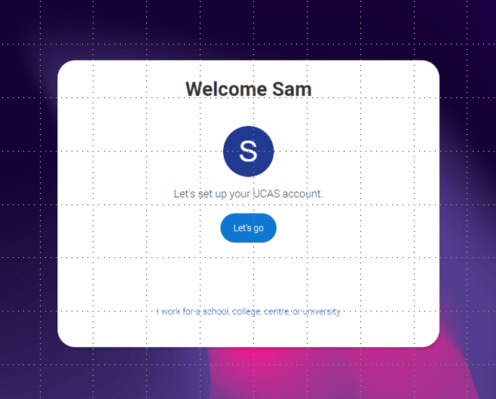
Discover your options
Register with the UCAS Hub to:
explore careers, subjects, places, and apprenticeships in one place
find and favourite over 35,000 courses
search for open days, events and virtual tours
turn predicted grades into UCAS Tariff points
speak to those in the know using Unibuddy
try before you apply with Subject Spotlights from Springpod.
take the UCAS Quiz to find your career matches
start your application

Slide 4
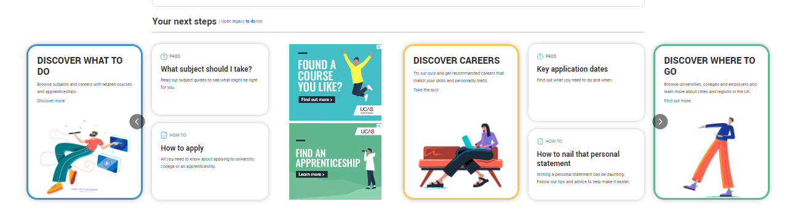
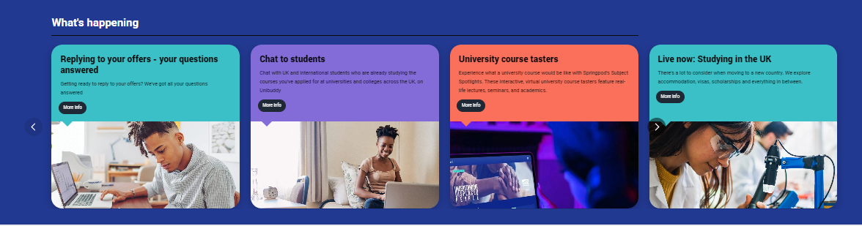

Slide 5
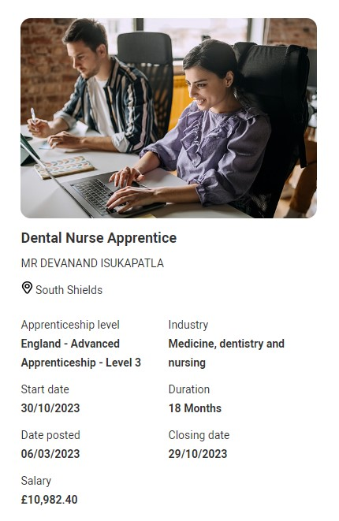
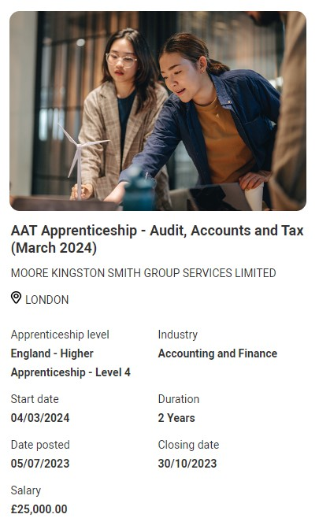
Your pathways Side by side
You can see apprenticeship opportunities alongside undergraduate courses.
The UCAS Hub enables you to explore all your options and build your profile in one place.

Slide 6

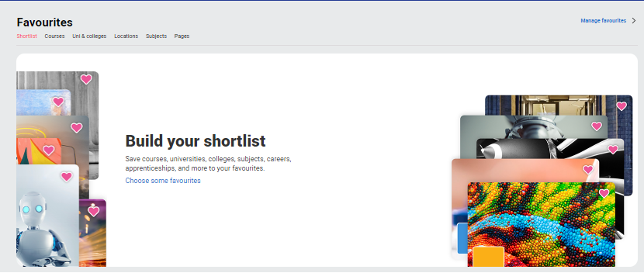
Build your profile. Favourite as you go.
Explore your future
What to do? Where to go? Discover all the options with our subject, industry, and career guides. Explore city, employer and accommodation information. Compare apprenticeships and course opportunities for you.
Build your shortlist
Save for courses, universities, colleges, subjects, apprenticeships and more! Use to shortlist your top 5 choices, manage, keep those favourite information pages to hand.
| 6

Slide 7

Subject Spotlights
Learn from some of the UK's finest academics as they give you a genuine, insightful, and engaging experience of studying their courses at their universities.
On-demand interactive video experiences
Have a go at interactive quizzes and activities
Get feedback on how you’ve done.
Try university degrees before you apply.
Certificate of completion
Explore more Springpod Subject Spotlights.

Slide 8




Chat to students
A peer-to-peer chat facility hosted on ucas.com powered by Unibuddy.
An opportunity to connect with current students, ask questions and learn about their experiences
Over 4,900 active ambassadors, with unlimited chats available

Slide 9

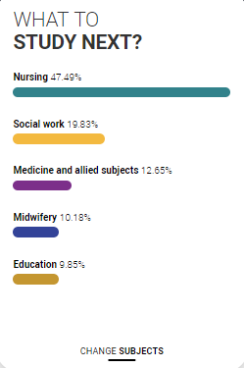
Personalised tools to help
UCAS Quiz
Find job and career ideas matched to your personality.
Plus a list of courses previous students studied in order to get there.
What to study next?
Broaden your horizons by exploring another subject area, that student’s who did your qualification went on to study.

Slide 10

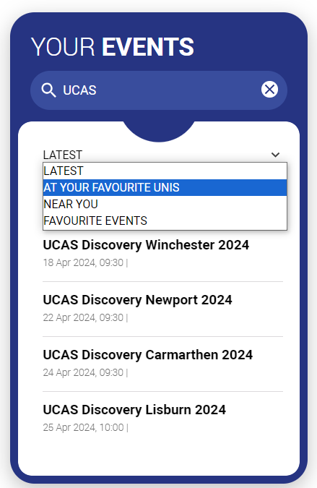
Advice and events
Hub lives
Watch expert interviews on demand.
Make an informed decision about the right path for you. University, apprenticeships or the world of work.
Your events
Filter to explore events, open days and tours to suit your needs.
Register straight from the Hub for our UCAS Discovery events, with exciting new zones covering all pathways.

Slide 11

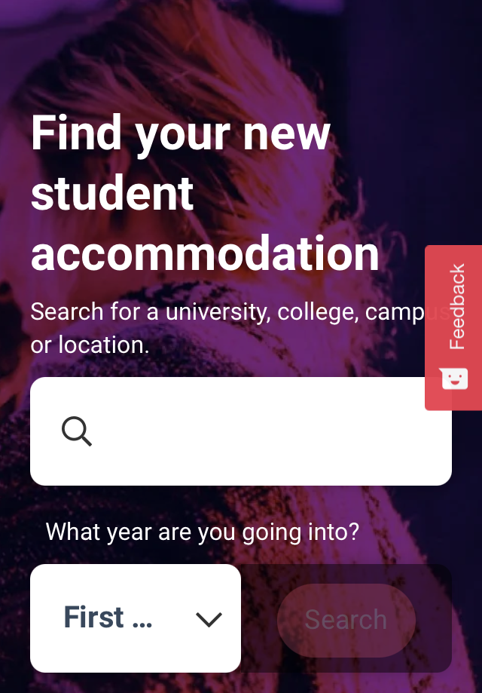
What else do you need?
Accommodation
High on the list when considering where to study, but it’s not always easy to compare what’s on offer. Understand what options there are using our accommodation search.
Personal Statement Builder
Designed to help you think about what to include, and how to lay it all out. It counts how many characters you’ve used, so it’s easy to see when you’re close to the 4,000 character limit.

Slide 12
University or college
How to apply
2025 Cycle

Slide 13
When to apply 2025 entry
30 April 2024
UCAS search displays courses
3 September
First day we can receive a completed application
15 October 2024*
Deadline for courses in medicine, veterinary medicine/science, dentistry, and courses at Oxford or Cambridge
29 January 2025*
UCAS equal consideration date
26 February
UCAS Extra opens
30 June
Last date to send an application
5 July
Clearing opens
14 May
UCAS application opens for 2025 entry
* 18.00 UK time

Slide 14
Key facts
Start your application from
14 May 2024
Universities and colleges can’t see your other choices when you apply.
Apply by the equal consideration date.
Five choices, unless applying to study medicine, veterinary, medicine/science, dentistry – then it’s four choices.
You can’t apply to both Oxford and Cambridge.
Applying costs £28.50.

Slide 15
Choosing the right place for you
Style – from traditional, with a focus on subject-based courses and research, to modern universities/colleges, with a greater focus on vocational courses.
Location – some are in large cities, others in small towns, by the coast or in the countryside – it’s all a major influence on the environment and lifestyle.
Size – larger universities can have more than 20,000 students, whereas some of the smallest have only a few thousand.
Culture and facilities – influenced by a range of factors, including the diversity of students who attend.
What graduates do – all universities collect destination statistics; it can be useful to find out what jobs or further study students go on to.
Tuition fees – can vary between universities and colleges; check if there are scholarships or bursaries available.
Living costs – accommodation, transport, and food can vary enormously.

Slide 16
Choosing the right course for you
What does the course cover?
Courses with the same title may be very different.
Look carefully at the core course content, and the range of optional studies/modules available.
Which modules are the most interesting and relevant to your career aspirations?
See if the course or university/college offers any internship, placement, or study abroad opportunities.
How is the course taught – structured teaching, or more independent research? How many lectures are there, and how much group work will be done in seminars?
How is the course assessed?

Slide 17
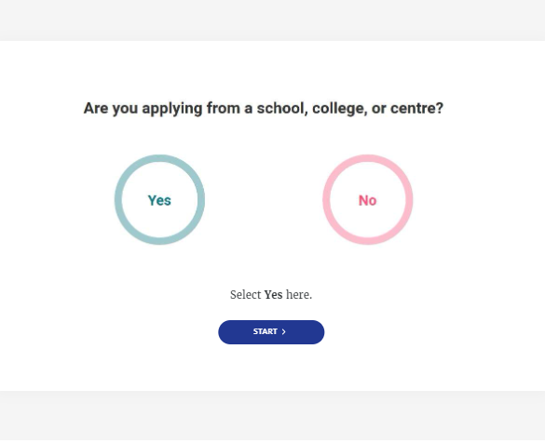
Linking to a centre
If you’re applying with the help of a school, college or centre you should enter their ‘buzzword’ to link your application to them.
The buzzword is a unique code set by your school, college or centre.
By linking your application you’re giving your school, college or centre permission to view and track your application.
It also means they’ll provide you with a reference and send your application to UCAS on your behalf.

Slide 18
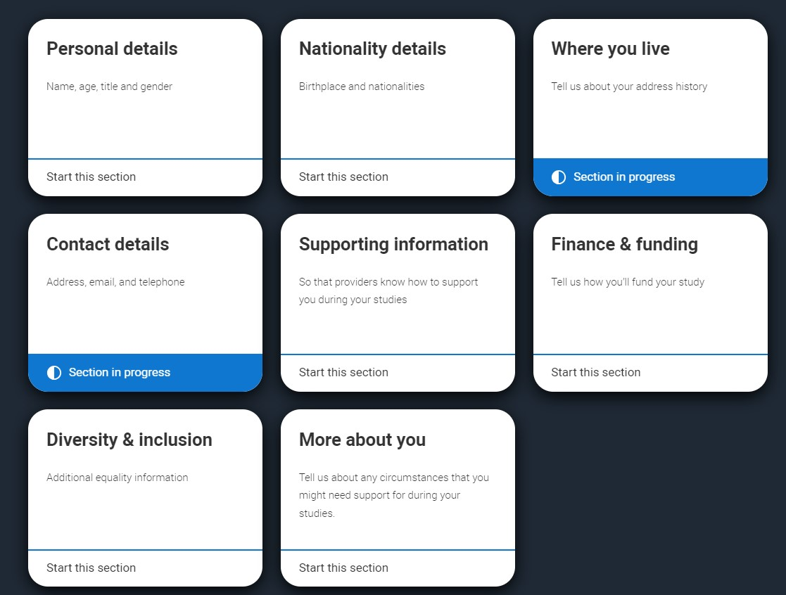
Application profile
Personal details
Nationality details
Where you live
Contact details
Supporting information
Finance and funding
Diversity and inclusion*
More about you
* (for students with a UK home address)

Slide 19
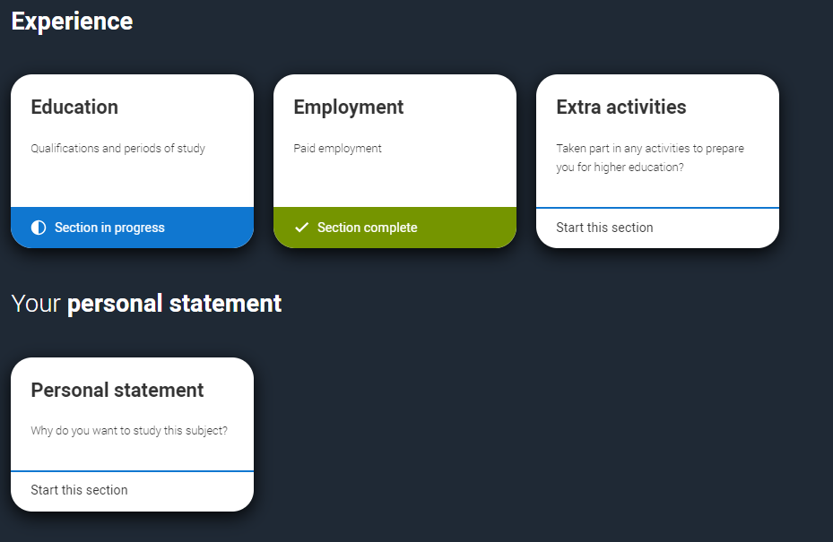
Your experiences
Education
Employment
Extra activities*
Personal statement
Reference**
*(for students with a UK home address)
**(not visible if linked to your school/college)

Slide 20







The personal statement
The only section you have full control over
Your only chance to market yourself as an individual
The same for all of your choices
UCAS’ similarity detection service:
every personal statement is run through software to check for plagiarism.
A maximum of 4,000 characters, or 47 lines
A minimum of 1,000 characters
There isn’t a spelling or grammar check
No formatting allowed
Security marking: PUBLIC
18 April 2024
| 20

Slide 21

Start early
Include:
  academic achievements, past and present
  why you’re interested in the subject area
  your knowledge of the course area
  your enthusiasm to go beyond the syllabus
  what you enjoy about studying
  details of your independent study skills
Security marking: PUBLIC
18 April 2024
| 21

Slide 22

Consider…
  Universities and colleges will consider:
  Have you chosen the course for the right reasons?
  Can you achieve in a new learning environment?
  Do you have a range of interests and aptitudes?
  Do you have a depth of interest in the subject?
  Have you studied independently?
  Do you appear motivated and committed?
  Do you have good numeracy and literacy skills?
Security marking: PUBLIC
18 April 2024
| 22

Slide 23

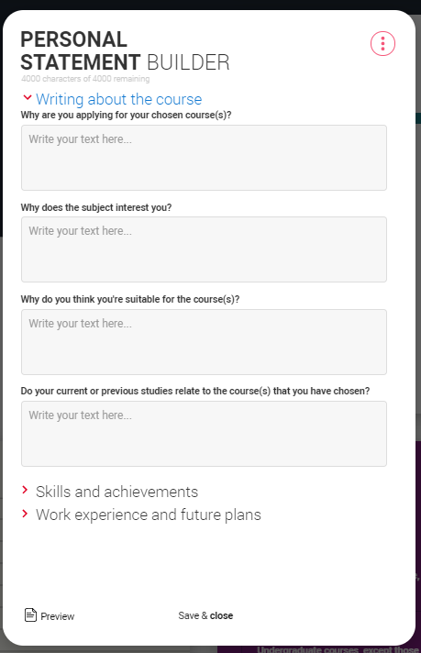
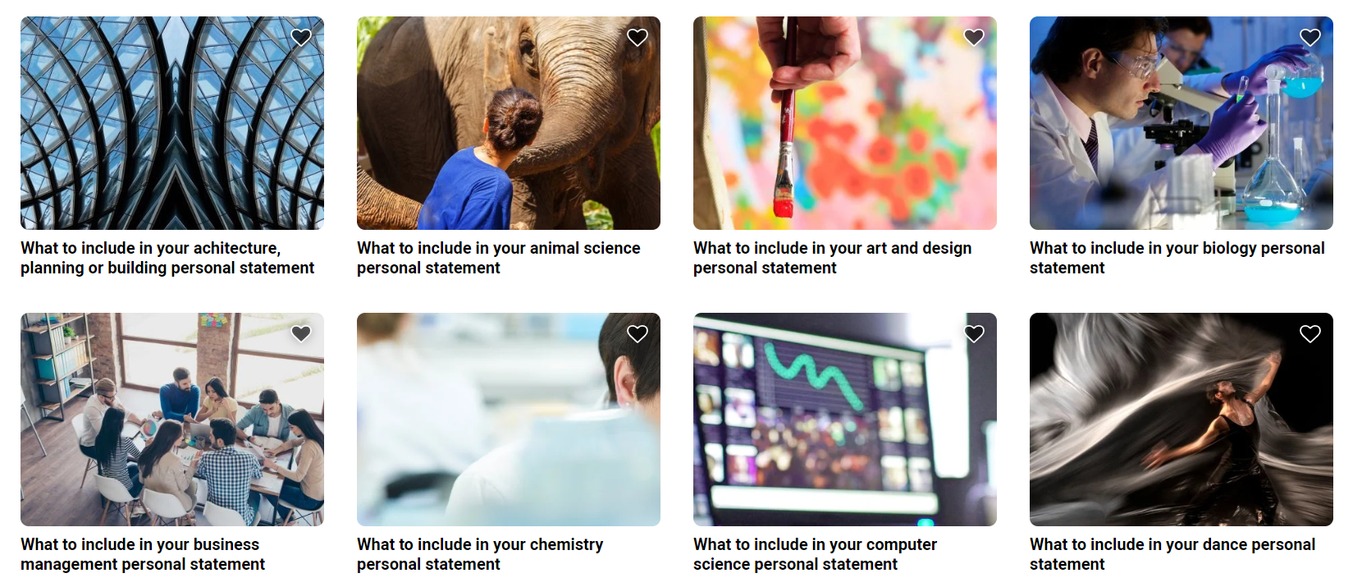
Personal statement support

Slide 24



Decisions
Universities and colleges will review the:
They may also ask for:
personal statement
admissions test
qualifications
interview
reference
portfolio/audition
Security marking: PUBLIC
18 April 2024
| 24

Slide 25
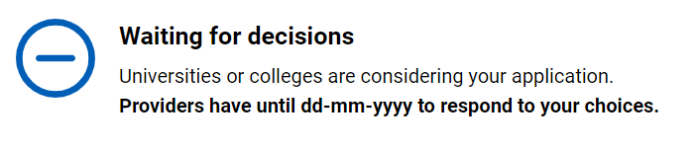
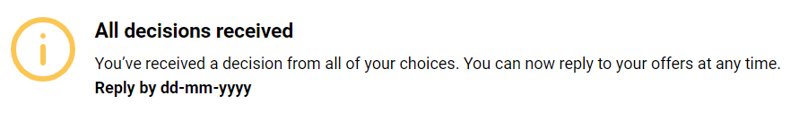
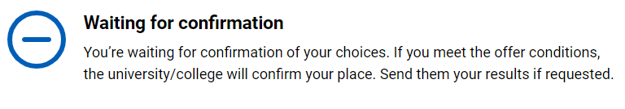
Tracking your application
Follow your application 24/7:
see your choices
keep contact information up to date
view and reply to your offers
You’ll receive one of three decisions from your choices:
unconditional offer
conditional offer
Unsuccessful
Security marking: PUBLIC
18 April 2024
| 25

Slide 26

Replies to offers
Once you have decisions on all your choices, you can choose two:
  One as a ‘firm’ acceptance – your first choice.
  The other as an ‘insurance’ acceptance. This acts as a back-up if you do not get into your ‘firm’ choice.
Any remaining offers must be declined.
Once all your decisions and replies have been made, if you are not holding an offer, you may be able to use Extra or Clearing to find available places.
Security marking: PUBLIC
18 April 2024
| 26

Slide 27

Other options
Extra (26 Feb – 4 Jul)
Used all five choices and had no offers.
Add Extra choices for consideration one at a time.
Clearing (5 Jul – Oct)
Apply after 30 June, receive no offers, decline all offers, not met conditions.
Find vacancies from 5 July and add a Clearing choice to your application.
Security marking: PUBLIC
18 April 2024
| 27

Slide 28

Apprenticeships
What you need to know
www.ucas.com/apprenticeships

Slide 29
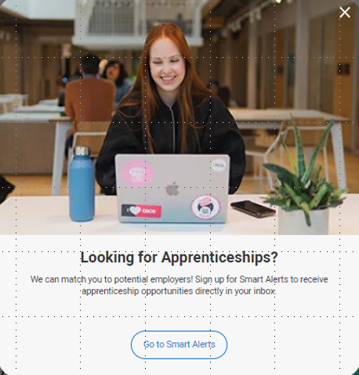
Your pathways Side by side
When you register on ucas.com, you can sign up to be linked to relevant apprenticeship opportunities that match your profile.

Slide 30


6 steps to follow
Step 1
Step 2
Step 3
Step 4
Step 5
Step 6
Register on UCAS Hub
Option to sign up to receive alerts on opportunities that match your profile
Explore subjects, courses, industries, job roles
Build your profile
Search
for vacancies
Make an application

Slide 31

When can I apply?
Not one deadline
Advertised throughout the year
Larger organisations with multiple application processes may recruit earlier than smaller local organisations
Higher apprenticeships with a Sep/Oct start tend to recruit in the previous academic year
www.ucas.com/apprenticeships

Slide 32

How can I apply?
Applications are made directly through the company or the education provider.
There is no limit on the number of applications you can make.
The application process might vary across vacancies, you could be asked for:
CV and Covering Letter
Application Form
In App/Site application
You can apply for universities and apprenticeships at the same time!

Slide 33





Our support
@ucas_online
UCAS Customer Experience Centre:
0371 468 0 468
From outside the UK:
+44 330 3330 230
Monday to Friday
08:30 – 18:00 (UK time)
@ucas_online
@ucas_online
@ucas
@UCASonline
Security marking: PUBLIC
18 April 2024
| 33
Security marking: PUBLIC
18 April 2024
| 33

Slide 34
Thank you
Security marking: PUBLIC
18 April 2024
| 34

