Slide 1
Discover your options
Last updated April 2024

Slide 2
Discover your options
Higher education
Apprenticeships
Studying abroad
Gap year
Getting a job
Register for the UCAS Hub to understand all your options and make the right choices for you: ucas.com/hub
Security marking: PUBLIC
18 April 2024
| 2

Slide 3
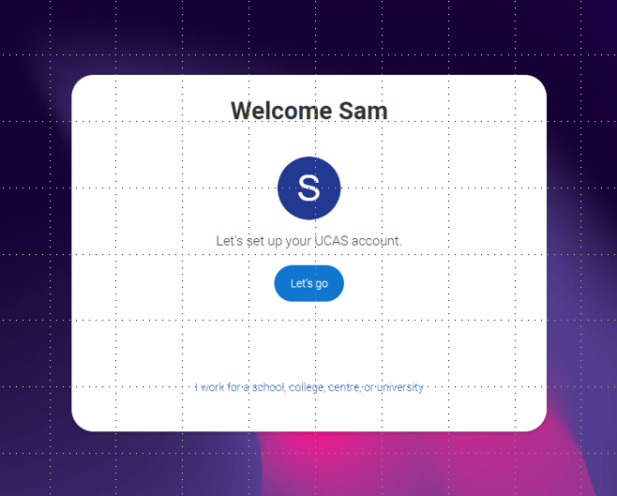
Discover your options
Register with the UCAS Hub to:
explore careers, subjects, places, and apprenticeships in one place
find and favourite over 35,000 courses
search for open days, events and virtual tours
turn predicted grades into UCAS Tariff points
speak to those in the know using Unibuddy
try before you apply with Subject Spotlights from Springpod.
take the UCAS Quiz to find career matches
start your application

Slide 4
Discover your pathways
Certificate of Higher Education (CertHE) and Diploma of Higher Education (DipHE): first and second year of a degree course.
Higher National Certificate (HNC) and Higher National Diploma (HND): HNC is a one-year industry specific course, and the HND is a two-year industry specific course.
Higher apprenticeships: provide an opportunity to gain Level 4 qualifications or above, e.g. HND, or foundation degree while you work. Can take from one to five years to complete, depending on the course level.
Foundation degree: flexible vocational qualification, combining both academic study and workplace learning. It usually takes two years to complete.
Bachelor’s or undergraduate degree: a three to four-year course which can also be available as a part-time option, allowing you to study and work.
Degree apprenticeships: enable you to gain a full undergraduate or master’s degree while you work. Degree apprenticeships take three to six years to complete, depending on the course.

Slide 5
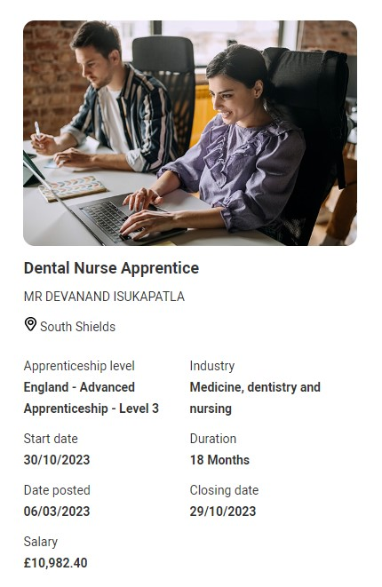
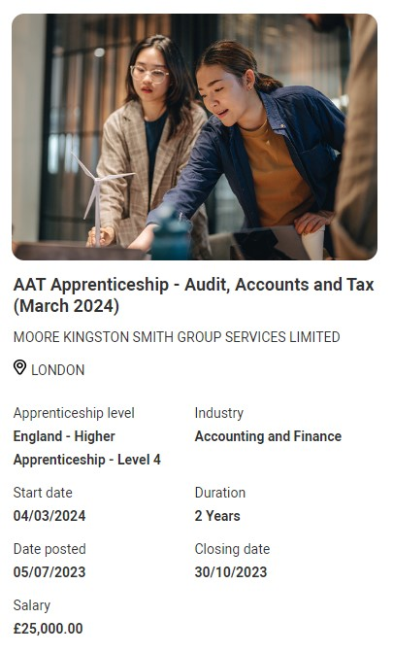
Discover pathways Side by side
You can see apprenticeship opportunities alongside undergraduate courses.
The UCAS Hub enables you to explore all your options and build your profile in one place.

Slide 6

Is it right for you?
There’s things to consider with your next step
something you enjoy – you’re investing time and effort
whether it’s right for your career path – check with employers and professional organisations
location – city or rural, transport links
a study and assessment style that suits you
environment including extracurricular, clubs, and societies
finances

Slide 7
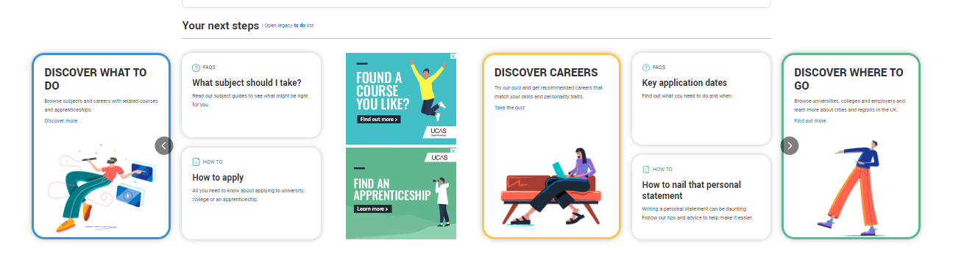


Slide 8

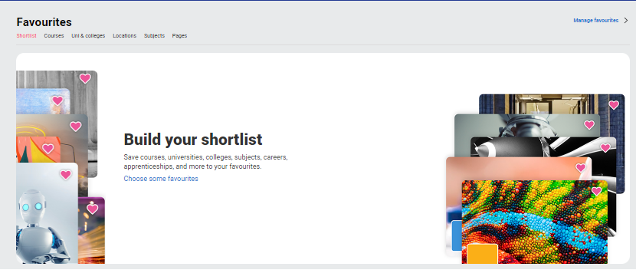
Build your profile. Favourite as you go.
Explore your future
What to do? Where to go? Discover all the options with our subject, industry, and career guides. Explore city, employer and accommodation information. Compare apprenticeships and course opportunities for you.
Build your shortlist
Save for courses, universities, colleges, subjects, apprenticeships and more! Use to shortlist your top 5 choices, manage, keep those favourite information pages to hand.
| 8

Slide 9

Subject Spotlights
Learn from some of the UK's finest academics as they give you a genuine, insightful, and engaging experience of studying their courses at their universities.
On-demand interactive video experiences
Have a go at interactive quizzes and activities
Get feedback on how you’ve done.
Try university degrees before you apply.
Certificate of completion
Explore more Springpod Subject Spotlights.

Slide 10




Chat to students
Peer-to-peer chat facility hosted on ucas.com powered by Unibuddy.
Connect, ask questions and learn about student experiences
Over 4,900 active ambassadors, with unlimited chats available

Slide 11

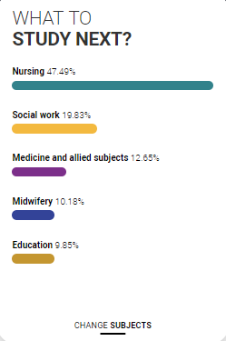
Personalised tools to help
UCAS Quiz
Find job and career ideas matched to your personality.
Plus a list of courses previous students studied in order to get there.
What to study next?
Broaden your horizons by exploring another subject area, that student’s who did your qualification went on to study.

Slide 12

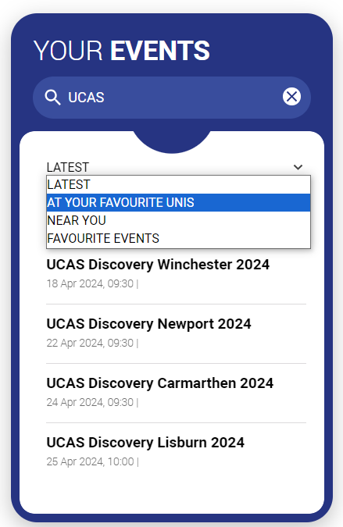
Advice and events
Hub lives
Watch expert interviews on demand.
Make an informed decision about the right path for you. University, apprenticeships or the world of work.
Your events
Filter to explore events, open days and tours to suit your needs.
Register straight from the Hub for our UCAS Discovery events, with exciting new zones covering all pathways.

Slide 13
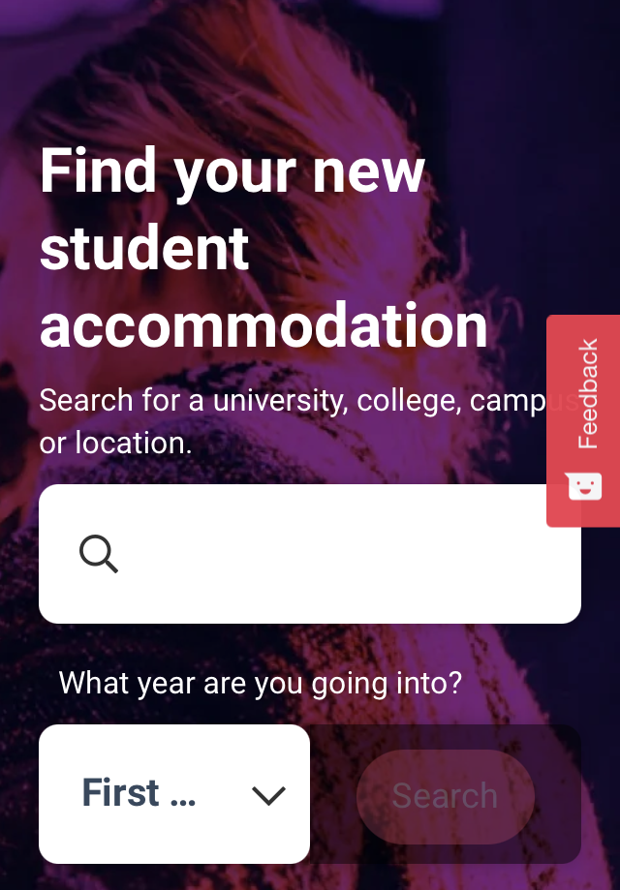

What else do you need?
Accommodation
High on the list when considering where to study, but it’s not always easy to compare what’s on offer. Understand what options there are using our accommodation search.
Personal Statement Builder
Designed to help you think about what to include, and how to lay it all out. It counts how many characters you’ve used, so it’s easy to see when you’re close to the 4,000 character limit.

Slide 14





Our support
@ucas_online
UCAS Customer Experience Centre:
0371 468 0 468
From outside the UK:
+44 330 3330 230
Monday to Friday
08:30 – 18:00 (UK time)
@ucas_online
@ucas_online
@ucas
@UCASonline
Security marking: PUBLIC
18 April 2024
| 14
Security marking: PUBLIC
18 April 2024
| 14

Slide 15
Thank you
Security marking: PUBLIC
18 April 2024
| 15

