Slide 1
Apprenticeships: An introduction to Early Connect
Update for teachers, careers advisers, educators delivering apprenticeships.
Notes:
Notes to the presenter before you use this slide deck: Early Connect is an exciting new pilot being delivered in partnership between the Department for Education (DfE) and UCAS.
The pilot aims to support more young people onto apprenticeships, and to make it easier for employers to find apprentices.
Please consider that this is an introduction to Early Connect, with some general information about apprenticeships. You can learn more about apprenticeships by visiting:
https://www.apprenticeships.gov.uk/
https://www.ucas.com/apprenticeships
Additional presenter notes have been provided in the notes section of each slide to assist you when delivering this presentation. The presenter notes do not need to be read to the audience but may be useful in providing wider context.
Please personalise the slides as appropriate. You may wish to include examples of former students that have become apprentices, refer to local employers that offer apprenticeships, or expand on the reasons for joining the pilot.
The imagery used in this slide deck is of real apprentices – a day in the life of apprentices at ASOS

Slide 2
Contents
Part 1: Apprenticeships overview: What apprenticeships are, their benefits, and how they work.
Part 2: Early Connect: The benefits of joining the pilot, why it matters, how to get involved and the support available.
Part 3: Resources: How UCAS can help support advisers and their students.
Notes:
Note for presenter: The aim of this slide deck is to enable you to spread the word about Early Connect across your school/college and get further support and understanding from the senior leadership team.
You may want to adapt the first section depending on the current understanding of apprenticeships across the staff and school/college.

Slide 3
Part 1: What’s an apprenticeship?
It’s a real job where you learn, gain experience, study for a qualification and get paid.
An apprentice is an employee, with a contract of employment and holiday leave.
Over 650 different apprenticeships available, from Nuclear Engineer to Architect to Digital Marketer.
Notes:
Notes to the presenter This section of the presentation presents the basics of apprenticeships.
Please adapt as appropriate to your audience.

Slide 4
3 key facts about apprenticeships
An apprenticeship takes between one to six years to complete.
Apprentices typically work for a minimum of 30 hours a week (and most will work full time, between 37 – 40 hours per week). Part-time options are also available in some cases.
By the end of an apprenticeship, they’ll have the right skills and knowledge needed for their chosen career.

Slide 5
How it works
Apprenticeships are funded by the Government and/or the employer. This means that apprentices won’t have loans or tuition fees.
Apprentices have time away from their day-job protected for study. This tends to equate to about a day a week. Depending on the type of apprenticeship this can be delivered differently, and may take place upfront, in blocks of study or spread throughout the duration of the apprenticeship.
The off-the-job time is paid time and included within working hours. Minimum apprenticeship wages apply and salaries can often be very competitive.
What apprentices earn will depend on the industry, location and type of apprenticeship.

Slide 6
How to understand the levels
There is an apprenticeship for everyone: some are more complex than others.
It is important to note that for apprenticeships, levels are only a rough guide.
For a year 13 school leaver with little or no work experience, a level 2 or Level 3 apprenticeship is a perfect entry point into the world of work, even if you already have A levels, BTEC or T-Levels.
Some higher and degree apprenticeships give you the opportunity to combine university study and work.
LEVEL 2
LEVEL 3
LEVEL 4+
LEVEL 6-7
Intermediate
Advanced
Higher
Degree
Job roles include: Nuclear Operative, Junior Estate Agent, Rail Engineering Operative, Finance Assistant.
Job roles include: Chef De Partie, Fashion Assistant, Veterinary Nurse, IT Solutions Technician.
Job roles include: Marketing Executive, Journalist, Clinical Dental Technician.
Job roles include: Aerospace Engineer, Police Constable, Cyber Security Professional, Ecologist.
Notes:
Notes to presenter
Please note that all apprenticeships at levels 4-7 are categorised as higher, but if they are level 6-7 and contain a degree, they have become known as degree apprenticeships (e.g. a level 7 Solicitor apprenticeship contains the professional qualifications required to be a solicitor, but not a law degree).
It is important that your audience understands that the level of apprenticeship that you start on will not necessarily be determined by your prior level of qualification.
For example, it is not always the case that students completing a level 3 qualification will progress immediately to a higher or degree level apprenticeship.
Just as it is not always the case that someone who already has a degree would progress immediately to a Master’s level apprenticeship.
The starting level of any apprenticeship will be determined by the level of the role that the employer has designed.
Many intermediate and advanced apprenticeships will be the natural starting point for an individual entering that industry with no experience.
All apprentices are given a range of opportunities that will expand their personal and professional skills through the apprenticeship.
Please avoid comparing apprenticeship levels to academic attainment as this could encourage students not to consider opportunities that could be fantastic for them as they could be put off by the perception that they are not progressing to the next academic level.

Slide 7
Types of apprenticeships
There are over 650 different apprenticeship roles to consider.
Here are some examples:
Architect
Cyber Security Technician
Finance assistant
Teacher
Accounting & Taxation
Game Programmer
Boat Builder
Journalist
Assistant Puppet Maker
Event Assistant
Police Constable
Youth Worker
Civil Engineer
Chef De Partie
Digital Marketing
Personal Trainer
Physiotherapist
Nuclear Scientist
Nurse
Software Developer
Sports Coach
Auto Technician
Aerospace Engineer
Doctor – from 2024
Notes:
You can find out more on The Institute website: www.instituteforapprenticeships.org/apprenticeship-standard

Slide 8
Part 2: What is Early Connect?
A pilot being delivered in partnership between the Department for Education (DfE) and UCAS.
Their aim is to support more young people onto apprenticeships and make it easier for employers to find apprentices.
To date a variety of employers have pledged over 5,000 apprenticeship vacancies in the three regions.
Notes:
Notes to the presenter The Government announcement about the Early Connect pilot can be found here:
https://www.gov.uk/government/news/apprenticeships-boosted-under-plans-to-broaden-ucas
This section of the presentation explores the Early Connect pilot in more detail.

Slide 9
Notes:
Note to presenter: Optional slide to share the video as part of the presentation – you will need internet access to play the video

Slide 10
Benefits for all: Why the Early Connect Project Matters
Schools / Colleges
Students
Sector
Access to fully funded support for your students
Receive exclusive resources & CPD
Support the achievement of Gatsby Benchmarks & unbiased careers provision
Increased exposure to more regional vacancies
Localised support for apprenticeship applicants in navigating application process
Access to wider pool of talent for employers
Understanding regional student interest in apprenticeships
Collaborative approach to increase starts

Slide 11
Why have we signed up?
To equip ourselves with the best possible tools, resources and knowledge to support our students when considering their next steps.
We will receive additional support from local networks and organisations.
We can help to shape the UCAS/DfE apprenticeship offer to improve outcomes for current and future students.
Notes:
This slide is for you to edit based on the reasons your school may have chosen to be involved in the project. Why have we signed up – refers to you and your school or college.

Slide 12
What local support will be available?
For students seeking an apprenticeship and who need some extra support, each region will offer an enhanced support package to students, which could include:
Linking with employers in the area, helping them to broaden their search to consider a wider range of vacancies.
Support with applications, interviews and employability skills.
Additional support where individuals are not initially successful.

Slide 13
How can we support our students
Help students to see how the subjects that they are studying link to jobs.
Give students time to search for vacancies and share their findings in class time and offer support in writing and submitting applications, as we would do with other post-18 options.
Encourage applications to be made within the classroom, so they have your support and guidance.

Slide 14
Part 3: How can UCAS help?
Notes:
Notes to the presenter This section of the presentation presents the UCAS resources currently available to support your students.
Please adapt as appropriate to your audience.

Slide 15
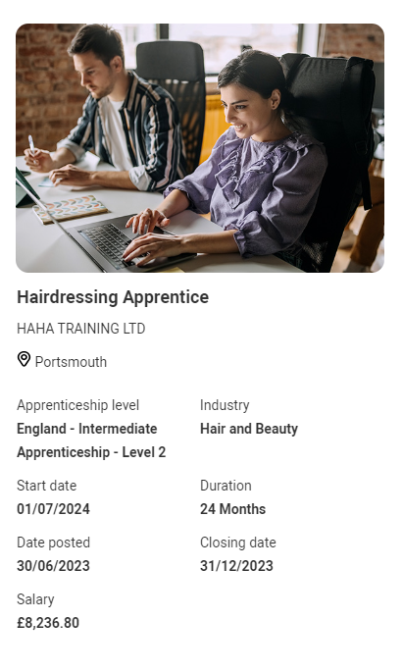
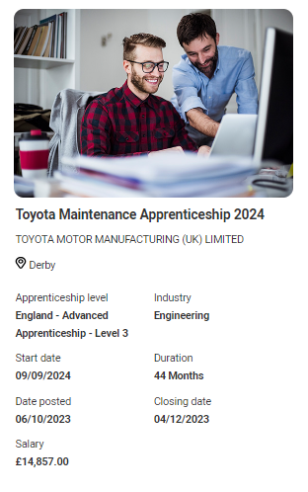
Student pathways side by side
For the first time students can now see apprenticeship opportunities alongside undergraduate courses.
The UCAS Hub enables them to explore all their options and build a profile in one place.

Slide 16
How to explore and apply for apprenticeships
Students can use the UCAS Hub to:
explore industries, employers, locations, careers and jobs
shortlist their favourites
find out where to start
find out how to apply
Notes:
Find out more at ucas.com/apprenticeships

Slide 17
The student journey
Smart Alerts
Student defines interests and can sign up to get matched to potential employers in their area.
October 2023
Advisers signpost students to the UCAS Hub
Student registers in UCAS Hub
Explore undergraduate & apprenticeships
Build a profile
Search for vacancies
Make an application
Everything in one place
Understand the options and access the
latest advice and guidance.
Notes:
Note to presenter:
Optional side to show the student journey on ucas.com in more detail.

Slide 18
What do your students need to do?
October 2023
November 2023
Students register in the
UCAS Hub to start
exploring all the
options
Build a profile, define interests and explore opportunities
Sign up to be matched to potential employers in the area

Slide 19
Smart Alerts
Smart alerts are a new matching service offered by UCAS.
The service enables participants to be matched to regional vacancies.
Smart Alert Sign Up
Data Entry
Matching
Students register for Smart Alerts in their Hub account.
Students enter information on their preferences such as location and area of interest.
If this matches an employer’s search criteria, then they are invited to apply.

Slide 20
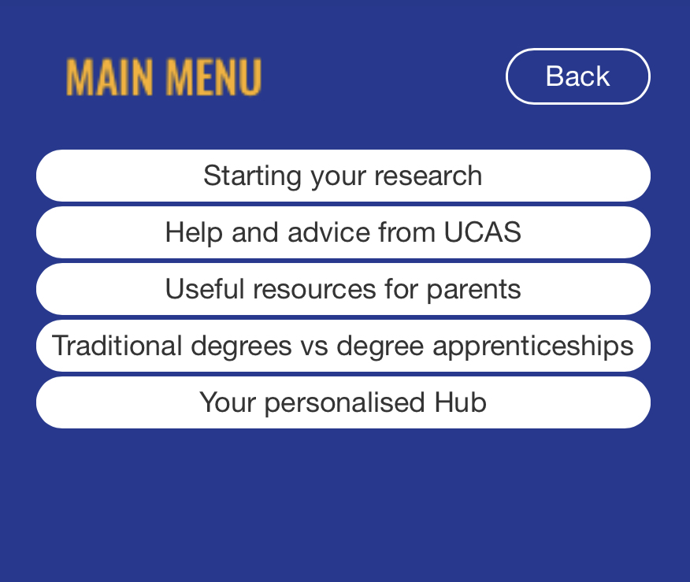
Get the UCAS Widget
The newly updated UCAS widget can be hosted on our *school or college’s website or Virtual Learning Environment (VLE) to link your students and parents to relevant pages on ucas.com.
From starting research to comparing different pathways the widget enables the user to go direct to relevant pages for help and guidance.
Find out more: www.ucas.com/widget
Notes:
*Delete as appropriate or delete this slide if you do not wish to have the widget on your website.

Slide 21
If they see it they can be it
Visit ucas.com/apprenticeships for all the latest guidance and advice on future pathways for your students.

