Slide 1
Introducing apprenticeships with Early Connect
Update for parents, guardians and carers to help them support a young person in finding apprenticeship and career opportunities.

Slide 2
Contents
Part 1: Apprenticeships overview: What apprenticeships are, their benefits, and how they work.
Part 2: Early Connect: The benefits of joining the pilot, why it matters, how to get involved and the support available.
Part 3: Resources: How UCAS can help support parents and their students.
Notes:
Note for presenter: The aim of this slide deck is to enable you to spread the word about Early Connect and engage parents, guardians and carers in the opportunities available to their young people.

Slide 3
Part 1: What’s an apprenticeship?
It’s a real job where you learn, gain experience, study for a qualification and get paid.
An apprentice is an employee, with a contract of employment and holiday leave.
Over 650 different apprenticeships available, from Nuclear Engineer to Architect to Digital Marketer.

Slide 4
3 key facts about apprenticeships
An apprenticeship takes between one to six years to complete.
Apprentices typically work for a minimum of 30 hours a week (and most will work full time, between 37 – 40 hours per week). Part-time options are also available in some cases.
By the end of an apprenticeship, they’ll have the right skills and knowledge needed for their chosen career.

Slide 5
How to understand the levels
There is an apprenticeship for everyone: some are more complex than others.
It is important to note that for apprenticeships, levels are only a rough guide.
For a year 13 school leaver with little or no work experience, a level 2 or Level 3 apprenticeship is a perfect entry point into the world of work, even if you already have A levels, BTEC or T-Levels.
Some higher and degree apprenticeships give you the opportunity to combine university study and work.
LEVEL 2
LEVEL 3
LEVEL 4+
LEVEL 6-7
Intermediate
Advanced
Higher
Degree
Job roles include: Nuclear Operative, Junior Estate Agent, Rail Engineering Operative, Finance Assistant.
Job roles include: Chef De Partie, Fashion Assistant, Veterinary Nurse, IT Solutions Technician.
Job roles include: Marketing Executive, Journalist, Clinical Dental Technician.
Job roles include: Aerospace Engineer, Police Constable, Cyber Security Professional, Ecologist.
Notes:
Notes to presenter
Please note that all apprenticeships at levels 4-7 are categorised as higher, but if they are level 6-7 and contain a degree, they have become known as degree apprenticeships (e.g. a level 7 Solicitor apprenticeship contains the professional qualifications required to be a solicitor, but not a law degree).
It is important that your audience understands that the level of apprenticeship that you start on will not necessarily be determined by your prior level of qualification.
For example, it is not always the case that students completing a level 3 qualification will progress immediately to a higher or degree level apprenticeship.
Just as it is not always the case that someone who already has a degree would progress immediately to a Master’s level apprenticeship.
The starting level of any apprenticeship will be determined by the level of the role that the employer has designed.
Many intermediate and advanced apprenticeships will be the natural starting point for an individual entering that industry with no experience.
All apprentices are given a range of opportunities that will expand their personal and professional skills through the apprenticeship.
Please avoid comparing apprenticeship levels to academic attainment as this could encourage students not to consider opportunities that could be fantastic for them as they could be put off by the perception that they are not progressing to the next academic level.

Slide 6
Types of apprenticeships
There are over 650 different apprenticeship roles to consider.
Here are some examples:
Architect
Cyber Security Technician
Finance assistant
Teacher
Accounting & Taxation
Game Programmer
Boat Builder
Journalist
Assistant Puppet Maker
Event Assistant
Police Constable
Youth Worker
Civil Engineer
Chef De Partie
Digital Marketing
Personal Trainer
Physiotherapist
Nuclear Scientist
Nurse
Software Developer
Sports Coach
Auto Technician
Aerospace Engineer
Doctor – from 2024
Notes:
You can find out more on The Institute website: www.instituteforapprenticeships.org/apprenticeship-standard

Slide 7
How it works
Apprenticeships are funded by the Government and/or the employer. This means that apprentices won’t have loans or tuition fees.
Apprentices have time away from their day-job protected for study this tends to equate to about a day a week but can be delivered in different fashions like blocks of study time or in the work-place. This is called ‘off-the-job’ training and is facilitated by a college, independent training provider, or a university.
The off-the-job time is paid time and included within working hours.
What apprentices earn will depend on the industry, location and type of apprenticeship.

Slide 8
Part 2: What is Early Connect?
A pilot being delivered in partnership between the Department for Education (DfE) and UCAS.
Their aim is to support more young people onto apprenticeships and make it easier for employers to find apprentices.
To date a variety of employers have pledged over 5,000 apprenticeship vacancies in the three pilot regions.

Slide 9
Notes:
Note to presenter: Optional slide to share the video as part of the presentation – you will need internet access to play the video

Slide 10
Why has your *school/college signed up?
To equip ourselves with the best possible tools, resources and knowledge to support your child when considering their next steps.
We will receive additional support from local networks and organisations to help your child secure an apprenticeship.
We can help shape the UCAS/DfE apprenticeship offer to improve outcomes for your children.
Notes:
*Please edit this slide to reflect the details for your centre. There may be additional reasons why you have joined the pilot.

Slide 11
What local support is available?
For students seeking an apprenticeship and who need some extra support, our region will offer an enhanced support package, which could include:
Linking with employers in the area, helping them to broaden their search to consider a wider range of vacancies.
Support with applications, interviews and employability skills.
Additional support where individuals are not initially successful.

Slide 12
How can you support your child?
Encourage them to be open-minded to the pathway they might take after school/college.
Support them to explore and search for apprenticeship opportunities and encourage them to continue if they’re not successful the first time around.
Where you can, help them to research what the recruitment process might be like and how they might need to prepare.
Notes:
Ucas.com/apprenticeships is a good place to start their research

Slide 13
Part 3: How can UCAS help?

Slide 14
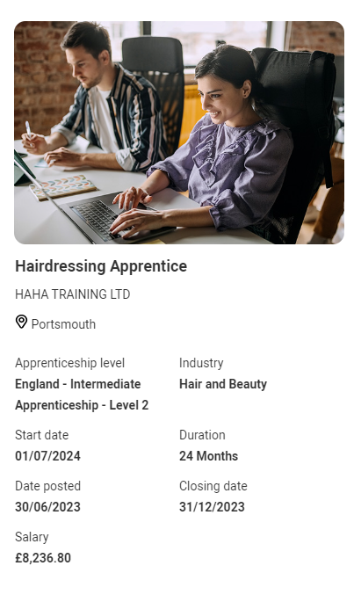
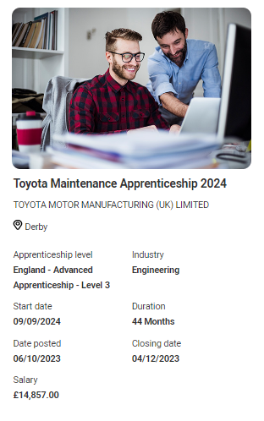
Student pathways side by side
For the first time students can now see apprenticeship opportunities alongside undergraduate courses.
The UCAS Hub enables them to explore all their options and build a profile in one place.

Slide 15
How to explore and apply for apprenticeships
Students can use the UCAS Hub to:
explore industries, employers, locations, careers and jobs
shortlist their favourites
find out where to start
find out how to apply

Slide 16
What does your child need to do?
October 2023
November 2023
Register in the
UCAS Hub to start
exploring all the
options
Build a profile, define interests and explore opportunities
Sign up to be matched to potential employers in the area

Slide 17
Smart Alerts
Smart alerts are a new matching service offered by UCAS.
The service enables participants to be matched to regional vacancies.
Smart Alert Sign Up
Data Entry
Matching
Students register for Smart Alerts in their Hub account.
Students enter information on their preferences such as location and area of interest.
If this matches an employer’s search criteria, then they are invited to apply.

Slide 18
Support for Parents
Read the latest guidance on all future pathways for your students > ucas.com/parents
Sign up to receive handy tips each month direct to your inbox > ucas.com/sign-up
Listen to the Parents evening Podcast for expert advice on apprenticeships, results day, Clearing and more > ucas.com/parents-evening-ucas-parent-podcast
Notes:
Specific link for parent support on apprenticeships: https://www.ucas.com/apprenticeships/parent-and-guardian-guide-apprenticeships

Slide 19
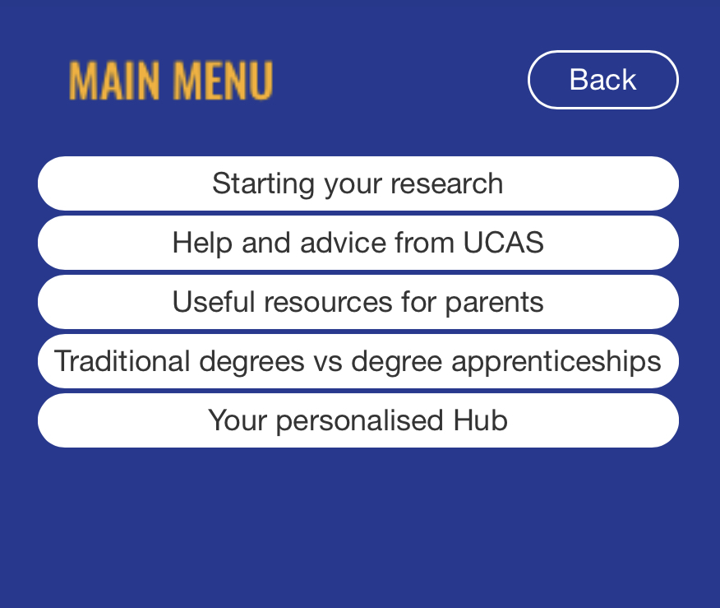
Look out for the UCAS Widget
The UCAS widget is hosted on our school’s *website or *Virtual Learning Environment (VLE) to link you to relevant pages on ucas.com.
From starting research to comparing different pathways the widget enables the user to go direct to relevant pages for help and guidance including help pages designed for parents and guardians.
Notes:
*Delete as appropriate or delete this slide if you do not have the widget on your website. www.ucas.com/widget for schools’ websites

