Slide 1
Applying through
UCAS
Last updated April 2023

Slide 2

By the end of this, you will be able to:
identify the tools to help you
explain how to apply to a UK university or college
list key application dates
know how to track your application

Slide 3
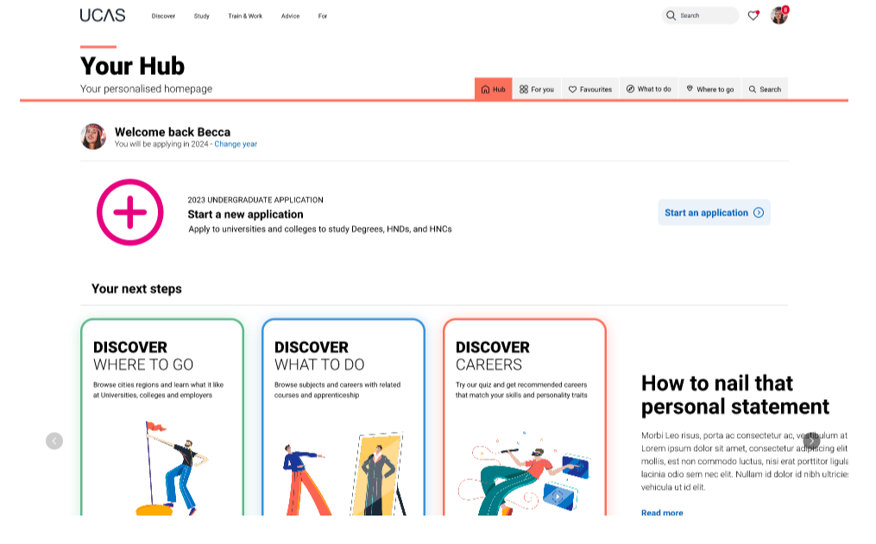
Starting your research
Register with the UCAS Hub to:
explore careers, subjects, places, and apprenticeships
find and favourite over 35,000 courses
search for open days, events and virtual tours
turn predicted grades into UCAS Tariff points
speak to those in the know using Unibuddy
speak to career, higher education, and application specialists by attending Hub lives
take the UCAS Quiz to find your career matches
start your application

Slide 4
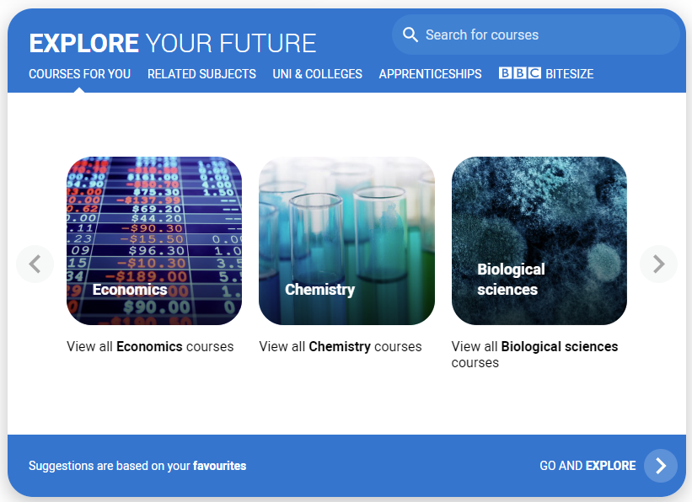
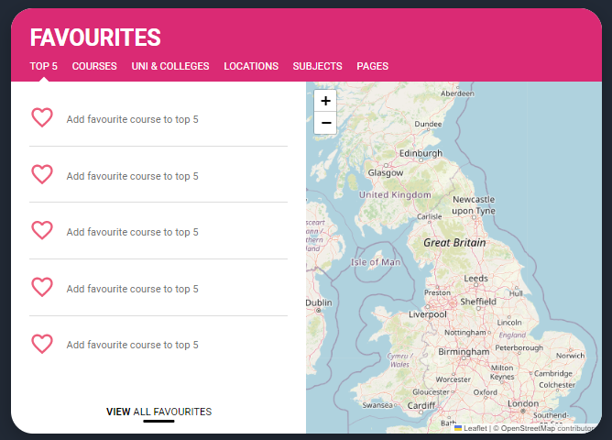
Personalised tools to help
Tools to help
Explore your future
Discover what to do with subject, industry, and career guides; discover where to go with city, employer and accommodation information. Explore apprenticeships and course opportunities for you. Favourite as you go.
Your favourites
Search for courses, use to decide your top 5 choices, manage, keep those favourite information pages to hand. Manage and edit at any time.
Security marking: PUBLIC
05 May 2023
| 4

Slide 5

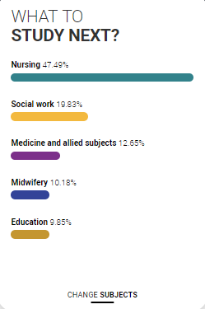
Personalised tools to help
UCAS Quiz
Find job and career ideas matched to your personality.
Plus a list of courses previous students studied in order to get there.
What to study next?
Broaden your horizons by exploring another subject area, that student’s who did your qualification went on to study.

Slide 6
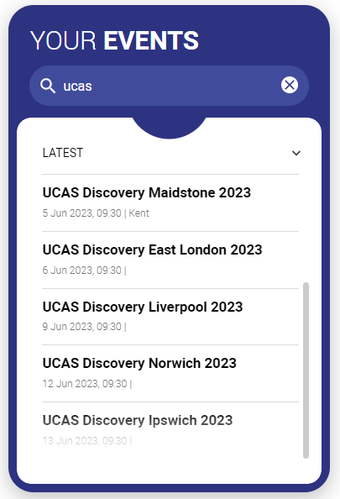
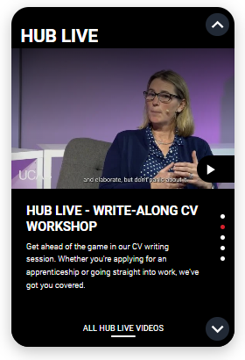
Our advice and events
UCAS Hub lives
Join our live sessions hosted by expert panels.
Ask questions to help you make an informed decision about the right path for you. University, apprenticeships or the world of work.
UCAS Discovery
Events and open days are presented based on your preferences.
Register straight from the Hub for our UCAS Discovery ‘The Big Q&A Tour’, with exciting new zones covering all pathways.

Slide 7
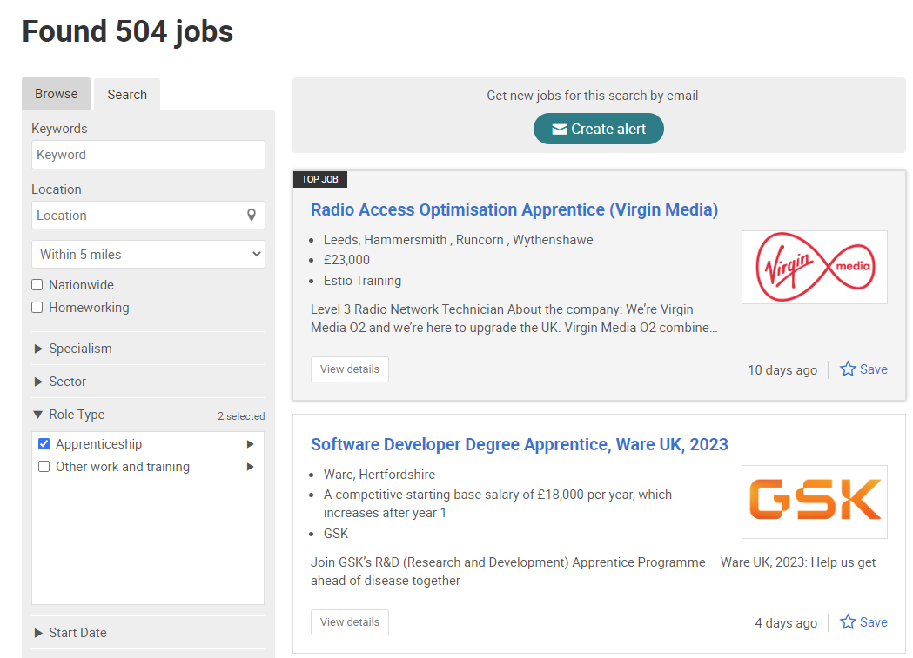

UCAS Exploring Apprenticeships
From UCAS Hub you can easily explore apprenticeships; learn more information and see a live selection of apprenticeship vacancies.
Set alerts to stay up to date.

Slide 8
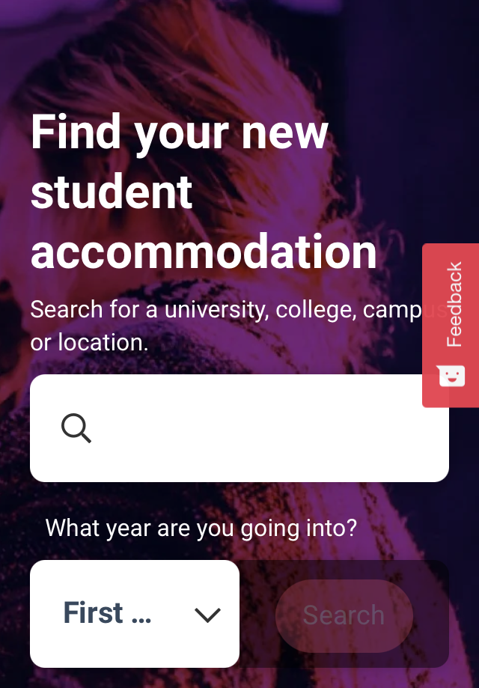

What else do you need?
Accommodation
High on the list when considering where to study, but it’s not always easy to compare what’s on offer. Understand what options there are using our accommodation search.
Personal Statement Builder
Designed to help you think about what to include, and how to lay it all out. It counts how many characters you’ve used, so it’s easy to see when you’re close to the 4,000 character limit.

Slide 9
Choosing the right place for you
Style – from traditional, with a focus on subject-based courses and research, to modern universities/colleges, with a greater focus on vocational courses.
Location – some are in large cities, others in small towns, by the coast or in the countryside – it’s all a major influence on the environment and lifestyle.
Size – larger universities can have more than 20,000 students, whereas some of the smallest have only a few thousand.
Culture and facilities – influenced by a range of factors, including the diversity of students who attend.
What graduates do – all universities collect destination statistics; it can be useful to find out what jobs or further study students go on to.
Tuition fees – can vary between universities and colleges; check if there are scholarships or bursaries available.
Living costs – accommodation, transport, and food can vary enormously.

Slide 10
Choosing the right course for you
What does the course cover?
Courses with the same title may be very different.
Look carefully at the core course content, and the range of optional studies/modules available.
Which modules are the most interesting and relevant to your career aspirations?
See if the course or university/college offers any internship, placement, or study abroad opportunities.
How is the course taught – structured teaching, or more independent research? How many lectures are there, and how much group work will be done in seminars?
How is the course assessed?

Slide 11
University/college
How to apply

Slide 12
When to apply for 2024 entry
16 May
UCAS Undergraduate application opens for 2024 entry.
5 September
First day UCAS can receive a completed application to process.
16 October
UCAS application deadline for courses in medicine, veterinary medicine/science, and dentistry, and courses at Oxford or Cambridge.
31 January 2024
UCAS equal consideration application deadline.
28 February
UCAS Extra opens.
30 June
Last date for applications before Clearing opens.
2 May 2023
UCAS search tool displays 2024 courses.
5 July
Clearing opens.
Security marking: PUBLIC
05 May 2023
| 12

Slide 13

Key facts
To start an application you need to register with ucas.com, you can register at any time.
From 16 May 2023 you’ll be able to start an application.
Universities and colleges can’t see your other choices when you apply.
Apply by the equal consideration date.
You have up to five choices, unless applying to study medicine, veterinary, medicine/science, dentistry – then it’s four choices.
You can’t apply to BOTH Oxford and Cambridge.
Applying costs £27.50.

Slide 14
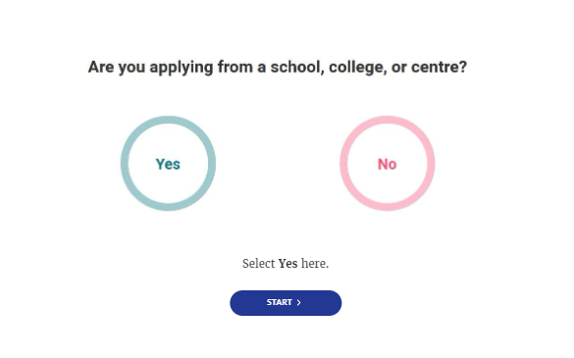
Linking to a school
If you’re applying with the help of a school, college or centre you should enter their ‘buzzword’ to link your application to them.
The buzzword is a unique code set by your school, college or centre.
By linking your application you’re giving your school, college or centre permission to view and track your application.
It also means they’ll provide you with a reference, and send your application to UCAS on your behalf.

Slide 15
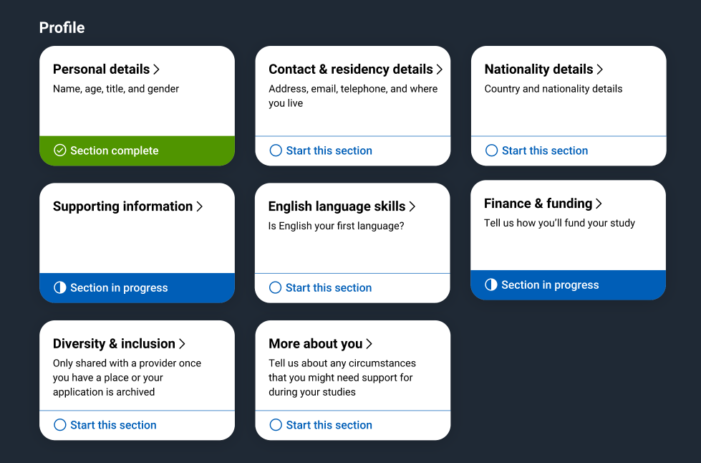
Application
Profile:
Personal details
Contact and residency details
Nationality details
Supporting information
English language skills
Finance and funding
Diversity and inclusion*
More about you
* (for students with a UK home address)
Security marking: PUBLIC
05 May 2023
| 15

Slide 16
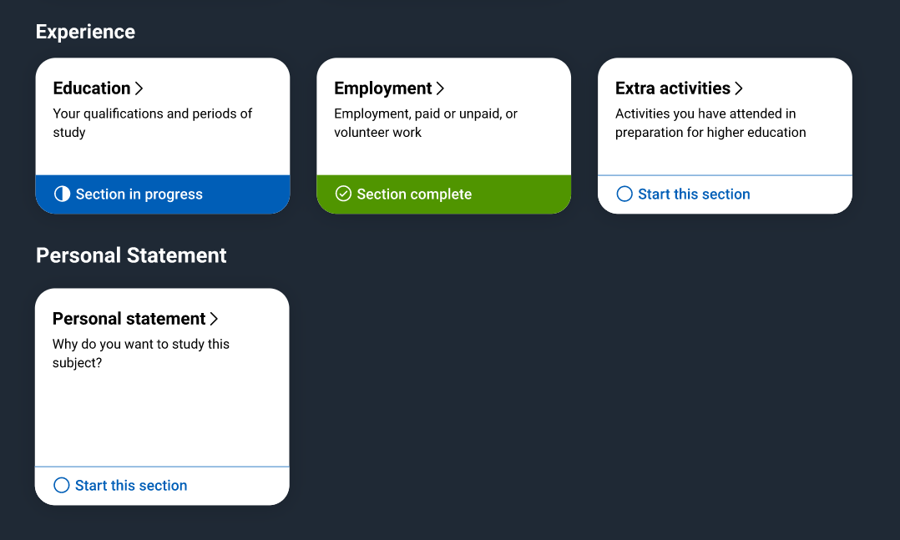
Application
Experiences:
Education
Employment
Extra activities*
Personal statement
Reference**
Add choices – up to five
*(for students with a UK home address)
**(not visible for students linked to their school/college)

Slide 17







The personal statement
The only section you have full control over
Your only chance to market yourself as an individual
The same for all of your choices
UCAS’ similarity detection service:
every personal statement is run through software to check for plagiarism.
A maximum of 4,000 characters, or 47 lines
A minimum of 1,000 characters
There isn’t a spelling or grammar check
No formatting allowed
Security marking: PUBLIC
05 May 2023
| 17

Slide 18

Start early
Include:
  academic achievements, past and present
  why you’re interested in the subject area
  your knowledge of the course area
  your enthusiasm to go beyond the syllabus
  what you enjoy about studying
  details of your independent study skills
Security marking: PUBLIC
05 May 2023
| 18

Slide 19

Consider…
  Universities and colleges will consider:
  Have you chosen the course for the right reasons?
  Can you achieve in a new learning environment?
  Do you have a range of interests and aptitudes?
  Do you have a depth of interest in the subject?
  Have you studied independently?
  Do you appear motivated and committed?
  Do you have good numeracy and literacy skills?
Security marking: PUBLIC
05 May 2023
| 19

Slide 20
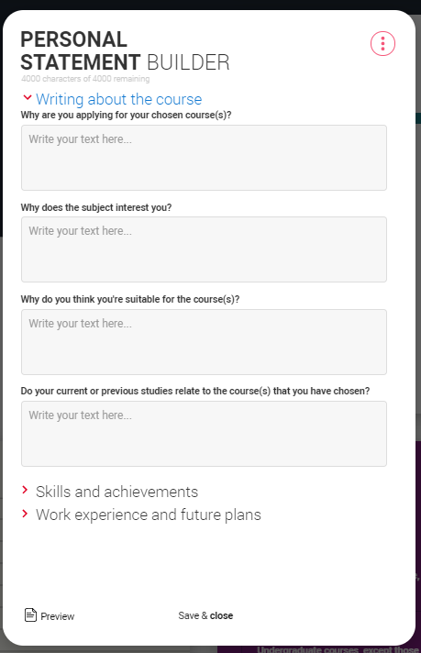


Security marking: PUBLIC
05 May 2023
| 20

Slide 21



Decisions
Universities and colleges will review the:
They may also ask for:
personal statement
admissions test
qualifications
interview
reference
portfolio/audition
Security marking: PUBLIC
05 May 2023
| 21

Slide 22



Tracking your application
Follow your application 24/7:
see your choices
keep personal information up to date
view and reply to your offers
You’ll receive one of three decisions from your choices:
unconditional offer
conditional offer
unsuccessful
Security marking: PUBLIC
05 May 2023
| 22

Slide 23

Replies to offers
Once you have decisions on all your choices, you can choose two:
  One as a ‘firm’ acceptance – your first choice.
  The other as an ‘insurance’ acceptance. This acts as a back-up if you do not get into your ‘firm’ choice.
Any remaining offers must be declined.
Once all your decisions and replies have been made, if you are not holding an offer, you may be able to use Extra or Clearing to find available places.
Security marking: PUBLIC
05 May 2023
| 23

Slide 24

Other options
Extra (28 Feb – 4 Jul)
Used all five choices and had no offers.
Add Extra choices for consideration one at a time.
Clearing (5 Jul – Oct)
Apply after 30 June, receive no offers, decline all offers, not met conditions.
Find vacancies from 5 July and add a Clearing choice to your application.
Security marking: PUBLIC
05 May 2023
| 24

Slide 25
Apprenticeships
What you need to know
www.ucas.com/apprenticeships

Slide 26

When can I apply?
Not one deadline
Advertised throughout the year
Larger organisations with multiple application processes may recruit earlier than smaller local organisations
Higher apprenticeships with a Sep/Oct start tend to recruit in the previous academic year
www.ucas.com/apprenticeships

Slide 27

How can I apply?
Applications are made directly through the company or the education provider.
There is no limit on the number of applications you can make.
The application process might vary across vacancies, you could be asked for:
CV and Covering Letter
Application Form
In App/Site application
You can apply for universities and apprenticeships at the same time!

Slide 28





Our support
@ucas_online
UCAS Customer Experience Centre:
0371 468 0 468
From outside the UK:
+44 330 3330 230
Monday to Friday
08:30 – 18:00 (UK time)
@ucas_online
@ucas_online
@ucas
@UCASonline
Security marking: PUBLIC
05 May 2023
| 28
Security marking: PUBLIC
05 May 2023
| 28

Slide 29
Thank you
Security marking: PUBLIC
05 May 2023
| 29

