Slide 1
Making the right choices
Last updated April 2023

Slide 2
Choices available
Higher education
Apprenticeships
Studying abroad
Gap year
Getting a job
Register for the UCAS Hub to understand all your options and make the right choices for you: ucas.com/hub
Security marking: PUBLIC
02 May 2023
| 2

Slide 3
What are the options?
Certificate of Higher Education (CertHE) and Diploma of Higher Education (DipHE): first and second year of a degree course.
Higher National Certificate (HNC) and Higher National Diploma (HND): HNC is a one-year industry specific course, and the HND is a two-year industry specific course.
Higher apprenticeships: provide an opportunity to gain Level 4 qualifications or above, e.g. HND, or foundation degree while you work. Can take from one to five years to complete, depending on the course level.
Foundation degree: flexible vocational qualification, combining both academic study and workplace learning. It usually takes two years to complete.
Bachelor’s or undergraduate degree: a three to four-year course which can also be available as a part-time option, allowing you to study and work.
Degree apprenticeships: enable you to gain a full undergraduate or master’s degree while you work. Degree apprenticeships take three to six years to complete, depending on the course.

Slide 4
Why?
Essential for some career paths.
Develop new transferable skills and subject knowledge.
Increase confidence and independence.
Broaden experiences.
Meet new people.
Investment in the future.
Increased job prospects.
Higher earning potential.

Slide 5
What’s right for you?
There are a number of things to consider with your next step
something you enjoy – you are investing time and effort
whether it’s right for your career path – check with employers and professional organisations
location – city or rural, transport links
a study and assessment style that suits you
environment including extracurricular, clubs, and societies
finances

Slide 6
UCAS Hub Your discovery tool

Slide 7
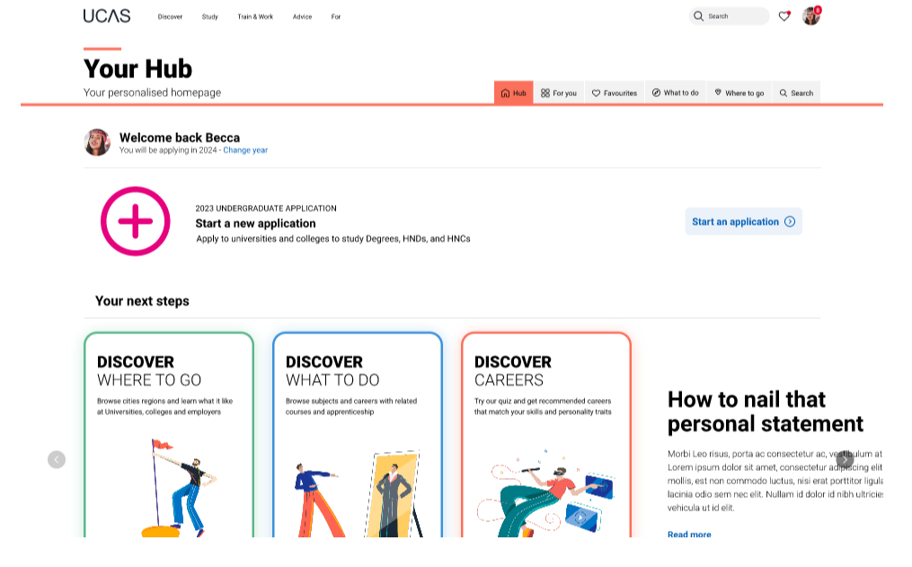
Starting your research
Register with the UCAS Hub to:
explore careers, subjects, places, and apprenticeships
find and favourite over 35,000 courses
search for open days, events and virtual tours
turn predicted grades into UCAS Tariff points
speak to those in the know using Unibuddy
speak to career, higher education, and application specialists by attending Hub lives
take the UCAS Quiz to find your career matches
start your application

Slide 8
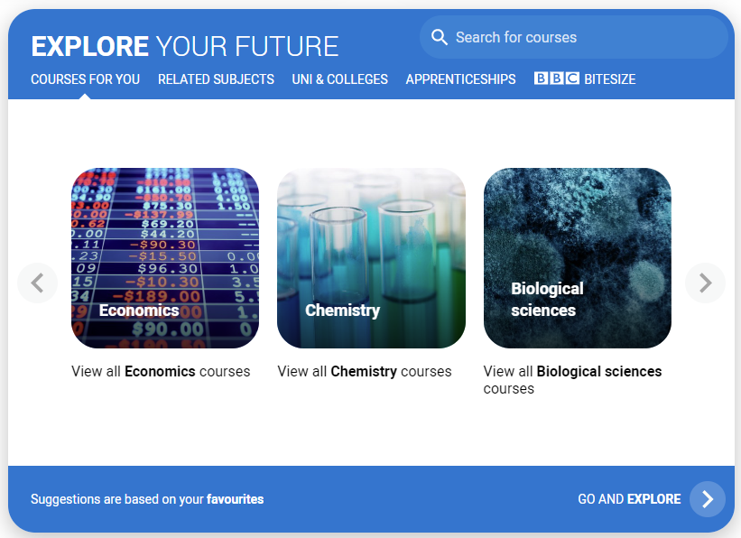
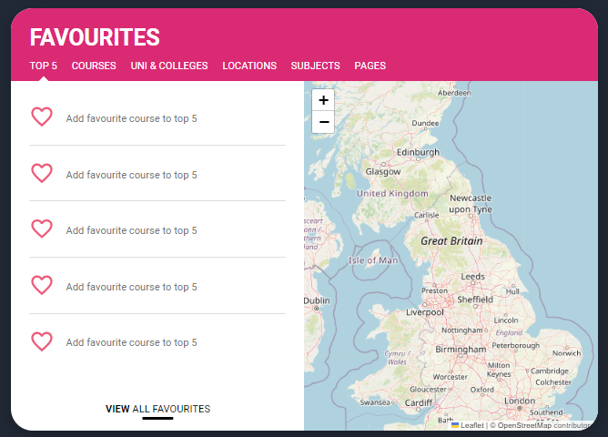
Personalised tools to help
Tools to help
Explore your future
Discover what to do with subject, industry, and career guides; discover where to go with city, employer and accommodation information. Explore apprenticeships and course opportunities for you. Favourite as you go.
Your favourites
Search for courses, use to decide your top 5 choices, manage, keep those favourite information pages to hand. Manage and edit at any time.
Security marking: PUBLIC
02 May 2023
| 8

Slide 9
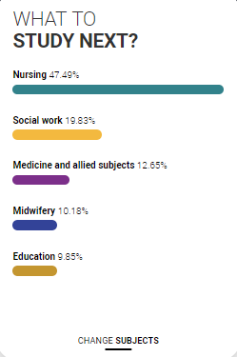
Personalised tools to help
UCAS Quiz
Find job and career ideas matched to your personality.
Plus a list of courses previous students studied in order to get there.
What to study next?
Broaden your horizons by exploring another subject area, that student’s who did your qualification went on to study.

Slide 10
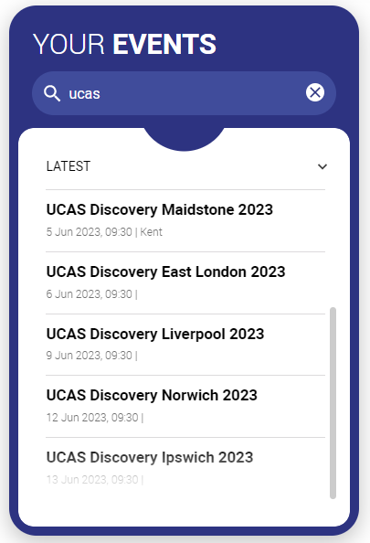
Our advice and events
UCAS Hub lives
Join our live sessions hosted by expert panels.
Ask questions to help you make an informed decision about the right path for you. University, apprenticeships or the world of work.
UCAS Discovery
Events and open days are presented based on your preferences.
Register straight from the Hub for our UCAS Discovery ‘The Big Q&A Tour’, with exciting new zones covering all pathways.

Slide 11
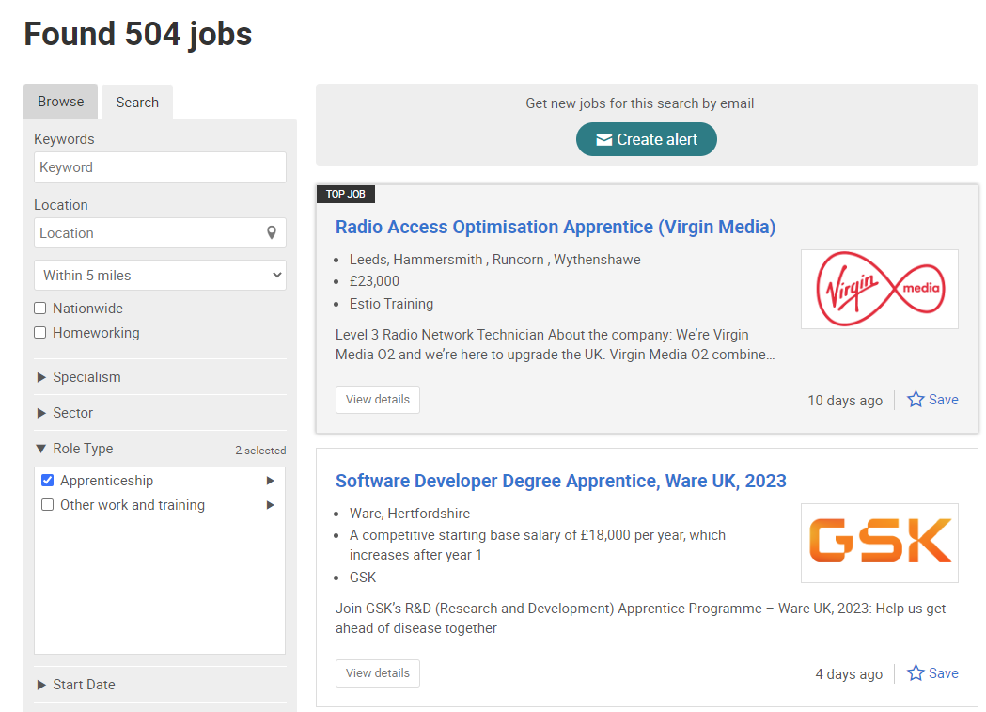
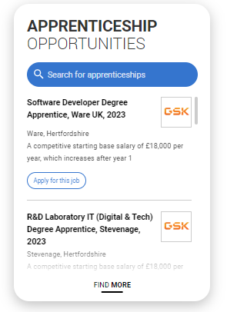
UCAS Exploring Apprenticeships
From UCAS Hub you can easily explore apprenticeships; learn more information and see a live selection of apprenticeship vacancies.
Set alerts to stay up to date.

Slide 12
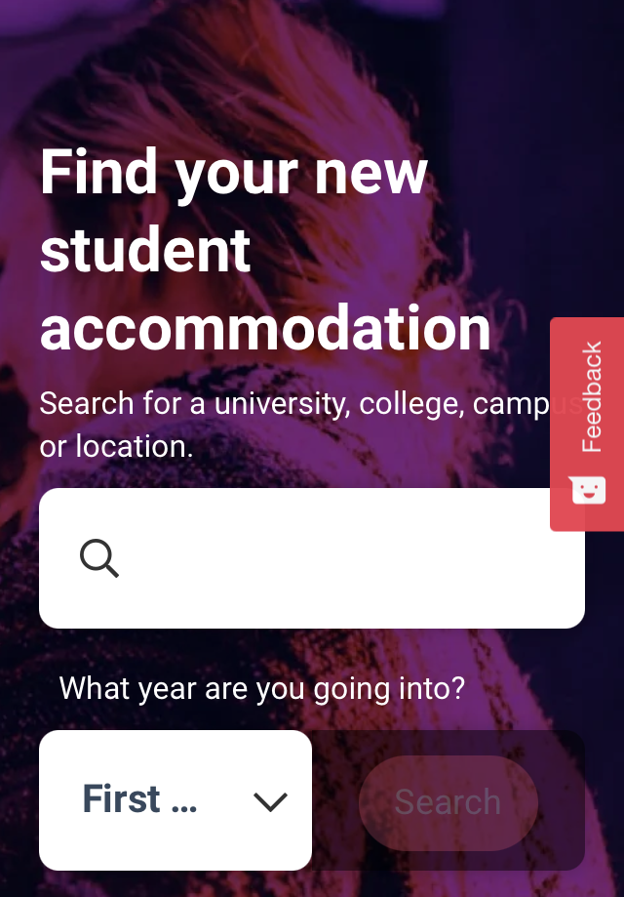
What else do you need?
Accommodation
High on the list when considering where to study, but it’s not always easy to compare what’s on offer. Understand what options there are using our accommodation search.
Personal Statement Builder
Designed to help you think about what to include, and how to lay it all out. It counts how many characters you’ve used, so it’s easy to see when you’re close to the 4,000 character limit.

Slide 13
Our support
@ucas_online
UCAS Customer Experience Centre:
0371 468 0 468
From outside the UK:
+44 330 3330 230
Monday to Friday
08:30 – 18:00 (UK time)
@ucas_online
@ucas_online
@ucas
@UCASonline
Security marking: PUBLIC
02 May 2023
| 13
Security marking: PUBLIC
02 May 2023
| 13

Slide 14
Thank you
Security marking: PUBLIC
02 May 2023
| 14

