Slide 1
Applying through UCAS
Last updated April 2022

Slide 2
By the end of this presentation, you will be able to:
identify what resources are available to support you
explain how to apply to a UK university or college
list the dates you need to send your application by
know how to follow your application and reply to offers

Slide 3
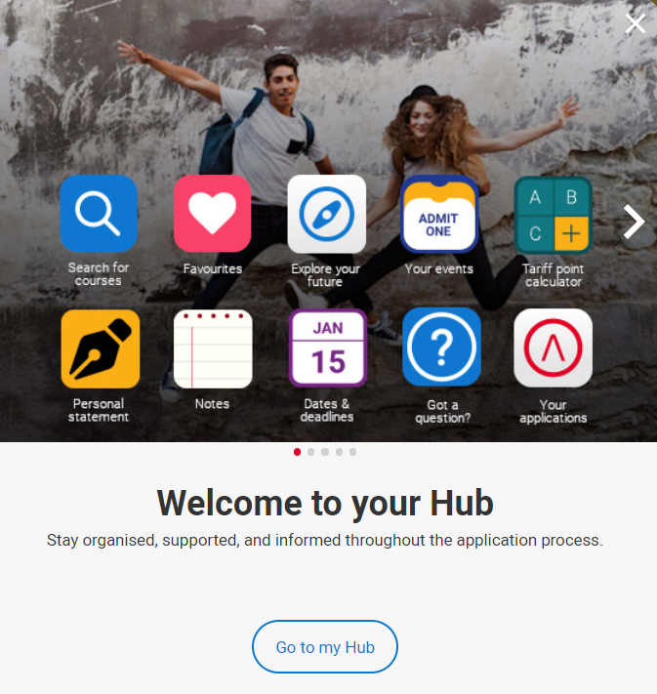
Starting your research
Register with the UCAS Hub to:
explore careers, subjects, places, and apprenticeships
find and favourite over 35,000 courses
search for open days, online events and virtual tours
turn predicted grades into UCAS Tariff points
speak to those in the know using Unibuddy
speak to career, higher education, and application specialists by attending the Hub lives
take the UCAS Quiz to find your career matches
start an application for 2023 entry (from May 2022)

Slide 4
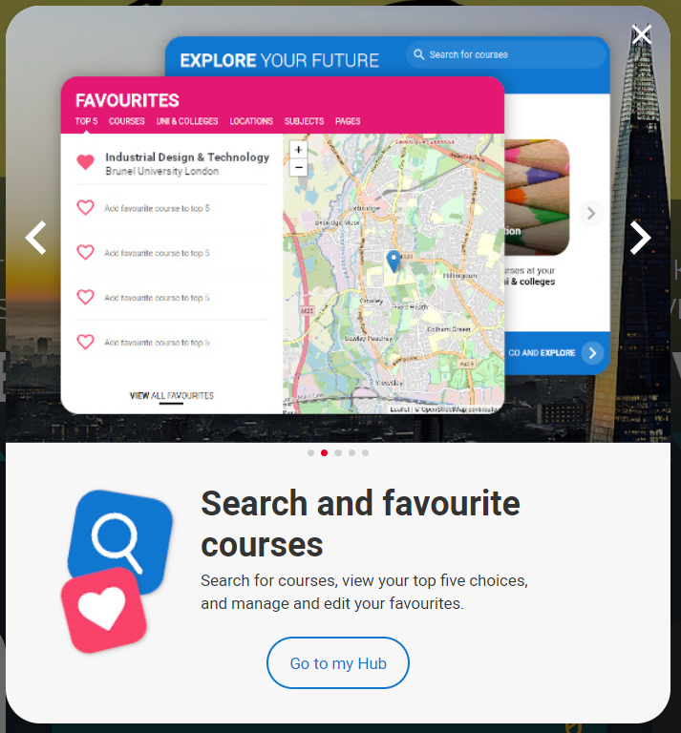
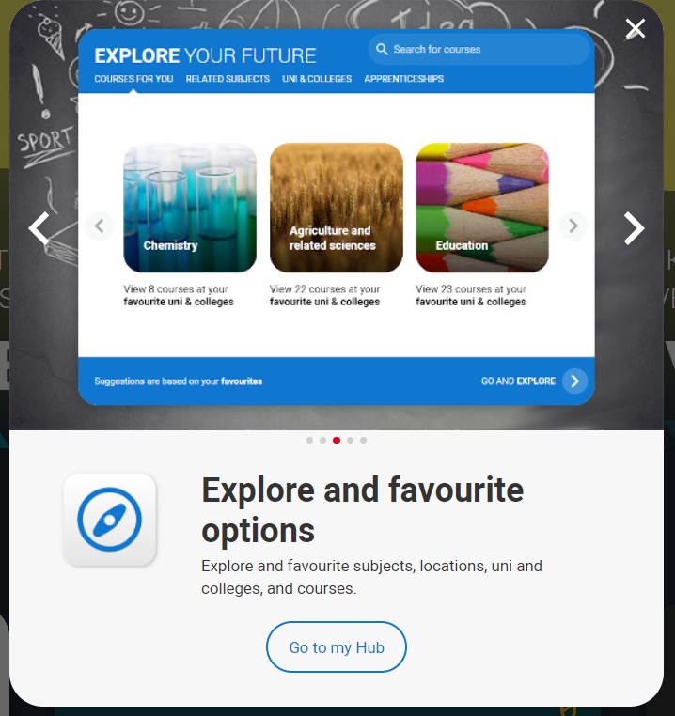
Tools to help
Tools to help

Slide 5
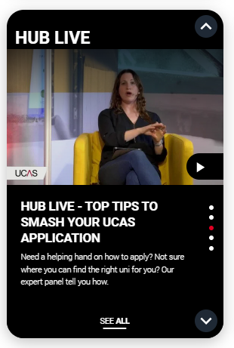
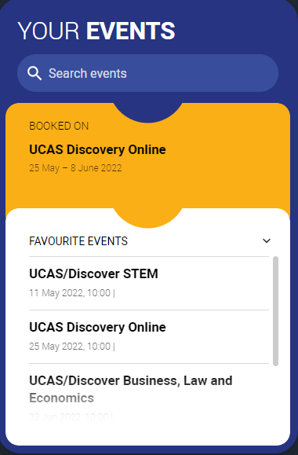
Tools to help
UCAS Hub lives
Join our live sessions hosted by expert panels.
Ask questions to help you make an informed decision.
UCAS Discovery
Talk to subject and admissions experts, discover apprenticeships, find advice on applying, and more!
Discover a world of opportunities.

Slide 6
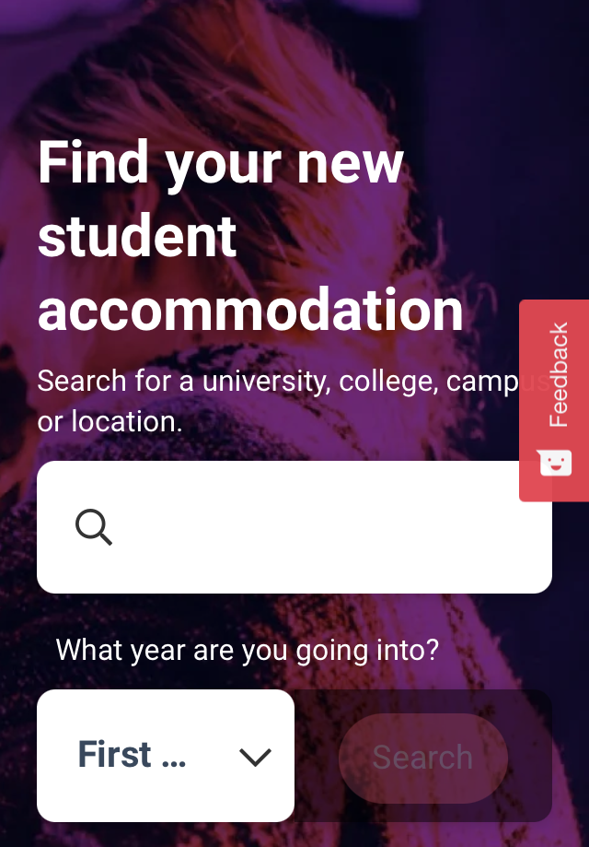
Tools to help
UCAS Quiz
Find job and career ideas matched to your personality.
Plus a list of courses previous students studied in order to get there.
Accommodation
High on the list when considering where to study, but it’s not always easy to compare what’s on offer.
Understand what options there are using our accommodation search.

Slide 7
Choosing the right place for you
Style – from traditional, with a focus on subject-based courses and research, to modern universities/colleges, with a greater focus on vocational courses.
Location – some are in large cities, others in small towns, by the coast or in the countryside – it’s all a major influence on the environment and lifestyle.
Size – larger universities can have more than 20,000 students, whereas some of the smallest have only a few thousand.
Culture and facilities – influenced by a range of factors, including the diversity of students who attend.
What graduates do – all universities collect destination statistics; it can be useful to find out what jobs or further study students go on to.
Tuition fees – can vary between universities and colleges; check if there are scholarships or bursaries available.
Living costs – accommodation, transport, and food can vary enormously.

Slide 8
Choosing the right course for you
What does the course cover?
Courses with the same title may be very different.
Look carefully at the core course content, and the range of optional studies/modules available.
Which modules are the most interesting and relevant to your career aspirations?
See if the course or university/college offers any internship, placement, or study abroad opportunities.
How is the course taught – structured teaching, or more independent research? How many lectures are there, and how much group work will be done in seminars?
How is the course assessed?

Slide 9
When to apply for 2023 entry
3 May
UCAS Undergraduate application opens for 2023 entry.
6 September
First day UCAS can receive a completed application to process.
15 October
UCAS application deadline for courses in medicine, veterinary medicine/science, and dentistry, and courses at Oxford or Cambridge.
25 January
UCAS equal consideration application deadline.
23 February
UCAS Extra opens.
30 June
Last date for applications before Clearing opens.
Security marking: PUBLIC
22 September 2022
| 9

Slide 10
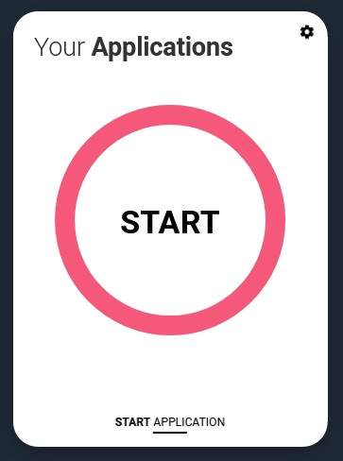
Key facts
To start an application you need a UCAS Hub account.
Register for a UCAS Hub account at any time.
From 3 May 2022 you’ll be able to ‘Start’ your application in your UCAS Hub.
You have up to five choices, unless applying to study medicine, veterinary, medicine/science, dentistry – then it’s four choices.
You can’t apply to BOTH Oxford and Cambridge.
Applying costs £22.50 for 1 choice, or £27 for multiple choices.
Apply by the equal consideration date.
Universities and colleges can’t see your other choices when you apply.

Slide 11
Linking to a school
If you’re applying with the help of a school, college or centre you should enter their ‘buzzword’ to link your application to them.
The buzzword is a unique code set by your school, college or centre.
By linking your application you’re giving your school, college or centre permission to view and track your application.
It also means they’ll provide you with a reference, and send your application to UCAS on your behalf.

Slide 12
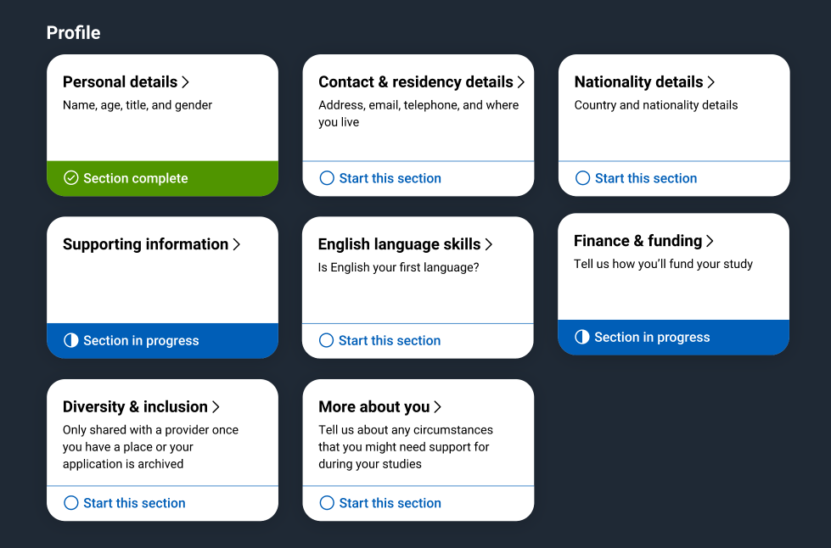
Application
Profile:
Personal details
Contact and residency details
Nationality details
Supporting information
English language skills
Finance and funding
Diversity and inclusion*
More about you
* (for students with a UK home address)
Security marking: PUBLIC
22 September 2022
| 12

Slide 13
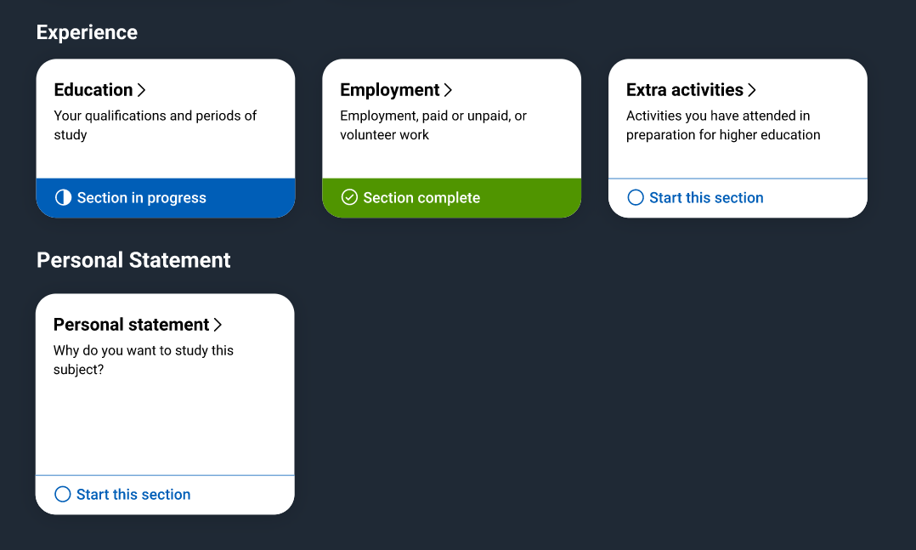
Application
Experiences:
Education
Employment
Extra activities*
Personal statement
Reference**
Add choices – up to five
*(for students with a UK home address)
**(not visible for students linked to their school/college)

Slide 14
The personal statement
The only section you have full control over
Your only chance to market yourself as an individual
UCAS’ similarity detection service:
every personal statement is run through software to check for plagiarism.
The same for all of your choices
A maximum of 4,000 characters, or 47 lines
A minimum of 1,000 characters
There isn’t a spelling or grammar check
No formatting allowed
Security marking: PUBLIC
22 September 2022
| 14

Slide 15
Start early
Include:
academic achievements, past and present
why you’re interested in the subject area
your knowledge of the subject area
your enthusiasm to go beyond the syllabus
what you enjoy about studying
details of your independent study skills
Security marking: PUBLIC
22 September 2022
| 15

Slide 16
Consider…
Universities and colleges will consider:
Have you chosen the course for the right reasons?
Can you achieve in a new learning environment?
Do you have a range of interests and aptitudes?
Do you have a depth of interest in the subject?
Have you studied independently?
Do you appear motivated and committed?
Do you have good numeracy and literacy skills?
Security marking: PUBLIC
22 September 2022
| 16

Slide 17
Decisions
Universities and colleges will review the:
They may also ask for:
personal statement
admissions test
qualifications
interview
reference
portfolio/audition
Security marking: PUBLIC
22 September 2022
| 17

Slide 18
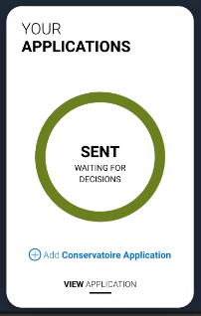
Tracking your application
Head to your UCAS Hub to follow your application:
follow its progress 24/7
see your choices and personal information
view your offers
reply to offers online
You’ll receive one of three decisions from your choices:
unconditional offer
conditional offer
unsuccessful
Security marking: PUBLIC
22 September 2022
| 18

Slide 19
Replies to offers
Once you have decisions on all your choices, you can choose two:
One as a ‘firm’ acceptance – your first choice.
The other as an ‘insurance’ acceptance. This acts as a back-up if you do not get into your ‘firm’ choice.
Any remaining offers must be declined.
Once all your decisions and replies have been made, if you are not holding an offer, you may be able to use Extra or Clearing to find available places.
Security marking: PUBLIC
22 September 2022
| 19

Slide 20
Other options
Extra (23 Feb – 4 Jul)
Used all five choices and had no offers.
Add Extra choices for consideration one at a time.
Clearing (5 Jul – 17 Oct)
Apply after 30 June, receive no offers, decline all offers, not met conditions.
Find vacancies from 5 July and add a Clearing choice to your application.

Slide 21
Additional help
UCAS Customer Experience Centre:
0371 468 0 468
From outside the UK:
+44 330 3330 230
Monday to Friday, 08:30 – 18:00 (UK time)
Stay up to date online at:
facebook.com/ucasonline
twitter.com/UCAS_online
Security marking: PUBLIC
22 September 2022
| 21

Slide 22
Thank you
Security marking: PUBLIC
22 September 2022
| 22

