Slide 1
Applying through
UCAS
For courses starting in 2023
Updated: 06 September 2022

Slide 2

Using this slide deck
This presentation deck has been designed to allow teachers and advisers to share the application journey with students.
The information relates to the opening of the 2023 application cycle.
You can copy and paste the screenshots included into your own materials and guides to support students. However please note the help text and question guidance in the application is frequently updated based on student feedback. As such, some screenshots will change, and we will update this slide deck periodically.
Find more help and advice on filling in the undergraduate application on ucas.com.

Slide 3
Registering for an account.

Slide 4

Registering for an account
Head to ucas.com and select Sign in.

Slide 5
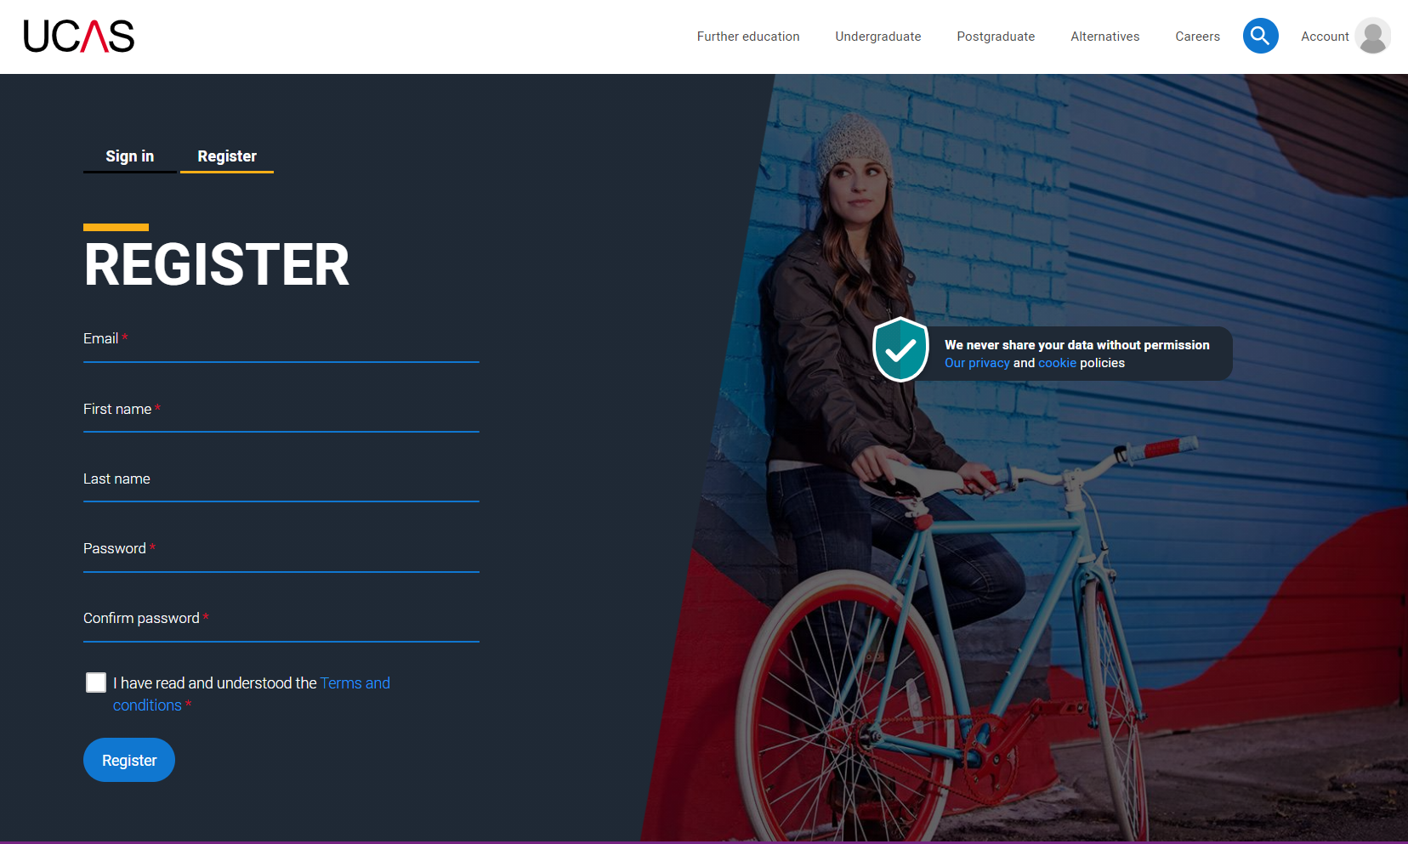
Registering for an account
Complete the short form. Make sure the password is memorable.
We recommend you use a personal email address so you have access to updates at all times.

Slide 6
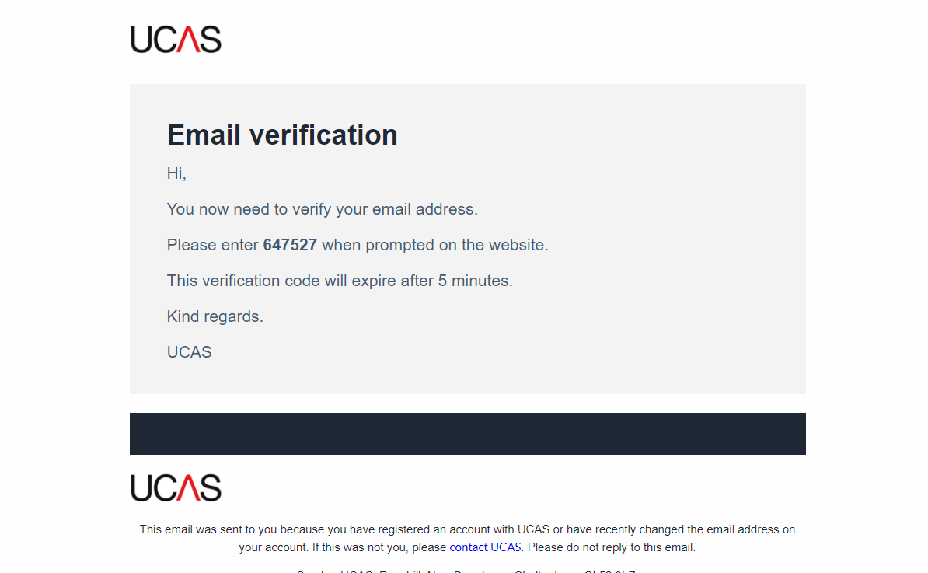
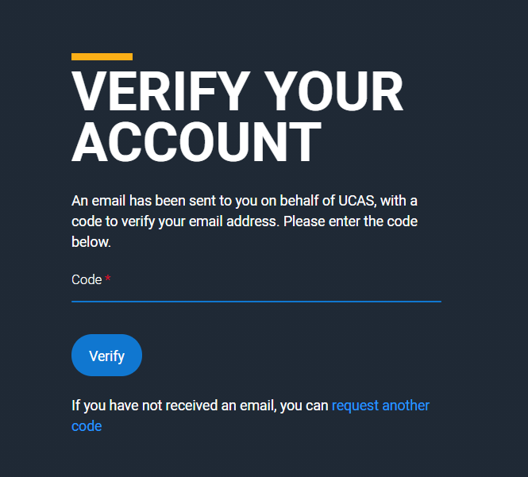
Registering for an account
We’ll email you a code to verify your email address, so we know we’ve got the right details.

Slide 7
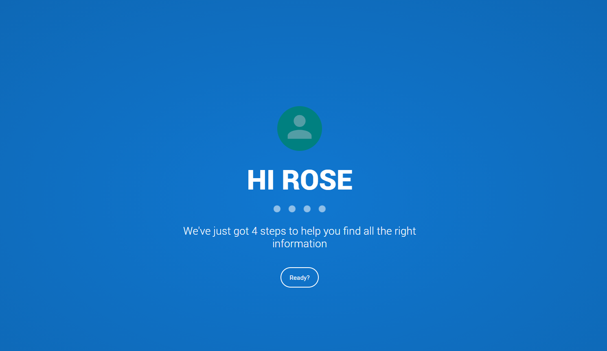
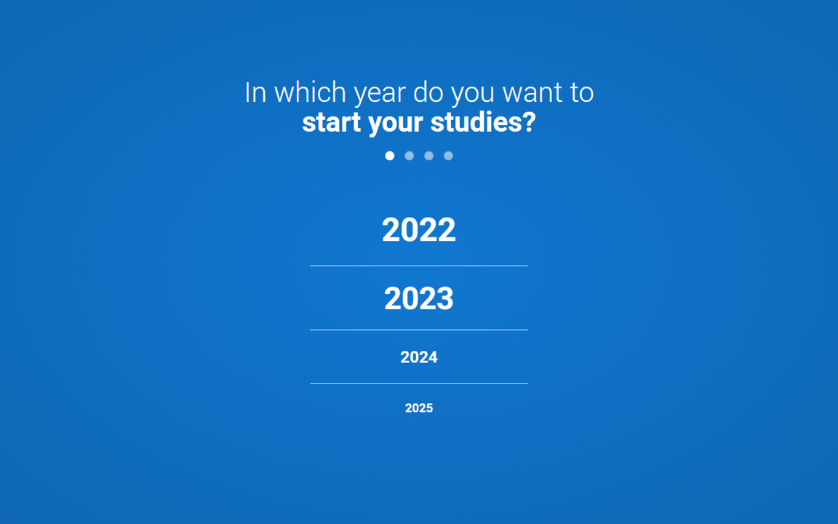
Registering for an account
Once you’ve registered, we ask you a few questions like when you want to start studying, where you live and what you’re interested in so we can tailor the information you see.
Make sure you choose the correct study year, 2023 if you want to start next year, including if you want to defer entry.

Slide 8
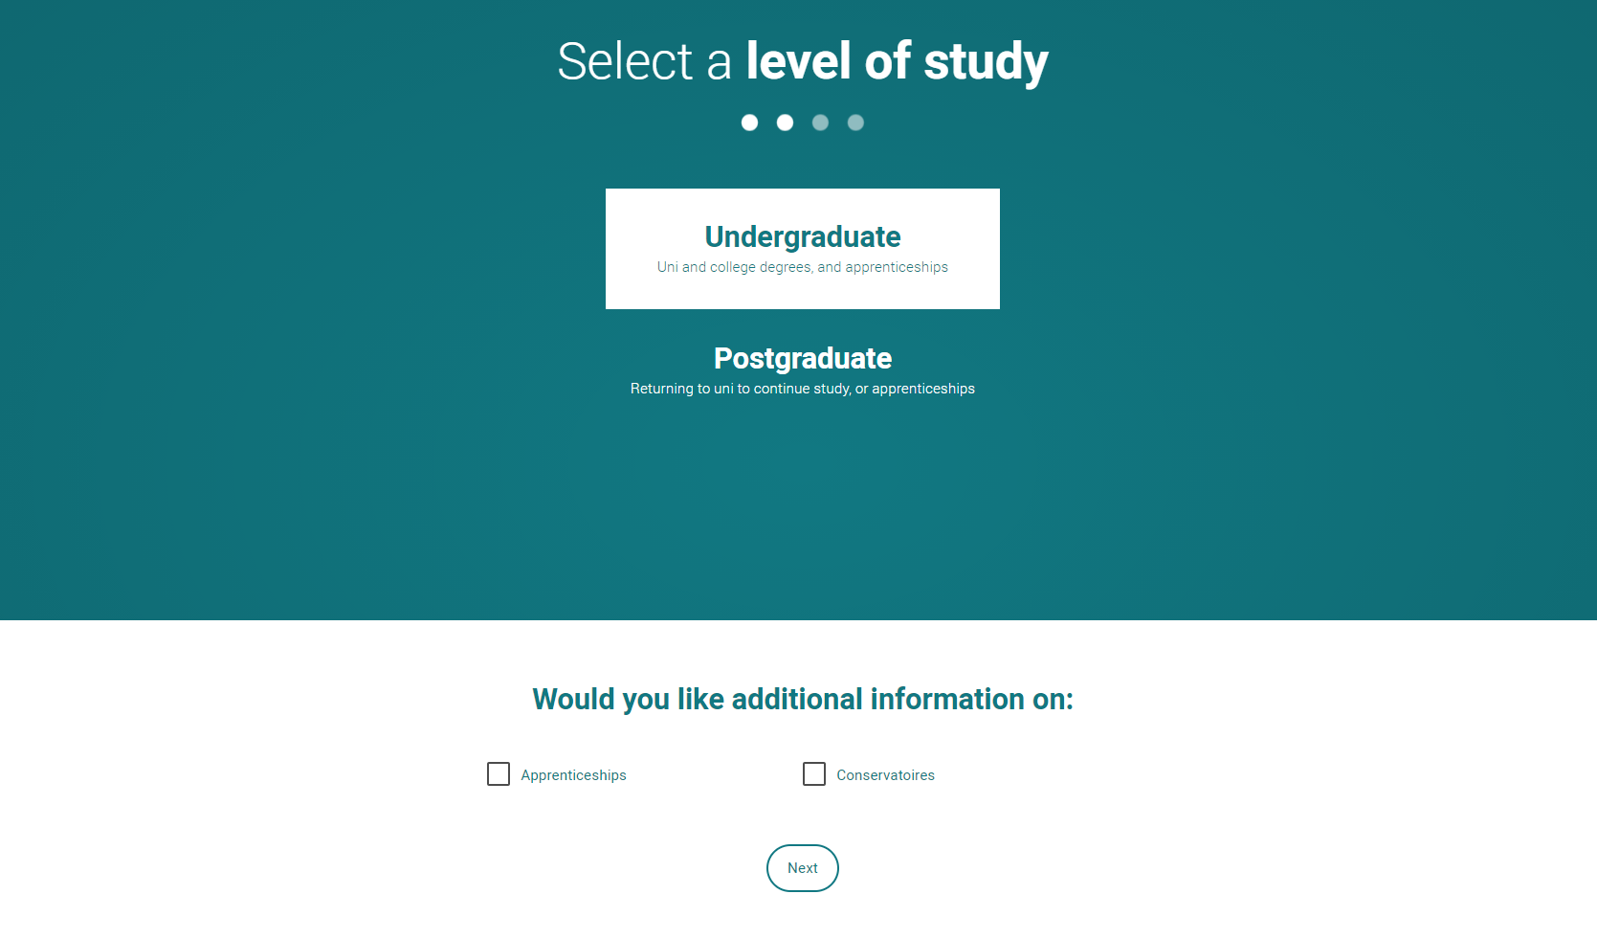
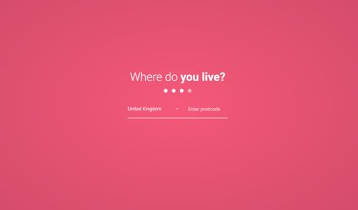
Registering for an account
Choose the correct level of study, it's Undergraduate if you are still at school/college.
You can choose to get information on apprenticeships and conservatoires here too.
Tell us where you live so we can direct you to the right information.

Slide 9
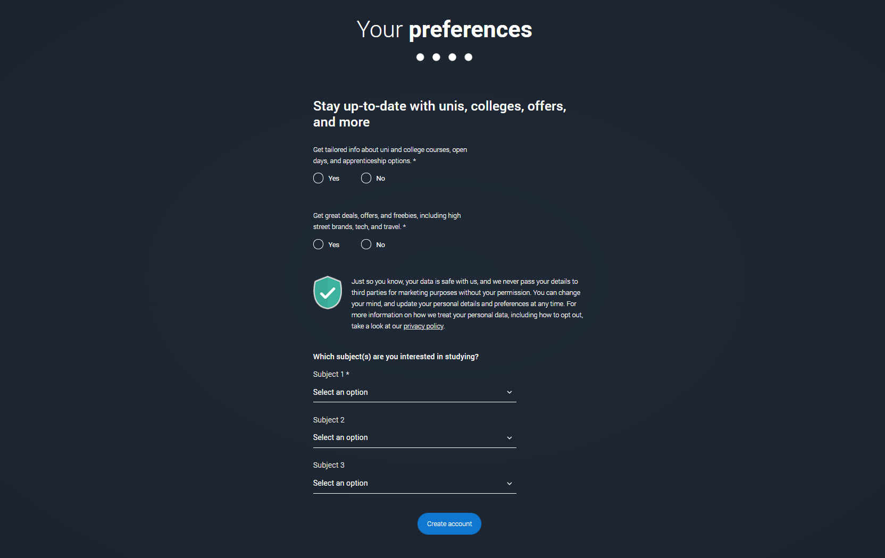
Registering for an account
Choose if you want to get tailored information about uni, college and apprenticeship options.
Select the subjects that you are interested in – you can change these at any point in your preferences.

Slide 10
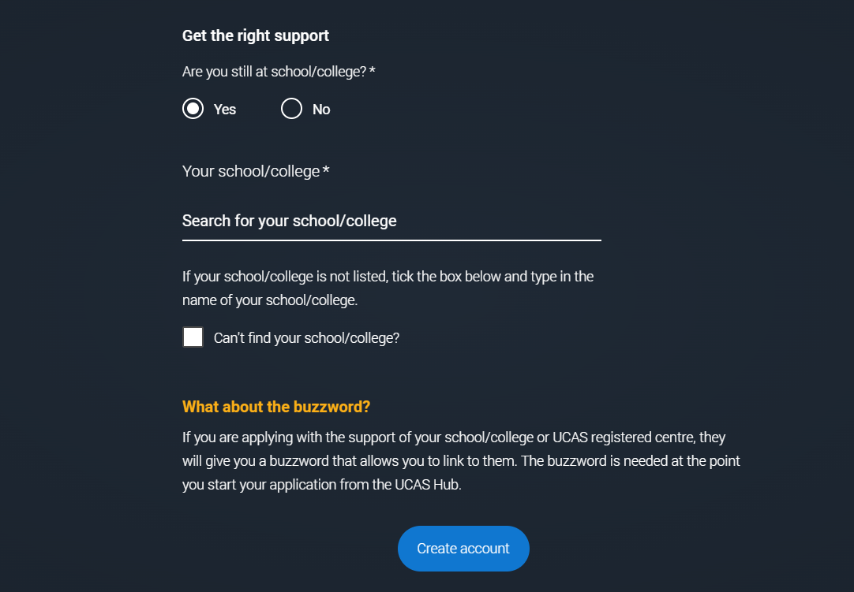
Registering for an account
Search for your school/college, if you can’t find it then you can type in the name.
You will also need to enter your school/college buzzword at the point you start your application.
Then scroll right to the bottom to Create account.

Slide 11
Starting your application.

Slide 12
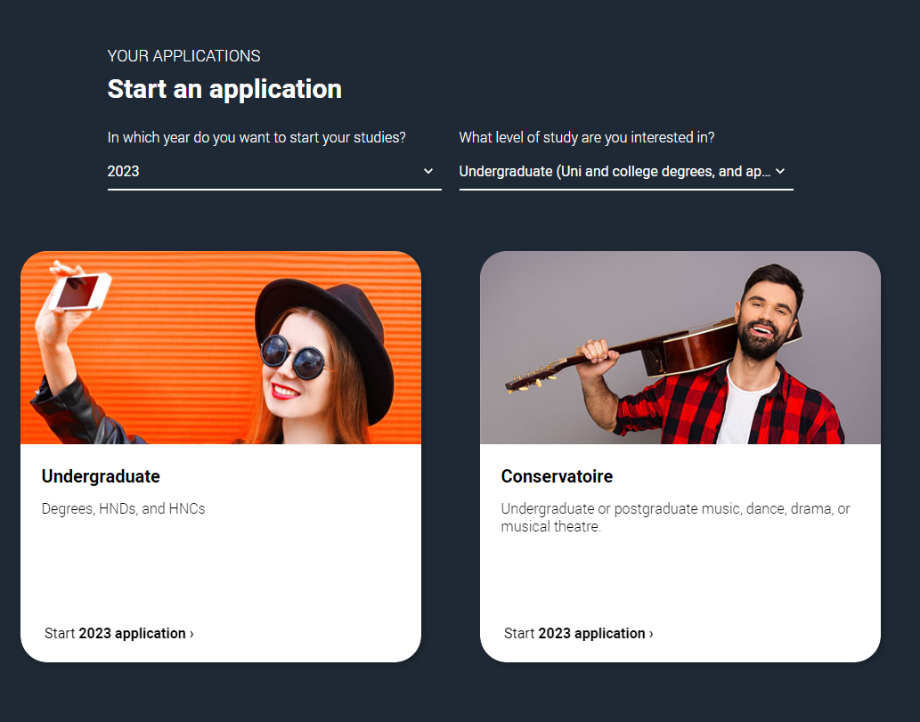
Starting your application
Choose the year you want to start your studies, level of study (it's Undergraduate if you are still at school/college) and type of application you wish to make.
Make sure you choose 2023 if you want to start next year, including if you want to defer entry.

Slide 13
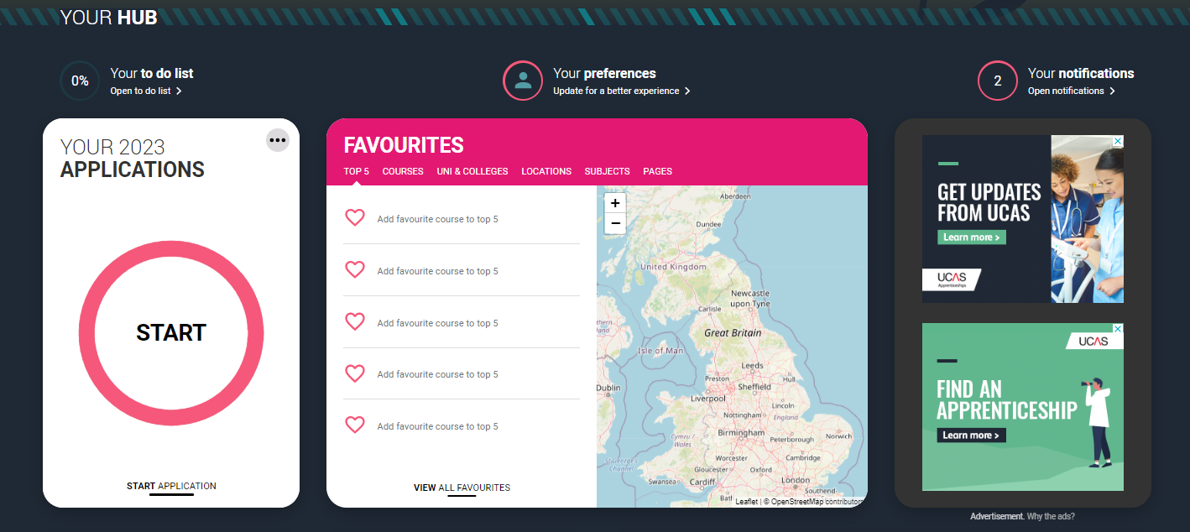
Starting your application
To start your UCAS application click on the ‘Your 2023 applications’ tile.

Slide 14
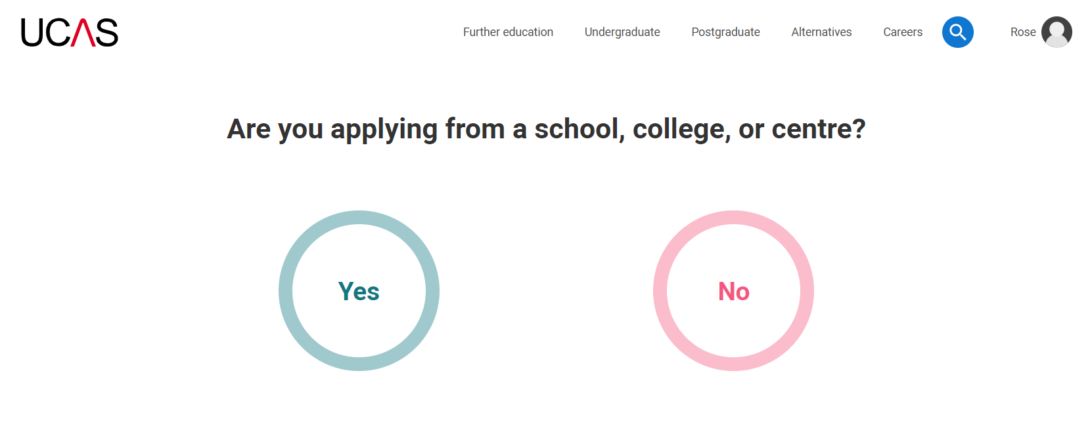
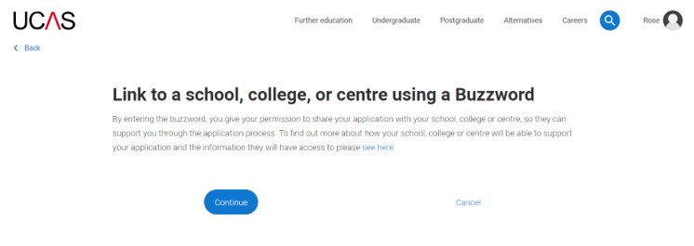
Linking to your school, college or centre
If you're applying with the help of your school, college or centre then select ‘Yes’.
You will then need to enter the Buzzword.
The Buzzword is given to you by your school, college or centre.

Slide 15
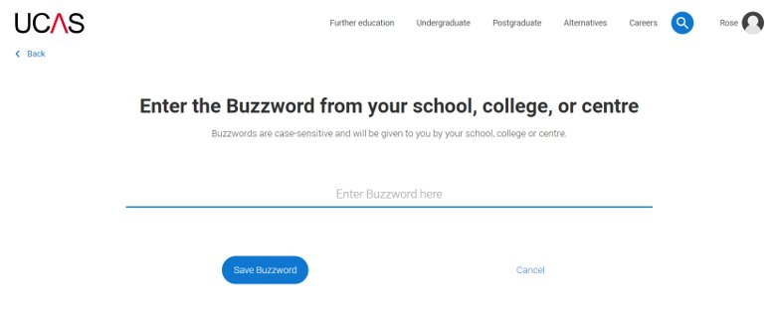
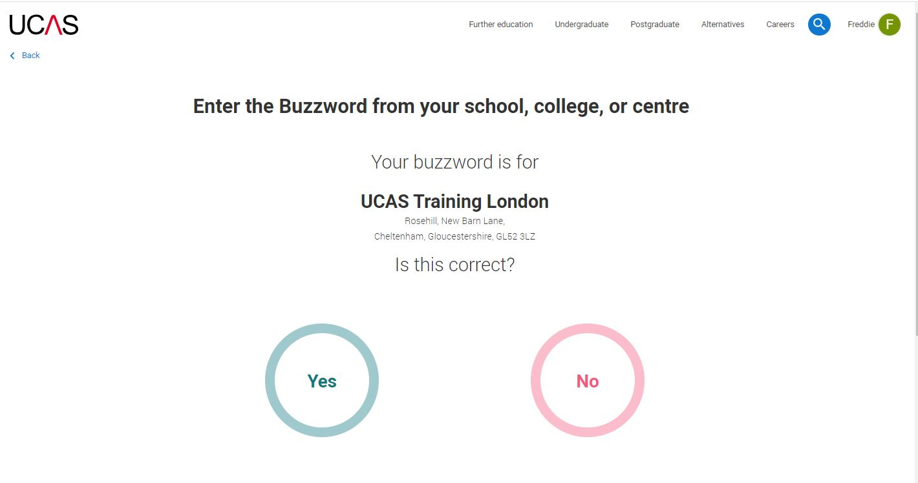
Linking to your school, college or centre
Enter the buzzword, and confirm the details are correct.
This will link your application to your school or college, so they can track your progress and provide support, including adding your reference.

Slide 16
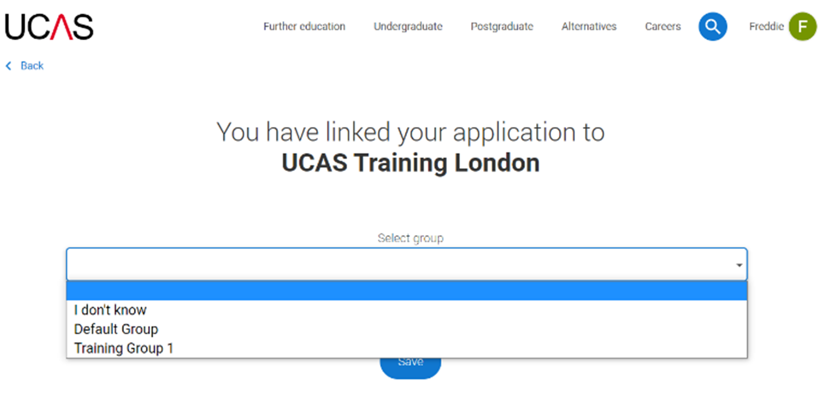
Linking to your school, college or centre
Once your application has been linked, you can then select a group (if this has been set up by your school or college) for your application.

Slide 17
Application overview.

Slide 18
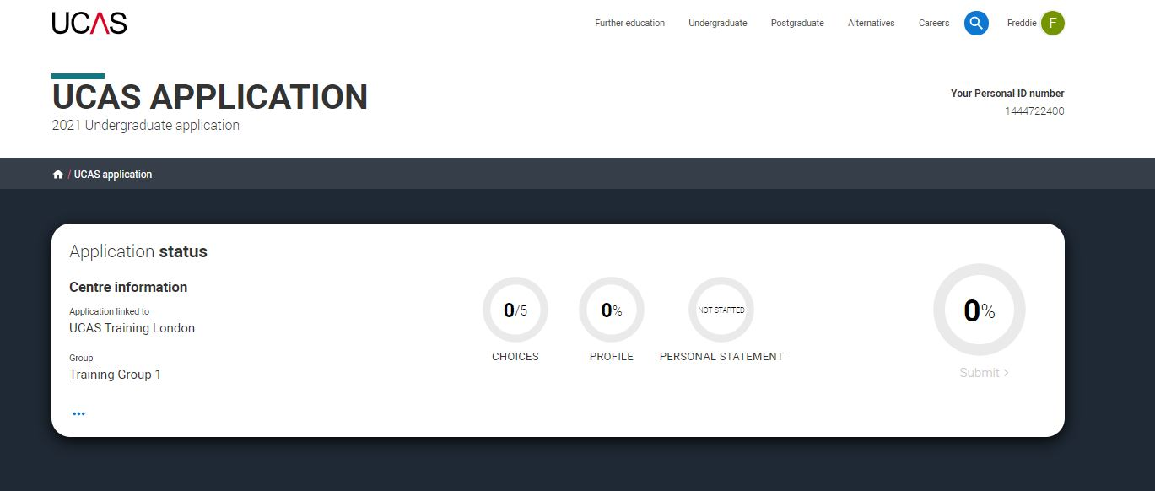
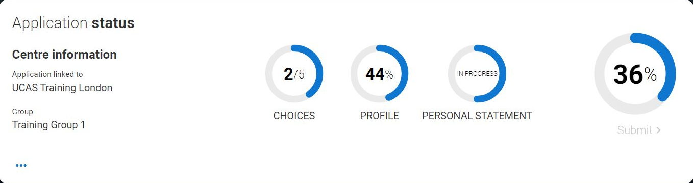
Application overview
Your ‘Application status’ helps you keep track of your progress.
As you add information to each tile, the percentage complete updates each time you mark a section as complete.
You don’t need to complete the application straight away, you can log in and out at any time until you're finished.

Slide 19
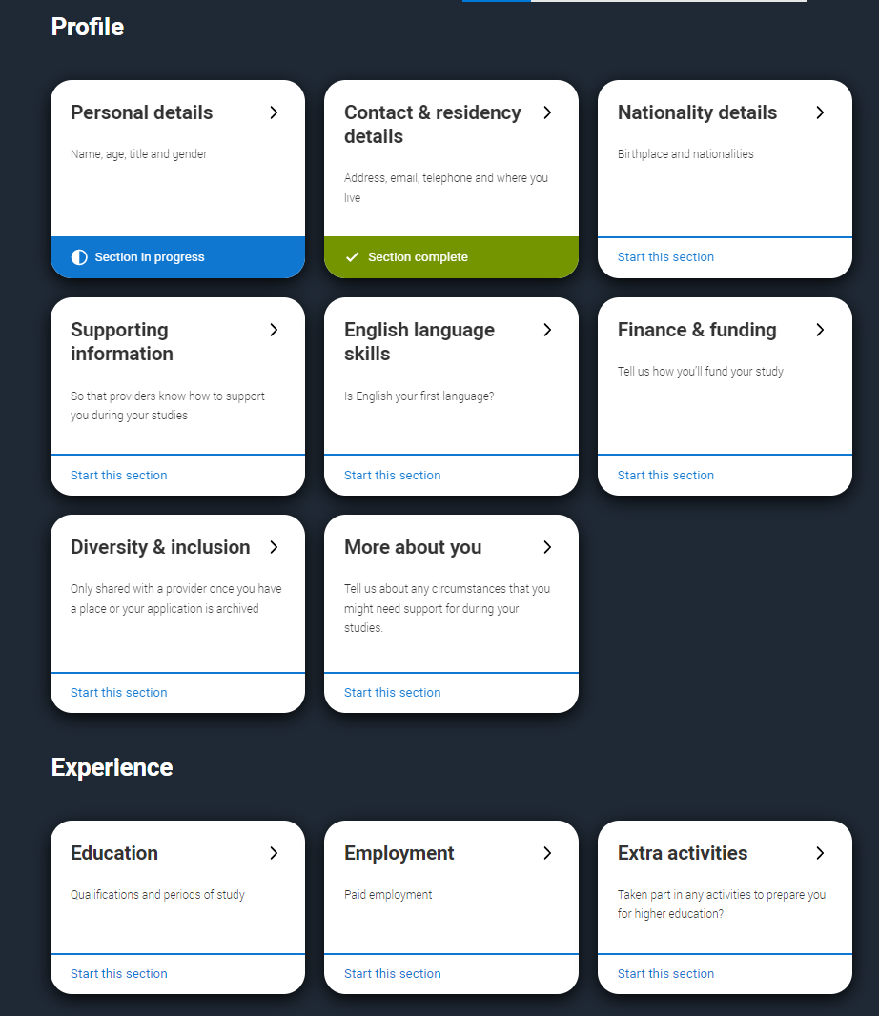
Application overview
The application form is responsive to make it easier to complete.
Once you’ve completed ‘Contact & residency details’ if your permanent residence is in the UK, you’ll also see the ‘Diversity and inclusion’ and ‘Extra activities’ sections to complete.
All sections must be marked as ‘Complete’ to send to your school or college that you may be linked to for review. You must complete all mandatory questions to mark a section as complete (they have a *).

Slide 20
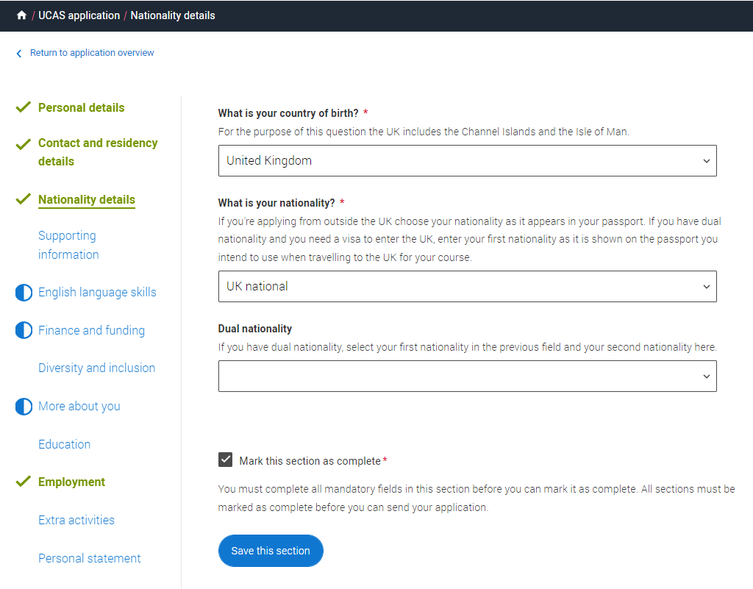
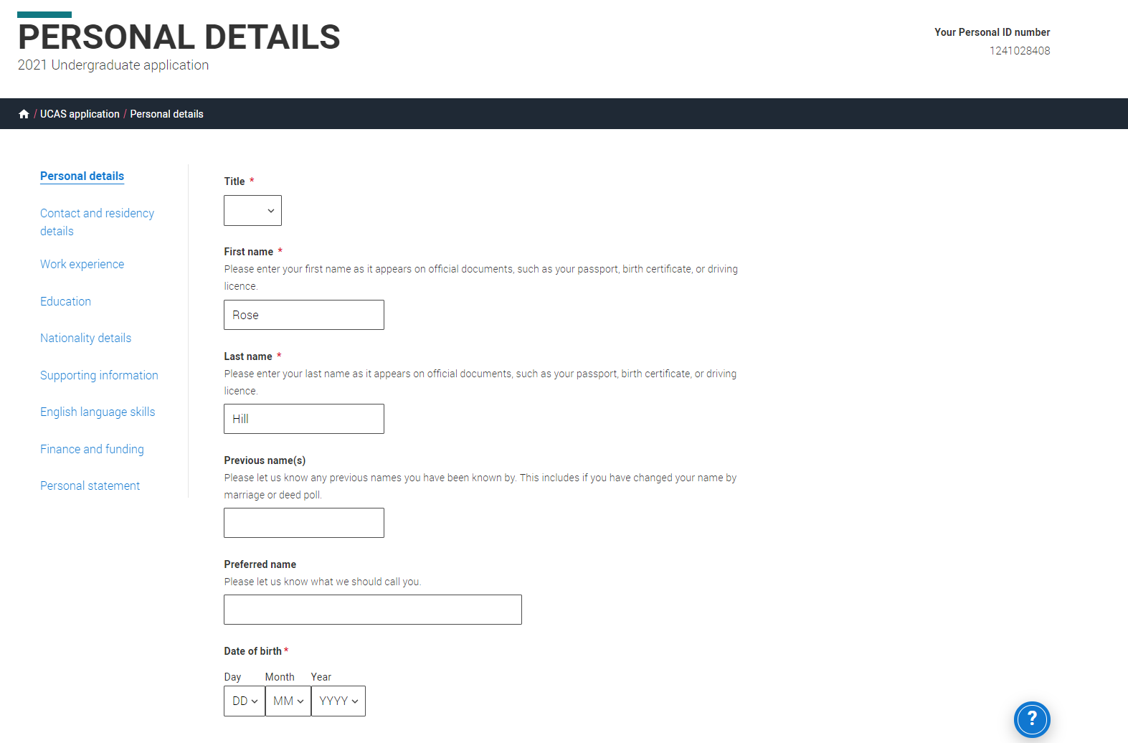

Application overview
The list on the left of each section will show which sections are completed (with a tick), which are in progress (with a half-moon) and which have yet to be started (no icon).
Click on the throughout for help text to provide advice about what to put.

Slide 21
Personal details.

Slide 22
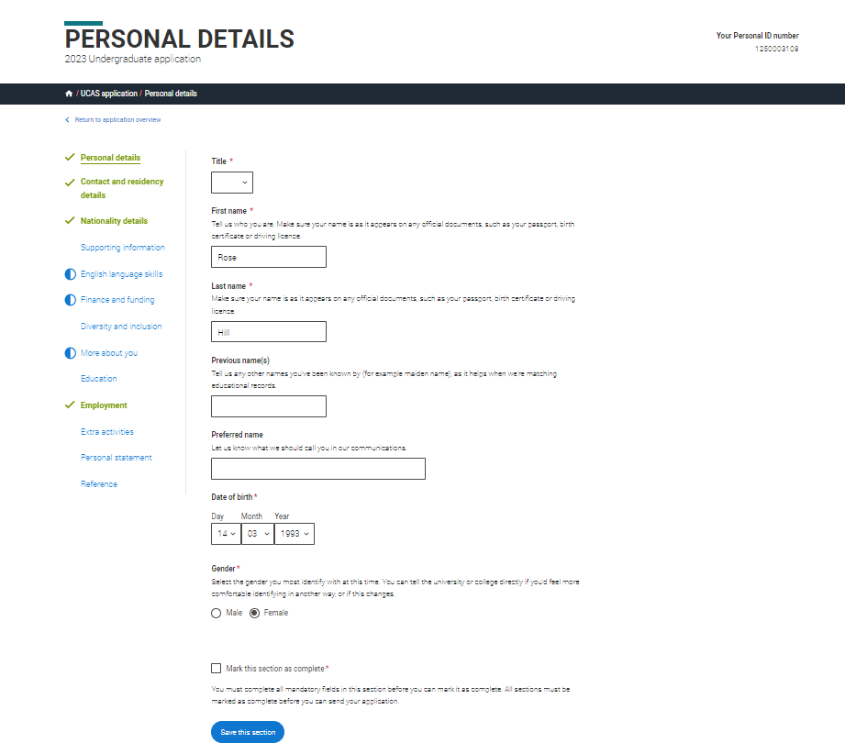
Personal details: your name should already be visible, but you'll need to add your title and complete the other mandatory fields (marked with a *).
Once you have completed a section you must remember to mark the section as complete and save it at the bottom of each page.

Slide 23
Contact and residency details.

Slide 24
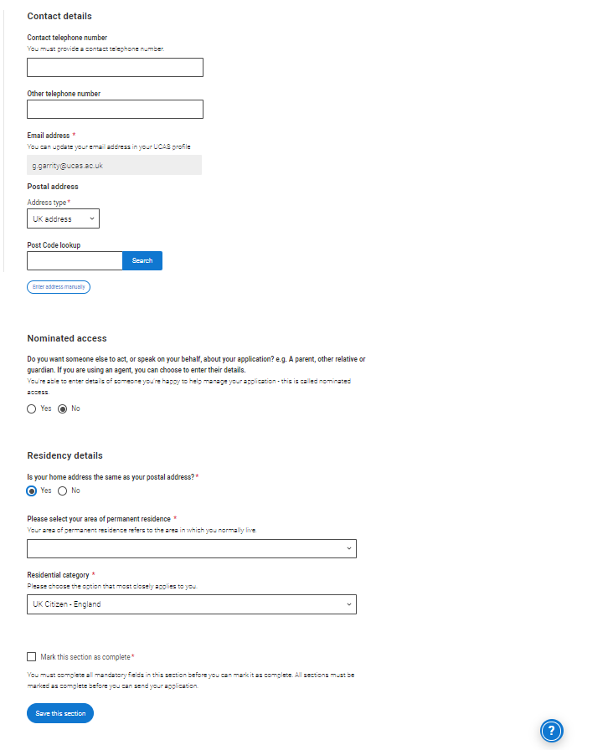
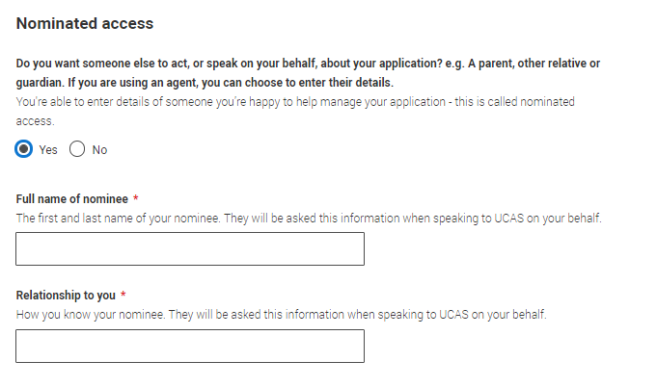
Your email will be used by both UCAS and your choices to update you. If you're using a school/college email address make sure you can access it at all times so you don’t miss anything important. We would advise using a personal email address.
You'll only see the fields to add the nominated contact details if you answer Yes to the question.
This means someone else can speak to us about your application.
Security marking: PUBLIC
| 24

Slide 25
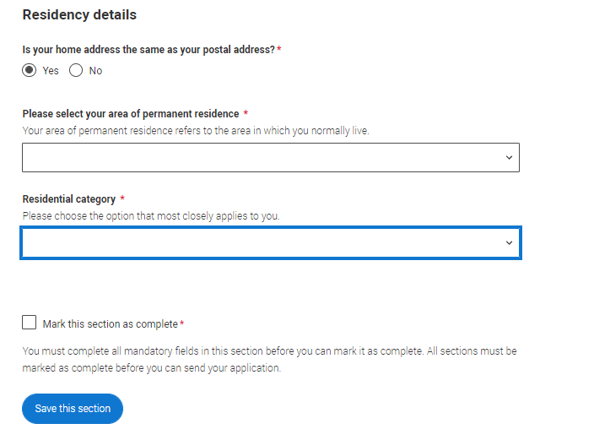
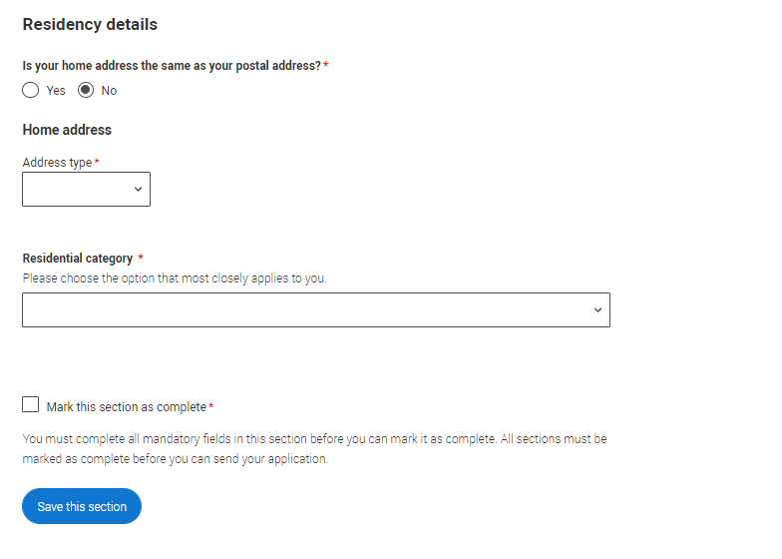
If you select No, additional Home address questions will appear. Remember to use our help text for advice about this question if you are unsure what to enter.
Security marking: PUBLIC
| 25

Slide 26
Nationality details.

Slide 27
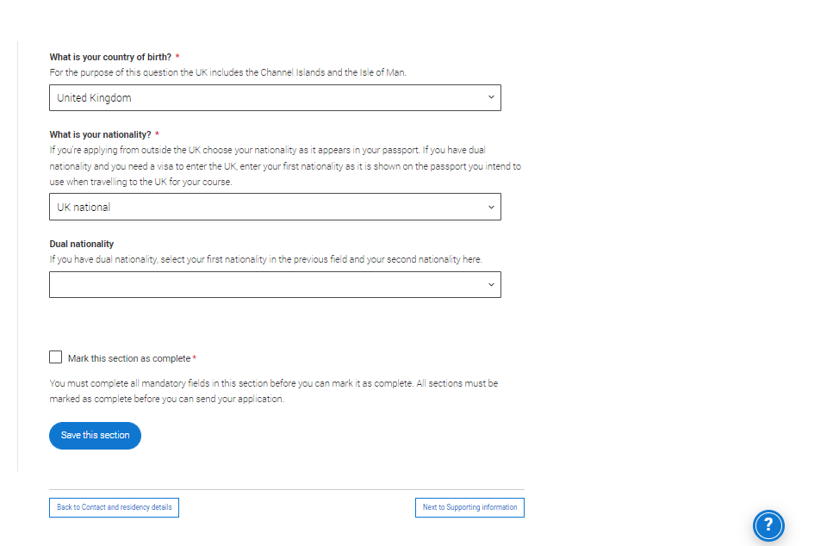
If you’re a UK national, this is what you will see.

Slide 28
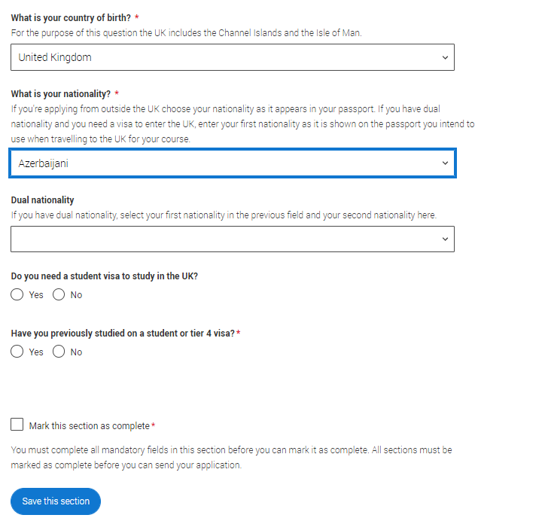
If you were born in the UK but have a different nationality, you will be asked additional questions.
The information you provide will help universities and colleges in determining your eligibility and allow them to assist you with the visa application process, if required.
There's some possible combinations but we'll only show relevant fields depending on your answers.

Slide 29
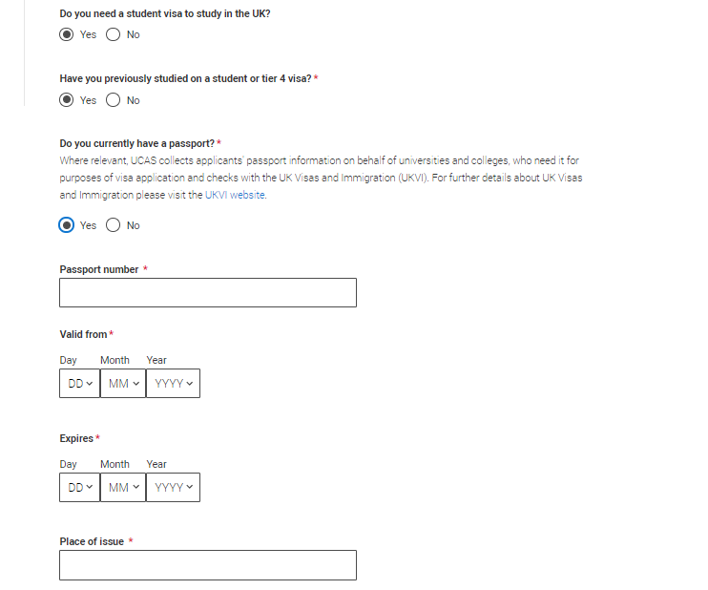
If you select you will need a visa, you’ll also be asked for your passport details.
If you have a passport, we ask you for your passport number, valid from and expiry dates; and place of issue.
Select the H to see our help text with advice abo.

Slide 30
Supporting information.

Slide 31
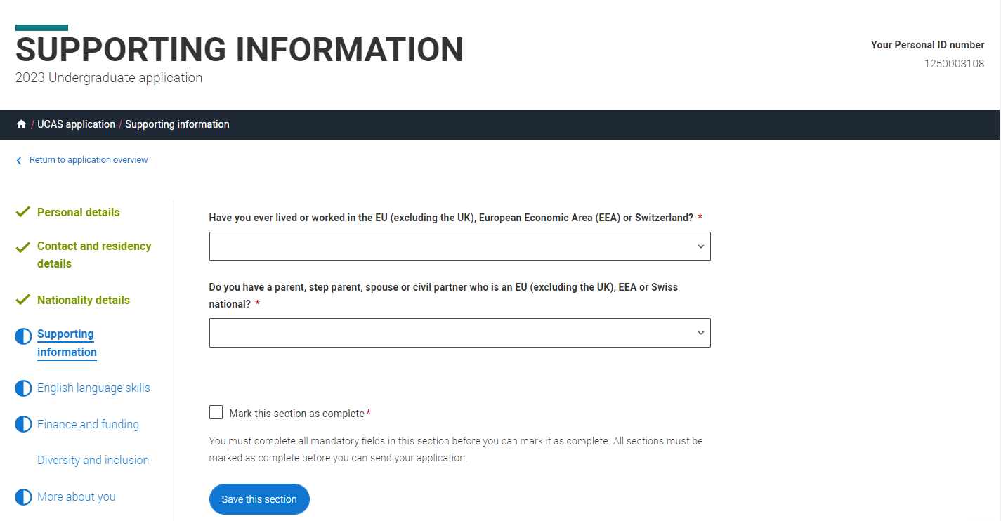
All questions are mandatory (*), but you have the option of don't know and Prefer not to say.

Slide 32
English Language Skills.

Slide 33
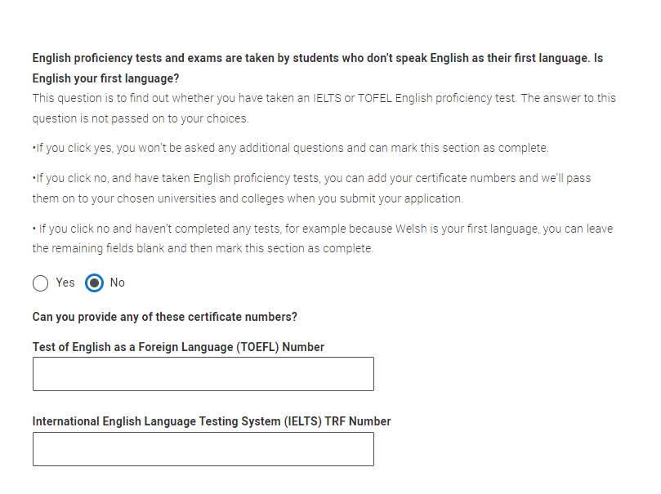
If English isn't your first language, and you have taken English proficiency tests, you can add your certificate numbers and we’ll pass them on to your chosen universities and colleges when you submit your application.
If you haven’t completed any tests, you can leave the remaining fields blank and then mark this section as complete.

Slide 34
Finance and funding.

Slide 35
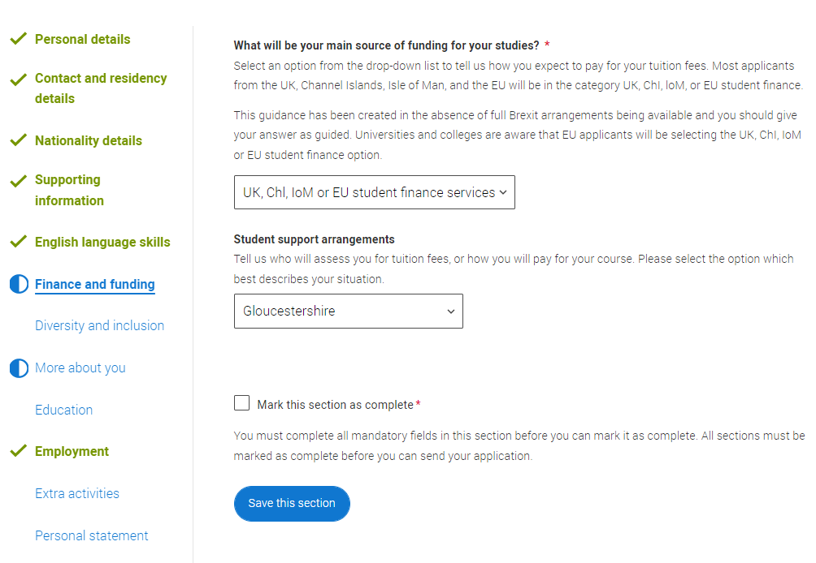
You will only be asked further questions in finance and funding if you select UK, ChI, IoM or EU Student Finance Services.
We'll ask you for your local authority under ‘Student support arrangements’.
For more information head to: ucas.com/finance
Security marking: PUBLIC

Slide 36
Diversity and inclusion.

Slide 37
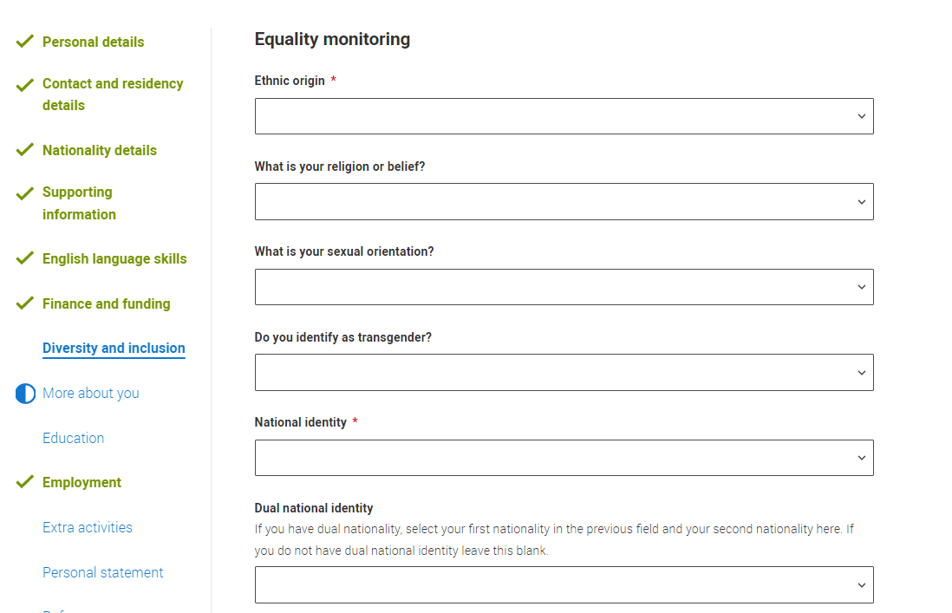
You’ll only see these questions if you have a UK home address.
There are two mandatory fields(*), but you have the option to respond with I prefer not to say.
This information is only shared with universities or colleges once you have secured a place, it does not influence any decision making. It’s used to ensure applications are treated fairly.

Slide 38
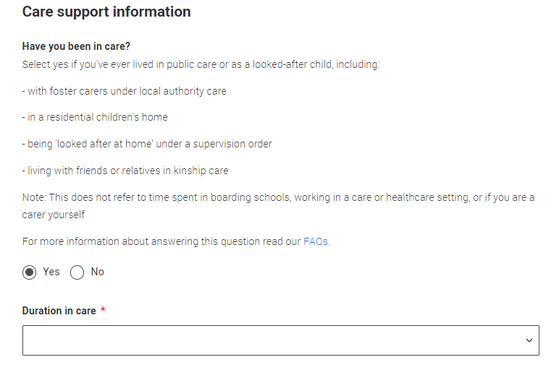
Growing up in care means you are entitled to a range of practical support; for example during your application, financial assistance, year-round accommodation, or help with managing your health and wellbeing.
When you give this information, you are letting the university or college know that you may need additional support during your studies. They may get in touch to tell you more about the benefits and options available, if you want it.

Slide 39
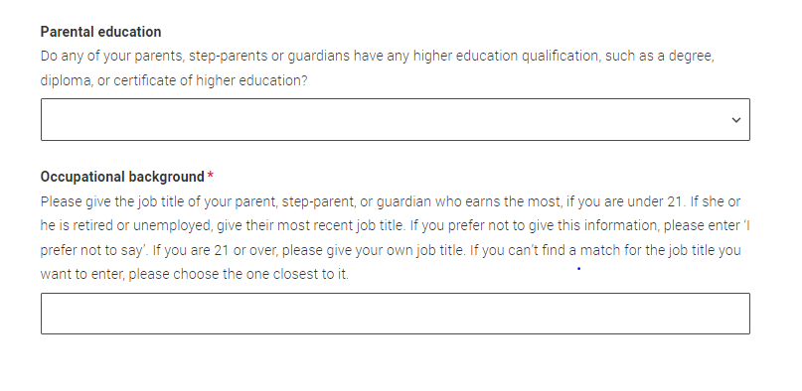
You can select I prefer not to say for the parental education question.
For the occupational background, you must type at least 3 letters into the response field, and then select an option from the menu that appears below it.
If you prefer not to give this information, please enter ‘I prefer not to say’.

Slide 40
More about you.

Slide 41
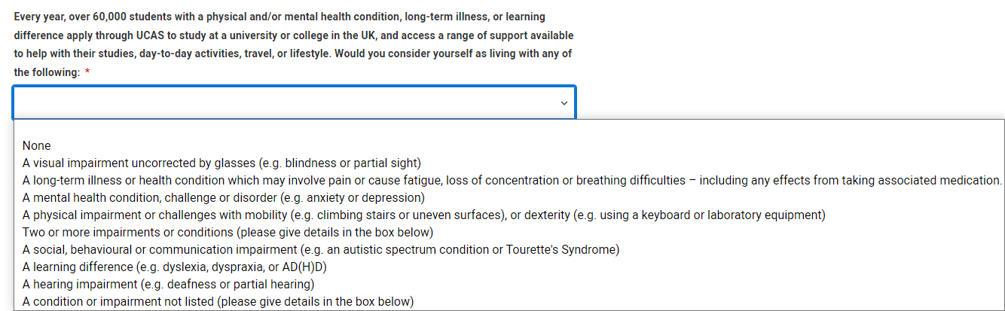
You can tell us about any circumstances that you might need support for during your studies.
We don't need you to give details – this information will be shared with those involved in making arrangements to support you at the university or college (e.g. the student support team, admissions staff), and they may get in touch to tell you more.
In order to mark the section as complete you will need to select an answer: either to share information or select 'No disability’. You will see this question if you have a UK or Non-UK home address.

Slide 42
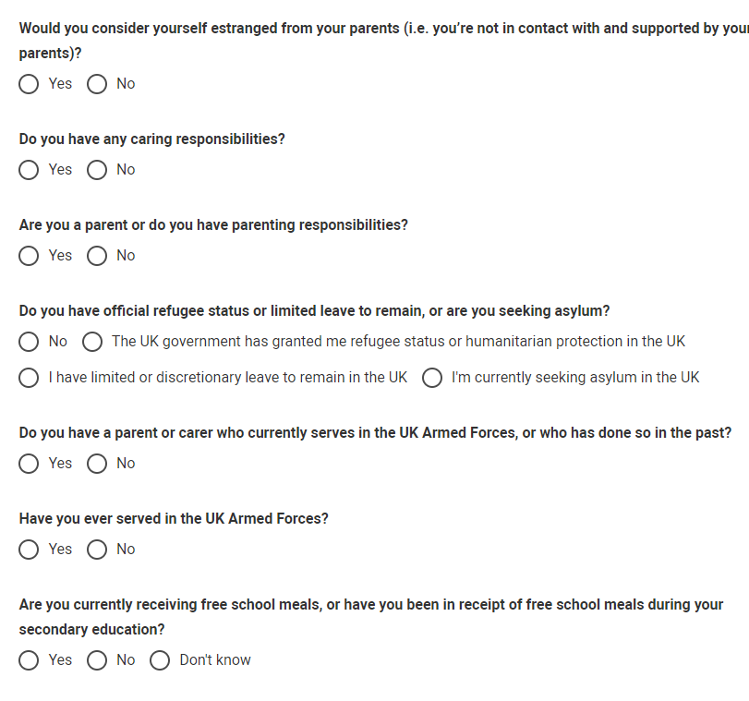
You might feel uncertain about sharing personal circumstances, please feel reassured this information is confidential and will not negatively impact your application.
These questions are intended to connect you to the right support for your needs.
You will only see these questions if you have a UK home address.

Slide 43
Education.

Slide 44
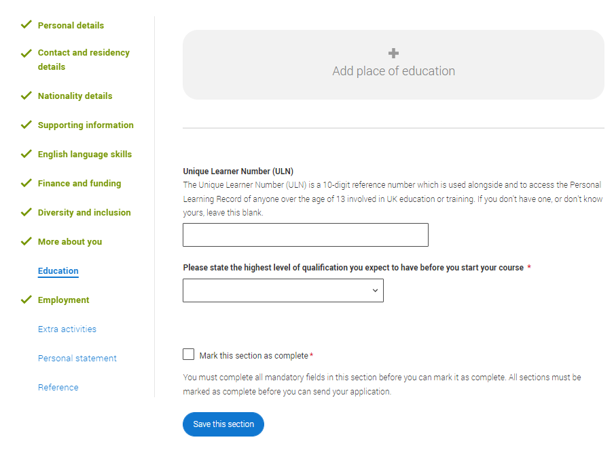
You must enter all your qualifications from secondary education onwards – whether you have the result (even any that were ungraded) or you’re still awaiting exams and results.
First you need to add details of where you’ve studied, or are studying, then add qualifications.
Start by clicking Add place of education.
You’ll be asked for a Unique Learner Number – if you don’t have one leave the question blank.
Security marking: PUBLIC

Slide 45
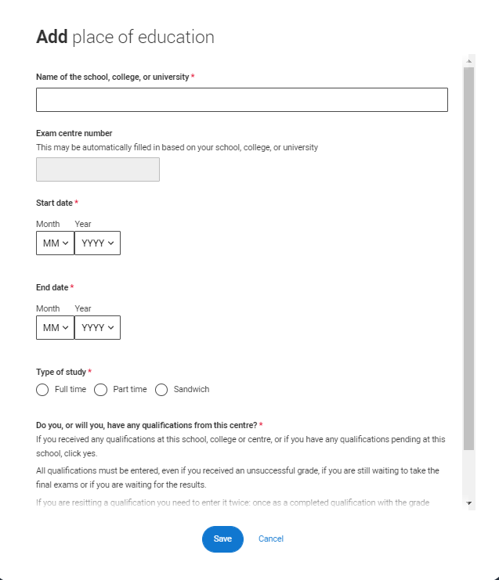
Type the name of where you studied. Once you find your centre, click on the name and the Exam centre number will automatically populate.
If an exam centre number doesn’t appear that’s ok, it’s because we don’t have it.
Add when you started and finished, and if you’re still studying there add the month, you’re due to finish.
Security marking: PUBLIC

Slide 46
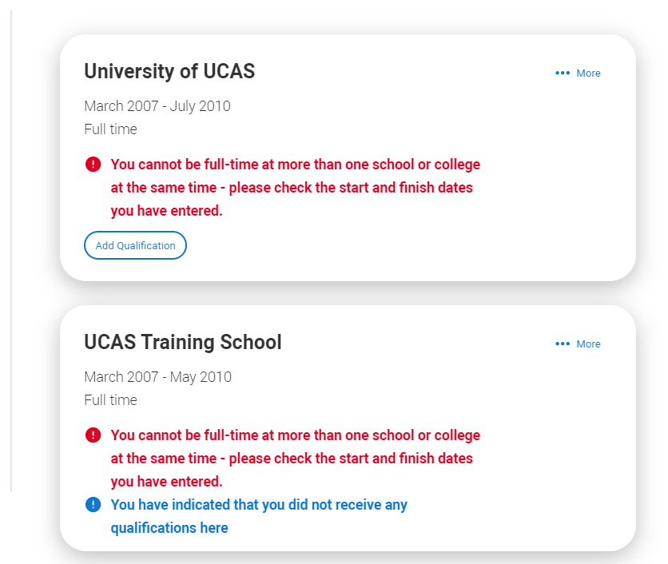
There are warning messages to help you.
For example, you can't say you attended 2 or more places of study full-time during the same date range.
Red text are warnings and mean something is wrong and blue text is for information you need to be aware of.
Security marking: PUBLIC

Slide 47
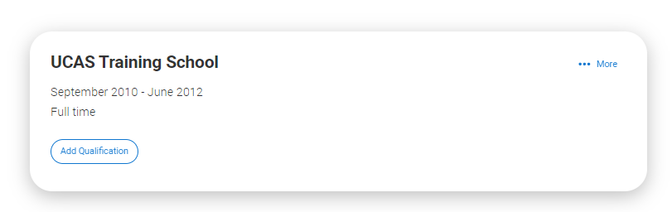
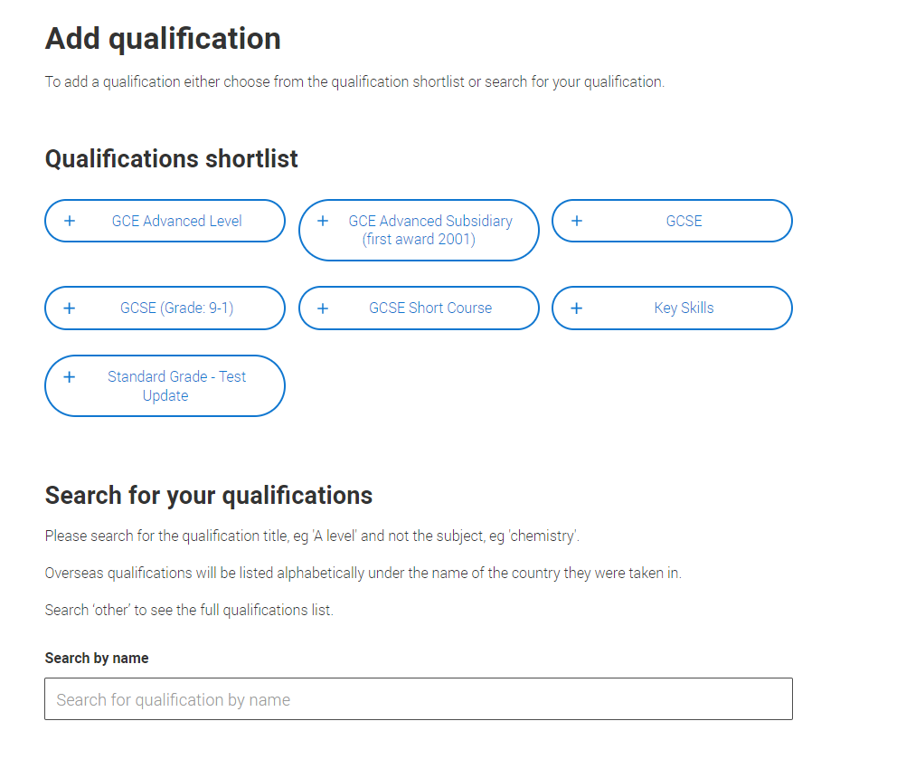
Once you’ve added where you studied you need to ‘Add qualification’.
If you are searching for a qualification make sure you use the qualification title and the subject. For more help and advice head to ucas.com.
International qualifications are listed by name and country, but don’t worry if yours isn’t there – just add it into the ‘other’ box.
Security marking: PUBLIC

Slide 48
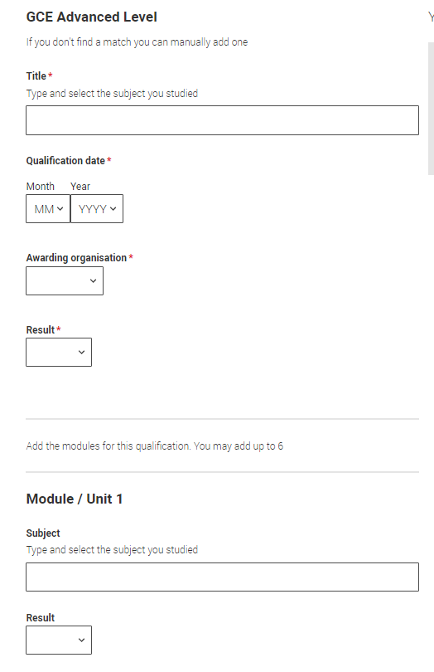
The qualification dates you can select are based on those you entered when you entered your place of education.
You need to enter the awarding organisation – speak to your teacher or adviser if you’re not sure.
If you haven't finished the qualification or had your result, then you must choose Pending.
It's entirely up to you whether you include module information. However, some courses may state in their entry requirements that they'd like to see module results – in which case make sure you include them on the application.
Security marking: PUBLIC

Slide 49
Employment.

Slide 50
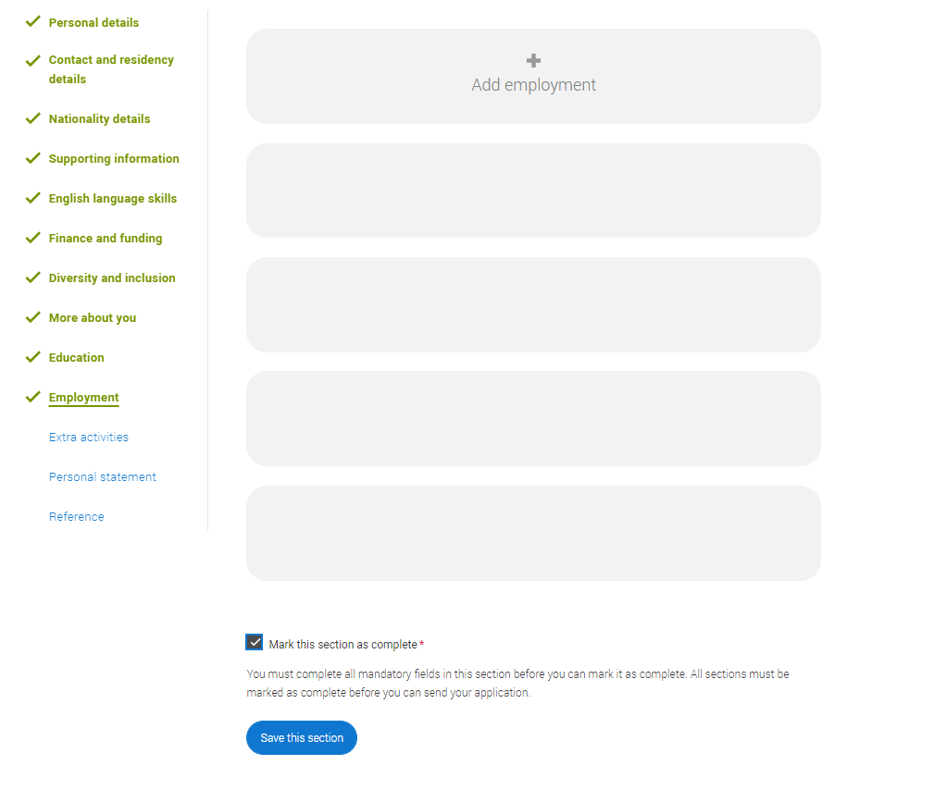
Only enter paid work here, so not everyone will have something to enter.
If you add more than one employer it will appear in chronological order with the most recent at the top.
Any work experience or volunteering should be covered in your personal statement.
If you leave this section blank remember to mark it as complete.

Slide 51
Extra Activities.

Slide 52
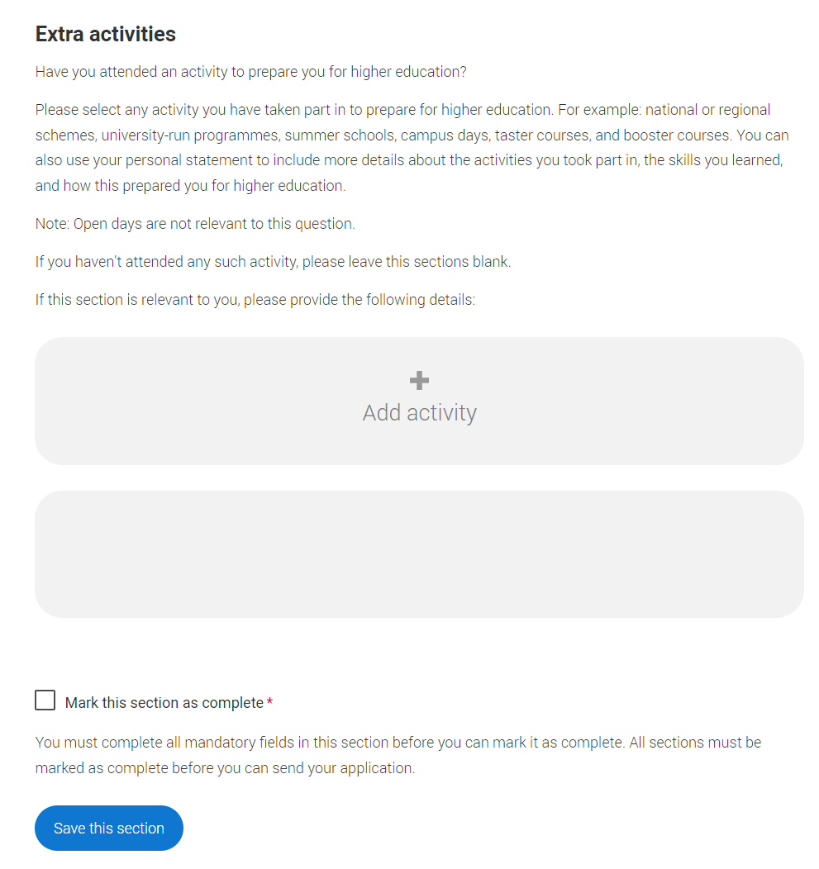
Please add any activity you have taken part in to prepare for higher education.
These include national or regional schemes, university-run programmes, summer schools, taster courses, and booster courses.
Open days are not relevant to this question.
If you haven’t attended any such activity, please leave this sections blank.

Slide 53
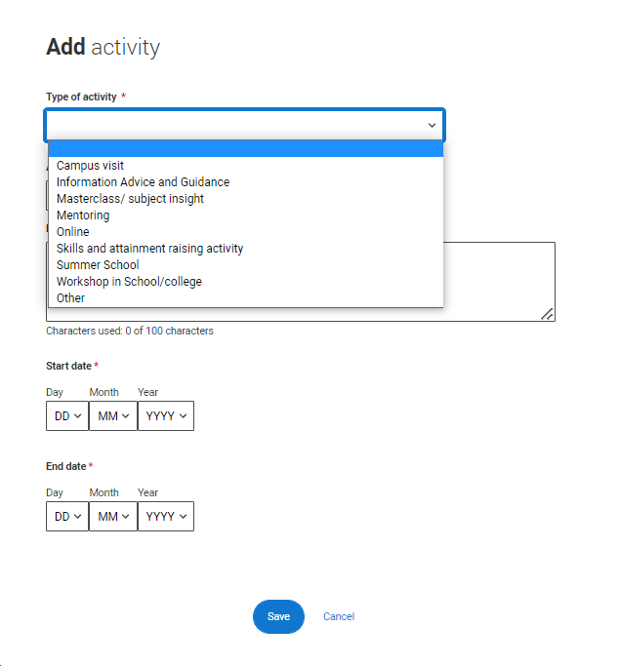
If this section is relevant to you, you need to include:
type of activity
name of the activity provider (from a drop down list)
name of the activity/programme (a free text box)
dates of the activity.
If the type of activity you attended is not listed, please select ‘Other’.

Slide 54
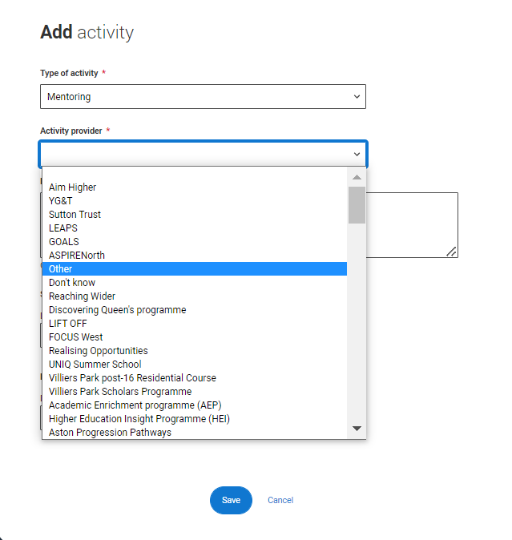
The activity provider is the organiser of the activity. It may be a university or college, or a national, regional, or local organisation.
If the activity provider isn’t listed, please select “Other”. If you’re unsure of the answer, contact whoever organised the activity to find out, and, if you’re still unsure, select ‘Don't know’.

Slide 55
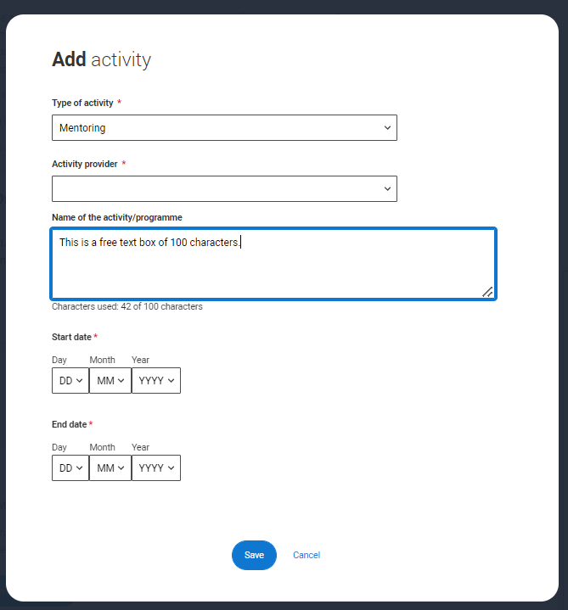
Add the official title of the activity. If you’re unsure of the answer, contact whoever organised the activity to find out.
Remember you can use your personal statement to include more details about the activities you took part in, the skills you learned, and how this prepared you for higher education.

Slide 56
Personal statement.

Slide 57
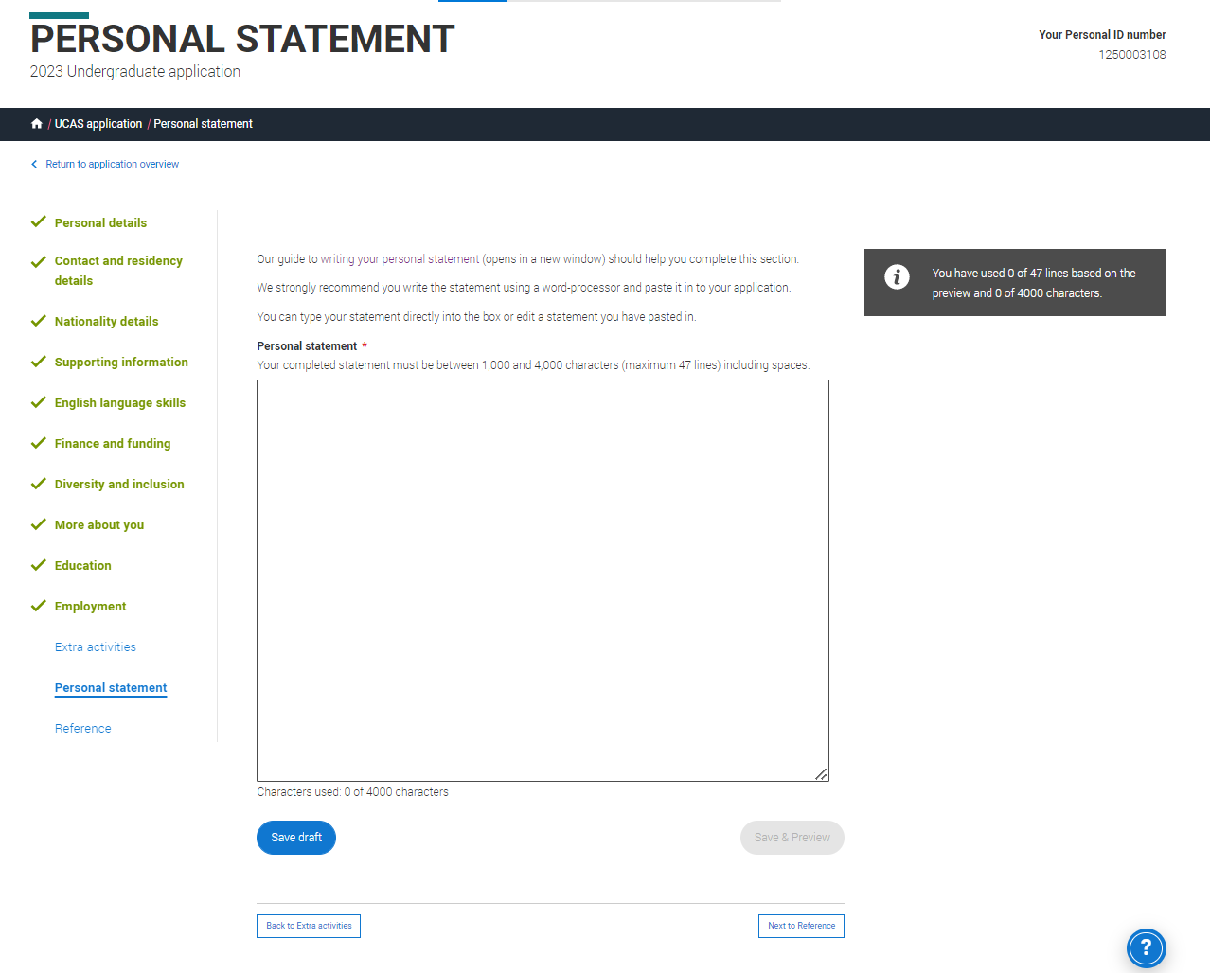
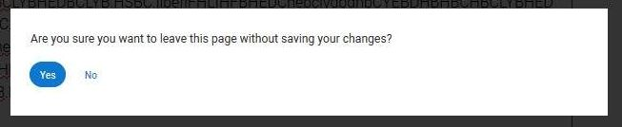
You can save and edit this section as many times as you need to.
If you try to navigate away without saving your work. We'll remind you with a pop-up warning.
For advice on how to write your personal statement head to ucas.com or use the personal statement builder in the UCAS Hub.
Security marking: PUBLIC

Slide 58

You can only mark this section as complete on the Preview screen.
Remember we'll carry out checks to verify your personal statement is your own work.
If it appears to have been copied from another source, we'll inform the universities and colleges to which you have applied. They will then take the action they consider appropriate.
We'll also contact you by email to tell you this has happened.
Security marking: PUBLIC

Slide 59
Adding a choice.

Slide 60


To add your choice start typing the name of the university or college into the institution field. Select from the options displayed.
Do the same for the course you have selected.
Locations and start dates are displayed according to the course details.
Security marking: PUBLIC

Slide 61

Some courses may require you to disclose your criminal conviction status.
We'll only show this question if the course choice requires it.
Security marking: PUBLIC

Slide 62


There is a maximum of 5 choices and choice restrictions still apply (a maximum of four courses of medicine, dentistry, veterinary medicine or veterinary science).
Once all choices are added you must mark the section as complete to be able to submit.
Security marking: PUBLIC

Slide 63

Some courses have extra admissions tests and assessments.
We'll show these in blue text on the choice card.
This should not be a surprise to you, as you should have seen details of this when researching the course.
Security marking: PUBLIC

Slide 64


Clicking the 3 dots in the bottom right of a card enables you to see it as a summary.
Any choice combinations that are not permitted will be flagged with red text on the right of each relevant card.
For example these screens show error messages for students trying to apply to University of Cambridge and University of Oxford.

Slide 65
Submitting the application.

Slide 66

There are 4 steps to the submission process.
The profile must be complete and showing 'Ready to Send' before being able to review and submit.

Slide 67


This shows the full application and you can download it as a pdf (in the top right) to help you check it.
At the bottom of the application, click Accept and proceed (or return to application if you want to make more changes).
Security marking: PUBLIC
| 67

Slide 68

We need you to update your preferences.
Security marking: PUBLIC
| 68

Slide 69

You must tick the box at the bottom of the page to confirm you have read and understood the terms and conditions.
You can collapse these by clicking the .
Then click Accept and proceed, or you can Return to application, or Return to marketing preferences.
Security marking: PUBLIC
| 69

Slide 70
Pay and Submit.

Slide 71

If your school or college pay for your application you won't need to enter any card details.
Security marking: PUBLIC
| 71

Slide 72

If you need to pay by card you will see this, click Pay now and you will be asked to enter your card details.
£27.00
Security marking: PUBLIC
| 72

Slide 73

When you've paid and submitted your application, it will go to your school/college to check.
They will submit the application to UCAS.
If you log in after you’ve submitted your application, you’ll see a read only version of it.
| 73

Slide 74
Tracking your application

Slide 75


Your UCAS Hub will update as the status of your application changes. Click on it to go to your application.
Security marking: PUBLIC

Slide 76



You’ll be taken to your application status, which displays all of the key information relevant to your application.
It will update to reflect your status and clearly state any actions you need to take.
Particularly when you will need to reply to any offers.
Security marking: PUBLIC

Slide 77


Latest updates – displays offer and decision notifications, click view all updates for full history.
Student bank account info – you’ll need this to open a student bank account (when eligible).
View all correspondence – all correspondence is grouped by choice.
Centre link permission – if you are linked to a centre this enables you to update your sharing preference. Remember if you don’t share with your centre then they will be unable to help support you with your application.
View all correspondence

Slide 78


It’s really important your contact details are kept up to date.
We recommend using a personal email address, rather than a school/college one, so that you have access to it throughout your application journey.
To update your email address, go to ‘Edit your account’ from drop-down, where you can change your email.

Slide 79

Your application details are displayed below your choices.
All are read-only with the exception of ’Contact and residency’ details. Here you can edit your phone numbers and postal address.

Slide 80


You can substitute a choice within 14 days of your application being sent to UCAS. Select the option from the actions box and complete the short substitution form.

Slide 81


The details of your offers will be shown including any conditions.
The full text of the offer can be seen by clicking ’View full offer’.
Your inactive choices (withdrawn, declined, unsuccessful) are in an accordion section below the active choices.

Slide 82


If a university or college has notified UCAS of an interview the invitation details will be shown alongside a button to enable you to respond.
There are three options you can select from to respond to the invitation.

Slide 83

Once all decisions have been received, you will make your reply and confirm your choices.
If you choose a conditional offer as your firm choice, you have the option to add an optional insurance choice.
If you choose an unconditional offer as your firm choice, you cannot have an insurance choice.
All other offers will be declined offers, underneath the Firm choice.
You must remember to ‘Save’ your choices.

Slide 84


The application status updates to show you have replied to your offer(s) and that you are waiting for the university or college to confirm your place when your results are available.
You are able to view the full text at any time by clicking ‘View full offer’.
Your application tile on the Hub will also update.

Slide 85


There is a link to ’Withdraw the whole application’.
If you withdraw, you will not be able to apply again during the academic year, and you will not be eligible for Clearing.
Do not use this if you wish to add another choice or apply somewhere else.
Follow the onscreen warnings or speak to your adviser to ensure you are taking the right action.

