Slide 1
Confirmation & Clearing 2022 The student journey

Slide 2
Using this slide deck
This deck has been designed to help understand the application journey for Clearing 2022.
The information relates to the 2022 application cycle.
You can copy and paste the screenshots included into your own materials and guides to support applicants. However please note help text and guidance in the application is updated based on feedback. As such, some screenshots will change, and we will update this slide deck periodically.

Slide 3
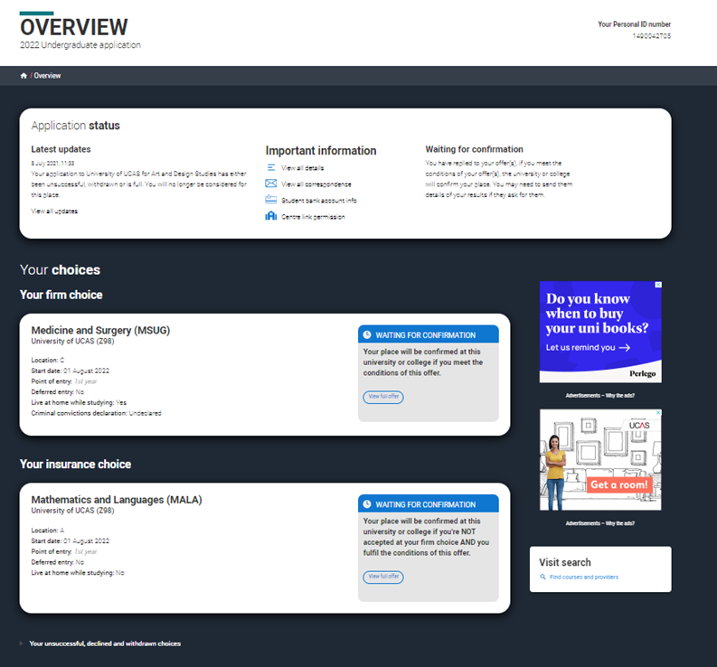
Waiting for confirmation (from July 5)
If an applicant has submitted an application, they will see this card on the UCAS Hub while universities and colleges are confirming their qualifications and other entry criteria.
If a student clicks this card they will see their application with each choice that also has a blue waiting for confirmation banner.​

Slide 4
Find a course in Clearing (from July 5)
If an applicant has no offers and is not waiting for any decisions, or has declined any offers they received, they will see this card.
From here they can search for courses in Clearing.
An applicant must discuss their choice with the university or college first, and only add a Clearing choice if the university or college has advised them to.

Slide 5
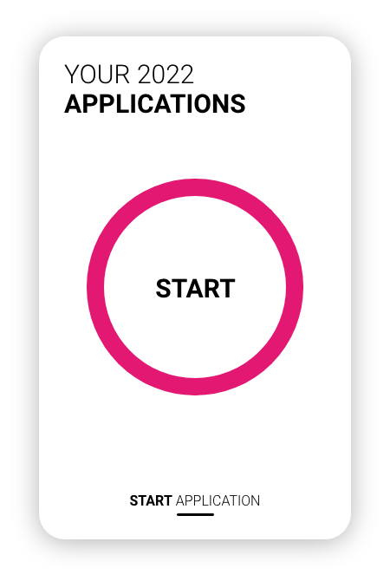
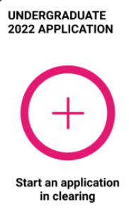
Making an application direct to Clearing
If an applicant has not started an application at all, they will see a start card. All sections, including a personal statement and reference, should be completed.
They will need to submit their application without any choices and then add their Clearing choice.
If an applicant has partially completed an application and added choices before Clearing begins (and submits their application after 30 June) their choices will be removed from the application on submission.

Slide 6
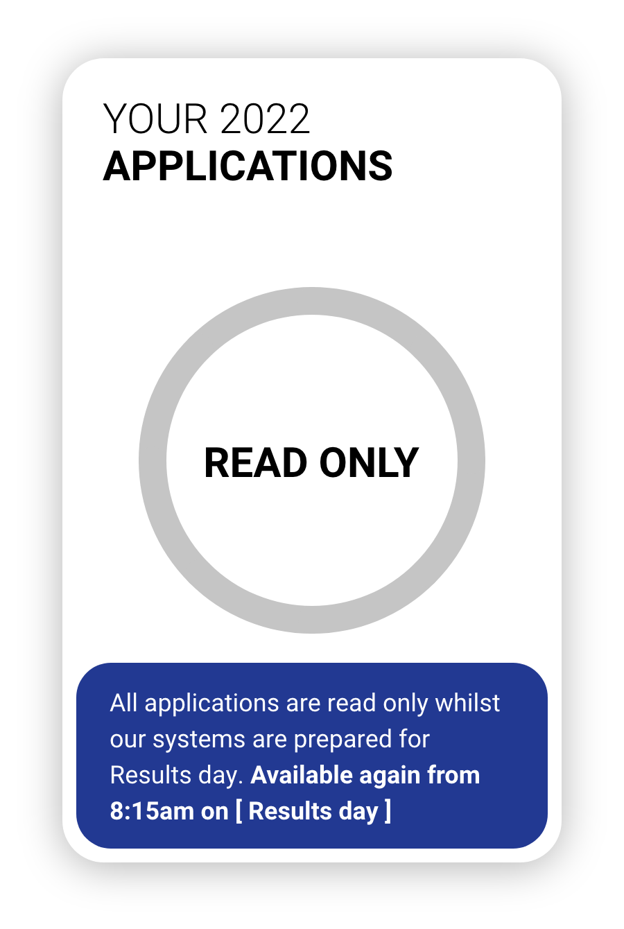
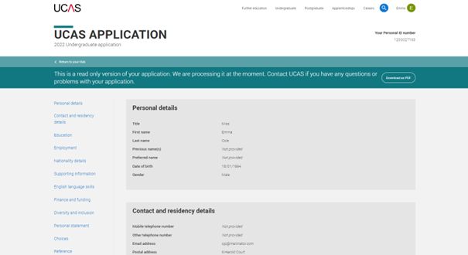
During the examination results embargos
If an application has been submitted, during the results embargo periods, the applicant will be taken to a read-only version of their application.
Just before results day applications will be unavailable whilst our systems prepare for results day.

Slide 7
On results days (9 and 18 August)
If an applicant has submitted their application and is waiting for confirmation of their offers, or if they had partially completed an application, they will see this card.
They need to select it to be taken to their application to check their status.
This card will not update to reflect the status of the application until later on results days.
Please note on 9 August and 18 August the 2023 application service will be unavailable.

Slide 8
Application status
The status bar at the top of application confirms a student’s status, and eligibility for Clearing.
Latest updates will reflect the latest action.
It will display their Clearing number (six digits).
Students also have a ten-digit Personal ID (PID), and should be able to quote both.

Slide 9
Application status
Applicants may be offered an unconditional place with substantial changes to the original choice. This could mean a change to the course, start date or point of entry.
It is usually offered if an applicant didn’t meet the conditions but the university or college wants to offer an alternative place.
Applicants can check the details in the application. If they have any questions or concerns about the change, they need to speak to the uni or college to find out why they’ve made this change.

Slide 10
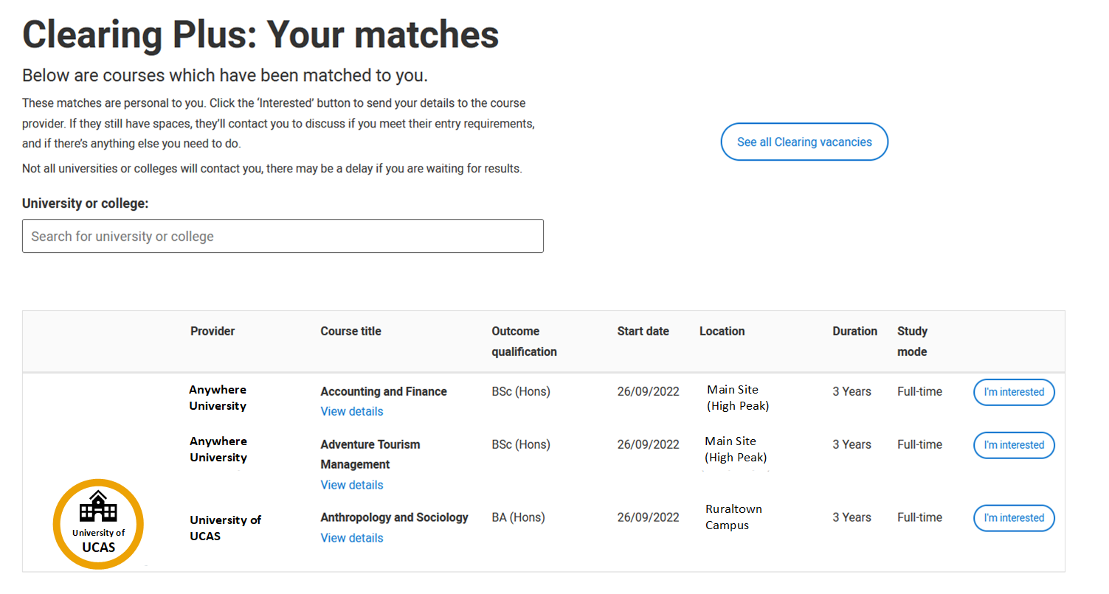
Clearing Plus
As soon as an applicant becomes unplaced and enters Clearing, the ‘see matches’ button will be visible on their application status.
The matches an applicant sees are unique and constantly updated.
If they express an interest in a course (up to 5 at a time), that university or college can contact them.
Remember, courses in Clearing fill up quickly, and they may not be contacted by a uni or college they have expressed interest in.
We’d recommend they also look for courses in Clearing using our search tool.

Slide 11
Adding a Clearing choice
Eligible applicants can add a Clearing choice from:
10:00 on SQA results day*.
15:00 on JCQ results day*.
*All timings are UK time

Slide 12
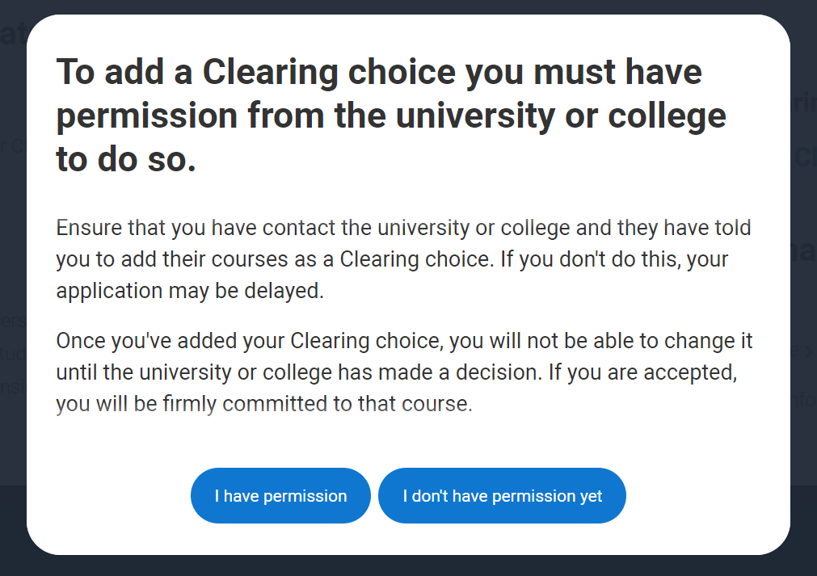
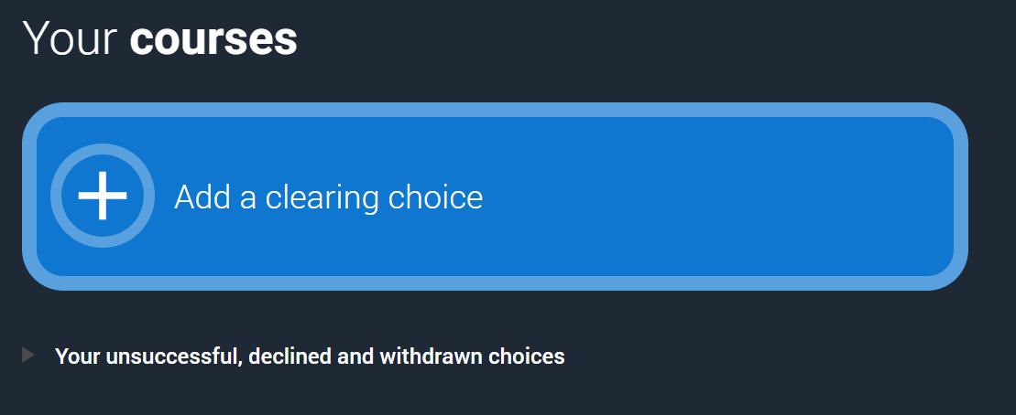
Adding a clearing choice (Step 1)

Slide 13
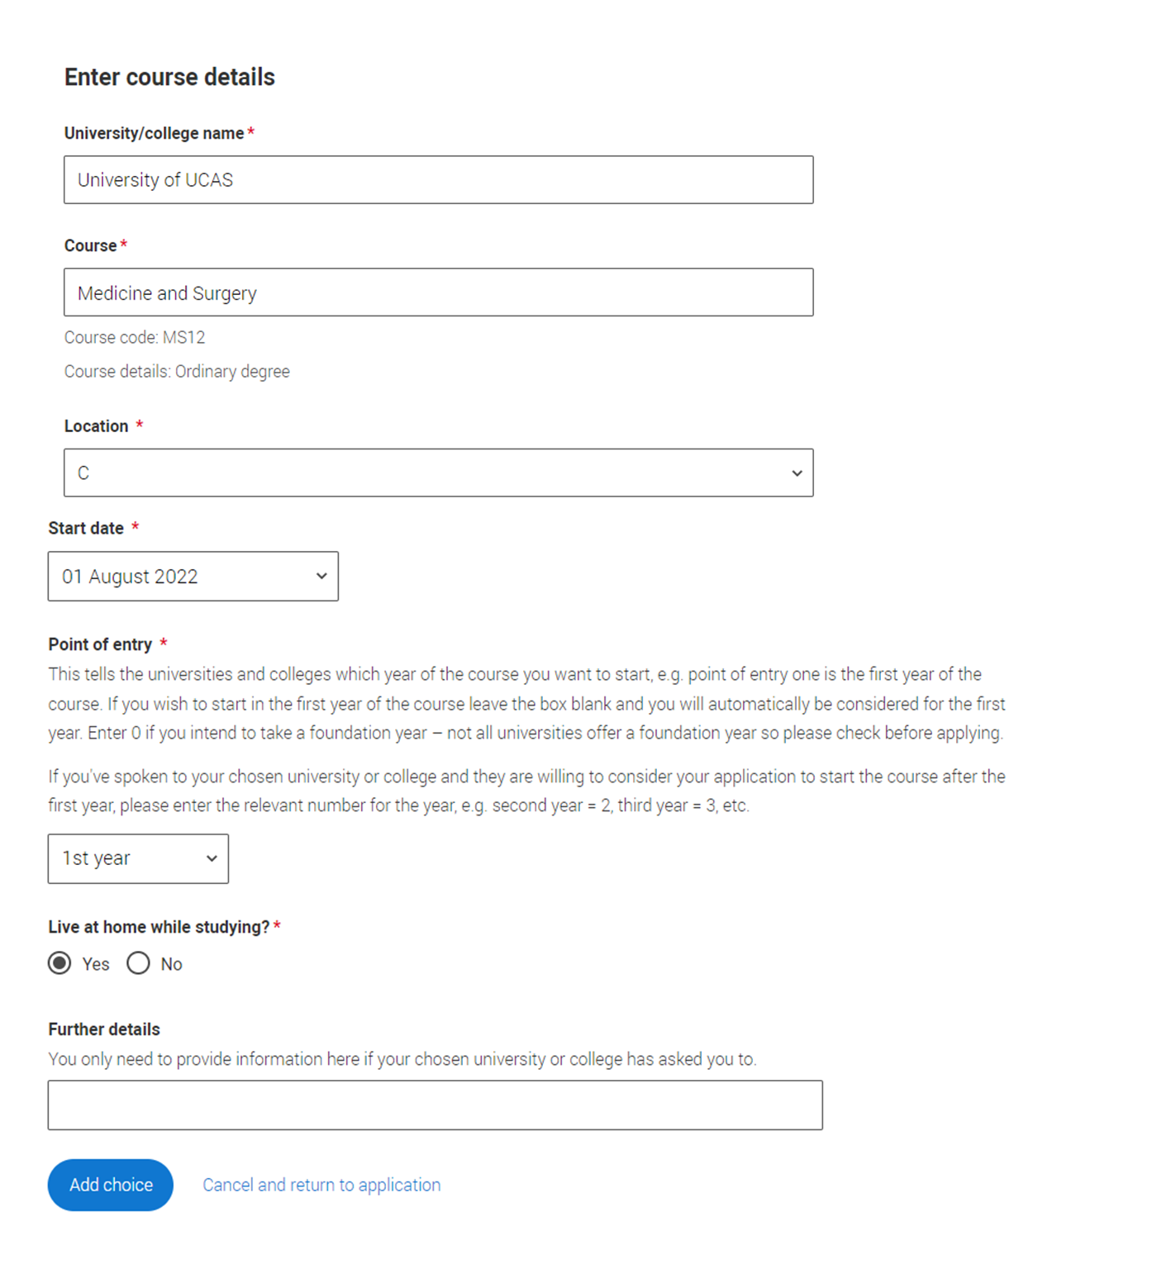
Adding a clearing choice (Step 2)
Applicants should only add a Clearing choice once they have permission from the university or college.
They need to fill in the course details by the date the university/college gave them.

Slide 14
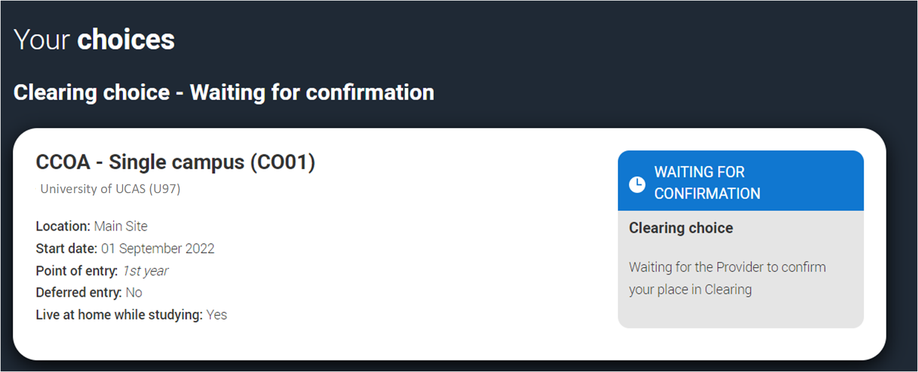
Adding a Clearing choice (Step 3)
Only one Clearing choice can be added at a time. If the university/college does not accept the Clearing choice (Unsuccessful) or the applicant chooses to use 'Decline my place' then they'll be able to add a new Clearing choice.'

Slide 15
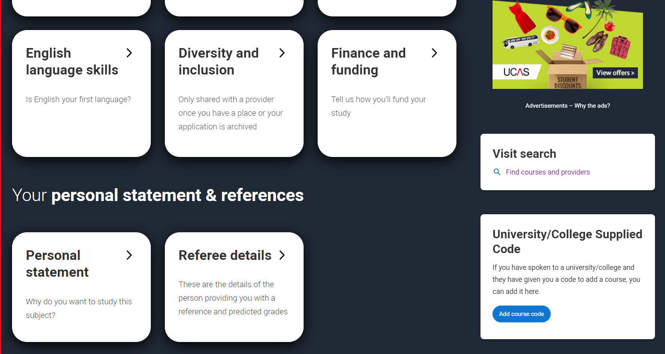
University/College Supplied Code
If the university or college has supplied the applicant with a specific course code for a course available in Clearing, they enter it directly.
This may be the case for competitive courses where vacancies are rare and usually filled quickly.

Slide 16
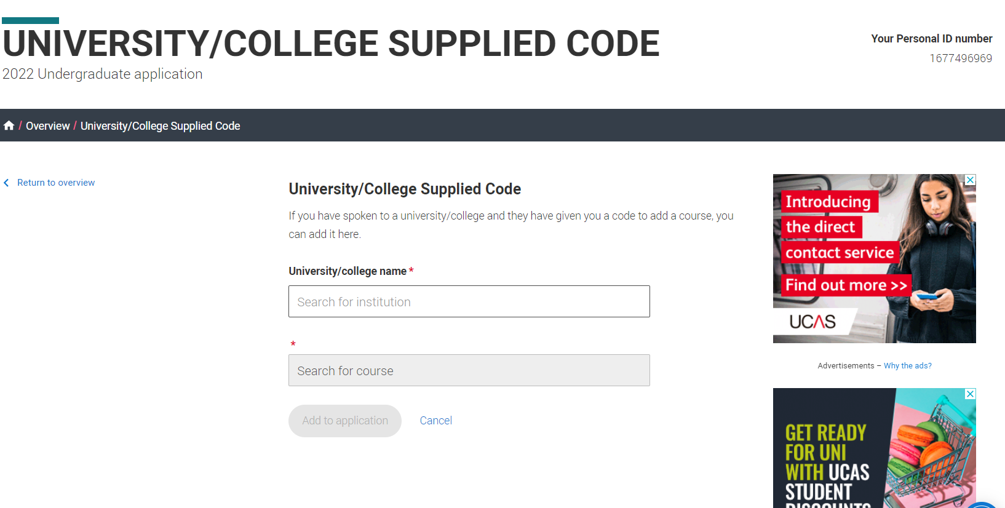
University/College Supplied Code

Slide 17
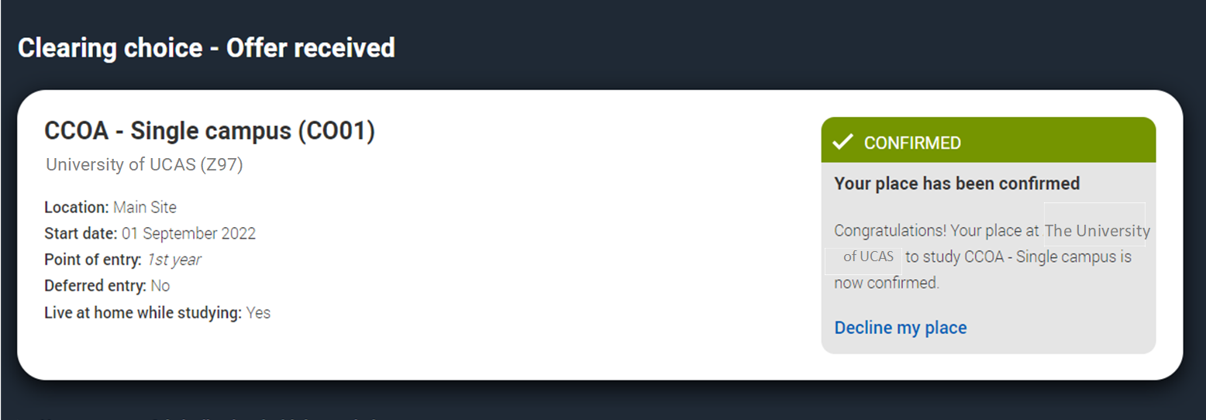
Clearing choice
Applicants don’t need to reply to a Clearing offer.
Once the choice has been added, it’s up to the university or college to confirm the place.
The confirmation will reflect in their application.
University of UCAS

Slide 18
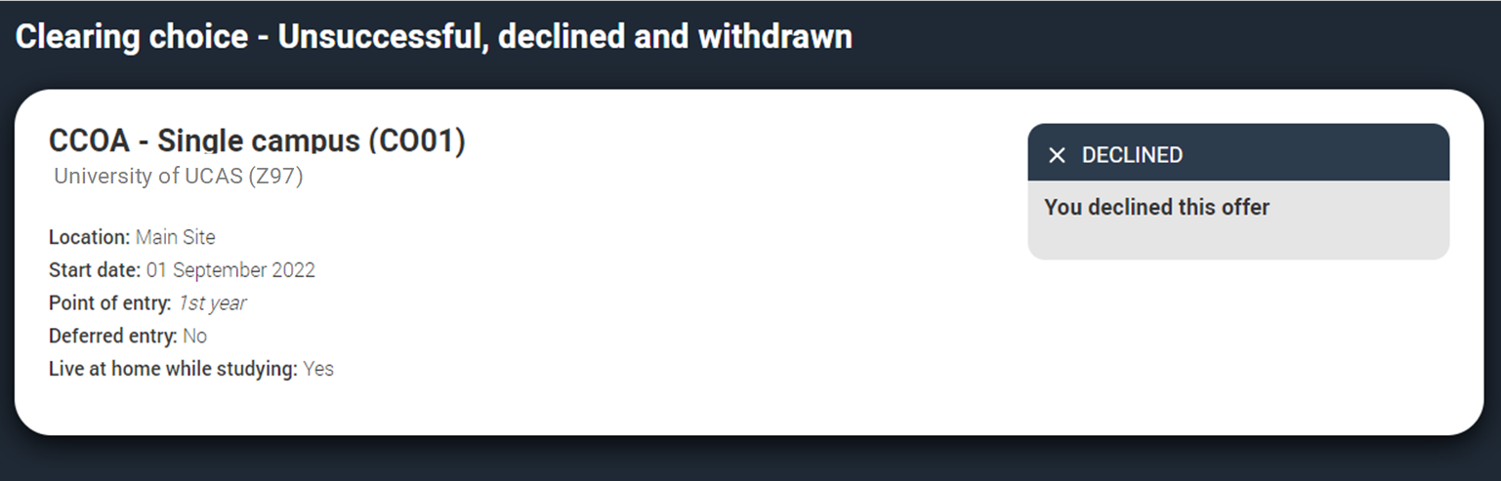
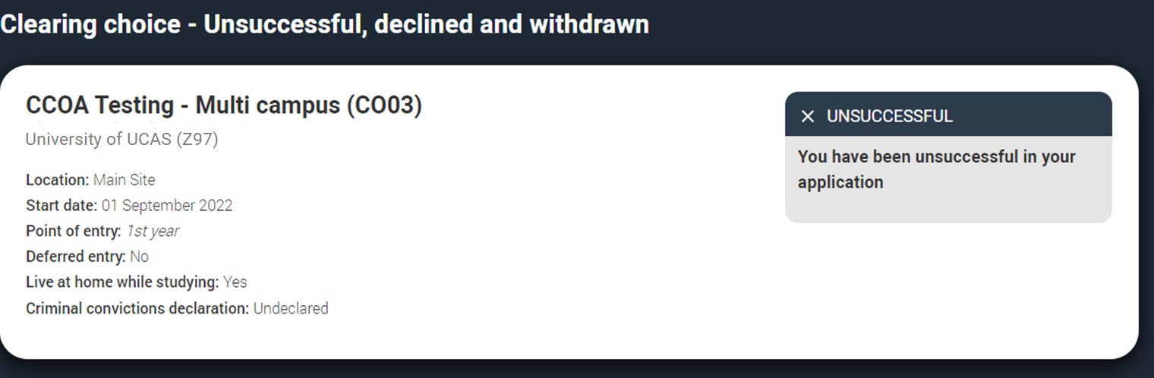
Clearing choice
If the university/college does not accept the Clearing choice (Unsuccessful) or the applicant chooses to use 'Decline my place' then they'll be able to add a new Clearing choice.'

Slide 19
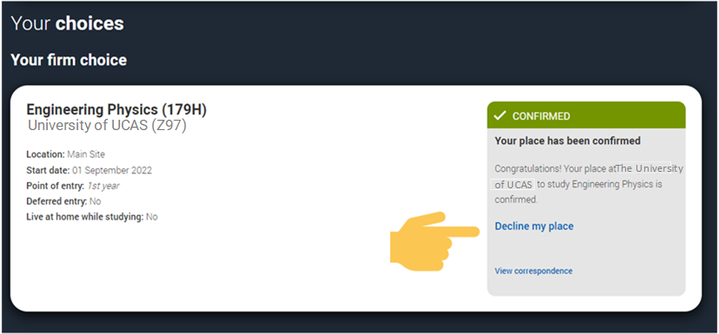
Decline my place (Step 1)
From 5 July, if an applicant is holding a firm unconditional place, they can release themselves into Clearing, by using the ‘Decline your place’ button in the application.
This is available until 7 September 2022.

Slide 20
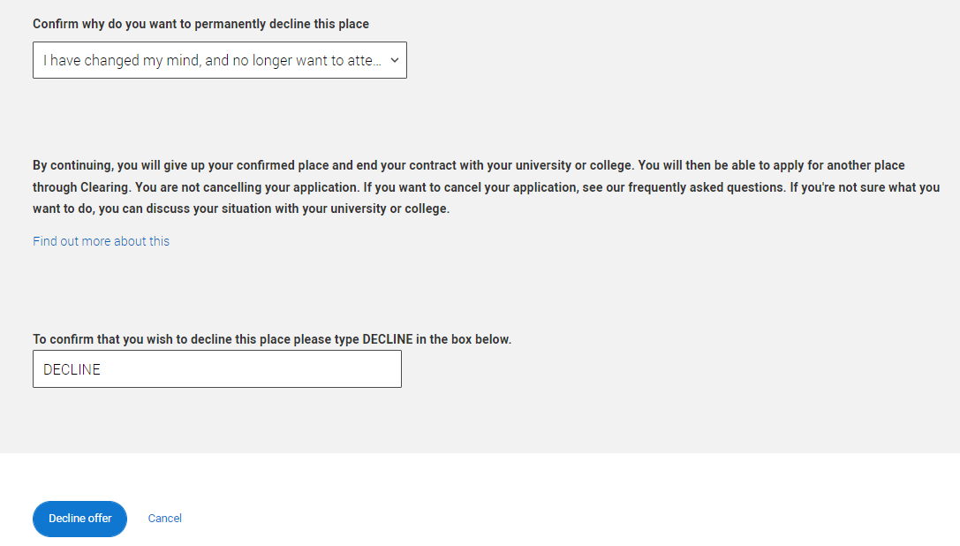
Decline my place (Step 2)
They should only use this if they no longer wish to take up their place at their confirmed firm choice.
Using it will mean their place will be declined and their contract with the university or college will be cancelled, including any arrangements made for accommodation or scholarships.
Students will need to confirm they want to decline their place.

Slide 21
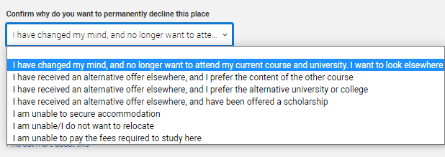
Decline my place (Step 2)
They may find the best option isn't to decline their place; other options are available.
Applicants should never be pressured into making a decision, if they seem unsure, suggest they give UCAS a call to discuss their options.

Slide 22
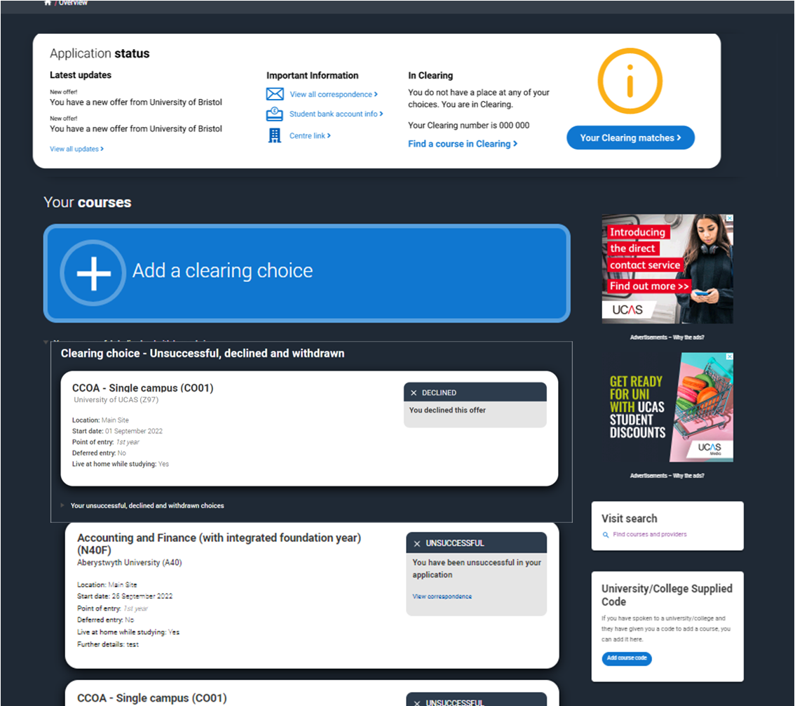
Decline my place (Step 3)
If an applicant uses ‘Decline my place’ they will then enter Clearing.
They will be able to apply for another course through Clearing or view their matches in Clearing Plus.

