Slide 1
Parents evening presentation
Last updated April 2022

Slide 2
What is UCAS?
UCAS is an independent charity providing information, advice and admissions services. We’re there to help people figure out what the next step in education might be.
UCAS does:
UCAS doesn’t:
provide information, advice, and support
process applications
complete fraud and verification checks
take part in education sector engagement
make decisions or offers
set entry requirements
advise on finance
advise on immigration or visas for individuals

Slide 3
Information and advice on
Higher education
Apprenticeships/ traineeships
Studying abroad
Gap year
Getting a job
Find out more: ucas.com
Security marking: PUBLIC
19 April 2022
| 3

Slide 4
Why higher education?
Essential for some career paths.
Develop new transferable skills and subject knowledge.
Increase confidence and independence.
Broaden experiences.
Meet new people.
Investment in the future.
Increased job prospects.
Higher earning potential.

Slide 5
Apprenticeships
Check out ucas.com/apprenticeships to find out more, including:
degree apprenticeships
how to find and apply for apprenticeships
preparing for application and interview
browse our industry guides
Sign up at careerfinder.ucas.com to search for apprenticeships and internships vacancies.
Security marking: PUBLIC
19 April 2022
| 5

Slide 6
Choosing the right place
Style – from traditional, with a focus on subject-based courses and research, to modern universities/colleges, with a greater focus on vocational courses.
Location – some are in large cities, others in small towns, by the coast or in the countryside – it’s all a major influence on the environment and lifestyle.
Size – larger universities can have more than 20,000 students, whereas some of the smallest have only a few thousand.
Culture and facilities – influenced by a range of factors, including the diversity of students who attend.
What graduates do – all universities collect destination statistics; it can be useful to find out what jobs or further study students go on to.
Tuition fees – can vary between universities and colleges; check if there are scholarships or bursaries available.
Living costs – accommodation, transport, and food can vary enormously.

Slide 7
Choosing the right course
What does the course cover?
Courses with the same title may be very different.
Look carefully at the core course content, and the range of optional studies/modules available.
Which modules are the most interesting and relevant to your career aspirations?
See if the course or university/college offers any internship, placement, or study abroad opportunities.
How is the course taught – structured teaching, or more independent research? How many lectures are there, and how much group work will be done in seminars?
How is the course assessed?

Slide 8
UCAS Hub

Slide 9
Starting your research
Register with the UCAS Hub to:
explore careers, subjects, places, and apprenticeships
find and favourite from over 35,000 courses
search for open days, online events, and virtual tours
turn predicted grades into UCAS Tariff points
speak to those in the know using Unibuddy
speak to career, higher education, and application specialists by attending the Hub lives
take the UCAS Quiz to find your career matches
start an application for 2023 entry (from May 2022)

Slide 10
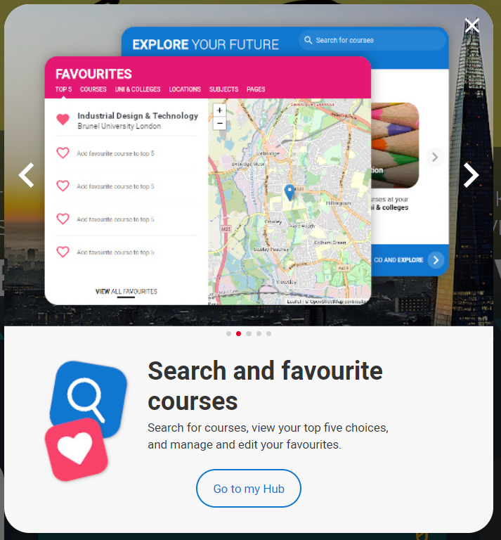
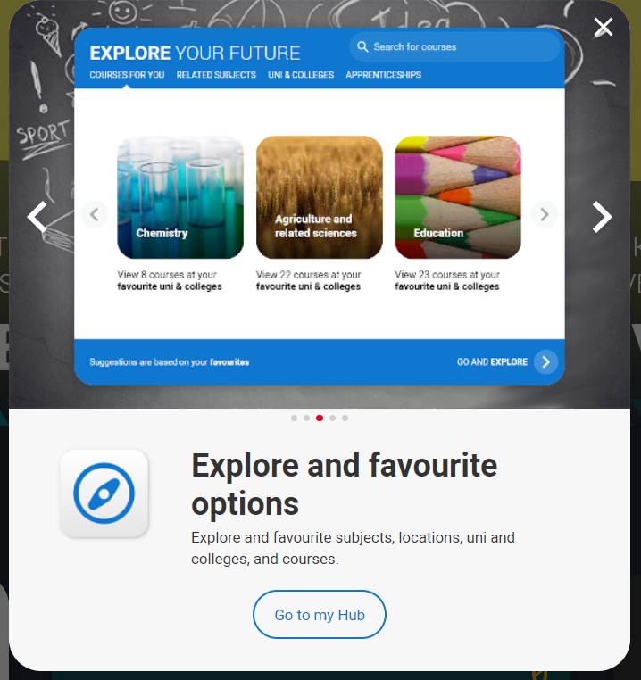
Tools to help
Tools to help

Slide 11
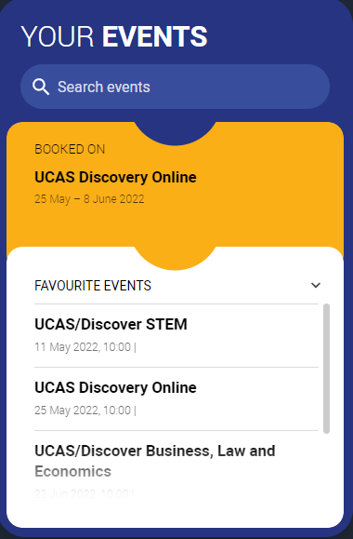
Tools to help
UCAS Hub lives
Join our live sessions hosted by expert panels.
Ask questions to help you make an informed decision.
UCAS Discovery
Talk to subject and admissions experts, discover apprenticeships, find advice on applying, and more!
Discover a world of opportunities.

Slide 12
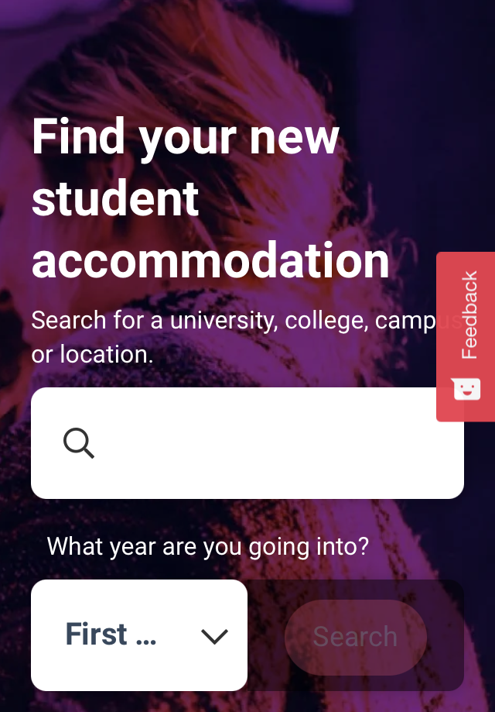
Tools to help
UCAS Quiz
Find job and career ideas matched to your personality.
Plus a list of courses previous students studied in order to get there.
Accommodation
High on the list when considering where to study, but it’s not always easy to compare what’s on offer.
Understand what options there are using our accommodation search.

Slide 13
Completing the UCAS application
Student registers for a UCAS Hub account to carry out research and start application.
Student completes all sections of the application and sends it to their school/college.
Teacher or adviser reviews the application and adds reference and predicted grades.
Applications are sent to UCAS by the school or college on behalf of the student.
Universities and colleges make their decisions on the application.
Security marking: PUBLIC
19 April 2022
| 13

Slide 14
When to apply for 2023 entry
3 May
UCAS Undergraduate application opens for 2023 entry.
6 September
First day UCAS can receive a completed application to process.
15 October
UCAS application deadline for courses in medicine, veterinary medicine/science, and dentistry, and courses at Oxford or Cambridge.
25 January
UCAS equal consideration application deadline.
23 February
UCAS Extra opens.
30 June
Last date for applications before Clearing opens.
Security marking: PUBLIC
19 April 2022
| 14

Slide 15
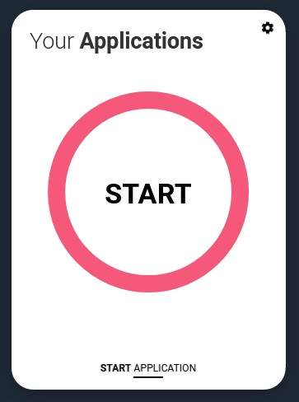
Key facts
To start an application you need a UCAS Hub account.
Register for UCAS Hub at any time.
From 3 May 2022 you’ll be able to ‘Start’ your application in your UCAS Hub.
You have up to five choices, unless applying to study medicine, veterinary, medicine/science, dentistry – then it’s four choices.
You can’t apply to BOTH Oxford and Cambridge.
Applying costs £22.50 for 1 choice, or £27 for multiple choices.
Apply by the equal consideration date.
Universities and colleges can’t see your other choices when you apply.

Slide 16
Linking to a school
If you’re applying with the help of a school, college or centre you should enter their ‘buzzword’ to link your application to them.
The buzzword is a unique code set by your school, college or centre.
By linking your application you’re giving your school, college or centre permission to view and track your application.
It also means they’ll provide you with a reference, and send your application to UCAS on your behalf.

Slide 17
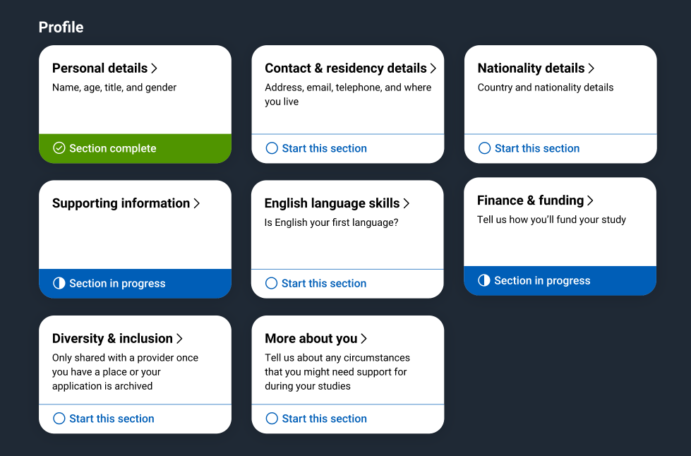
Application
Profile:
Personal details
Contact and residency details
Nationality details
Supporting information
English language skills
Finance and funding
Diversity and inclusion*
More about you
* (for students with a UK home address)
Security marking: PUBLIC
19 April 2022
| 17

Slide 18
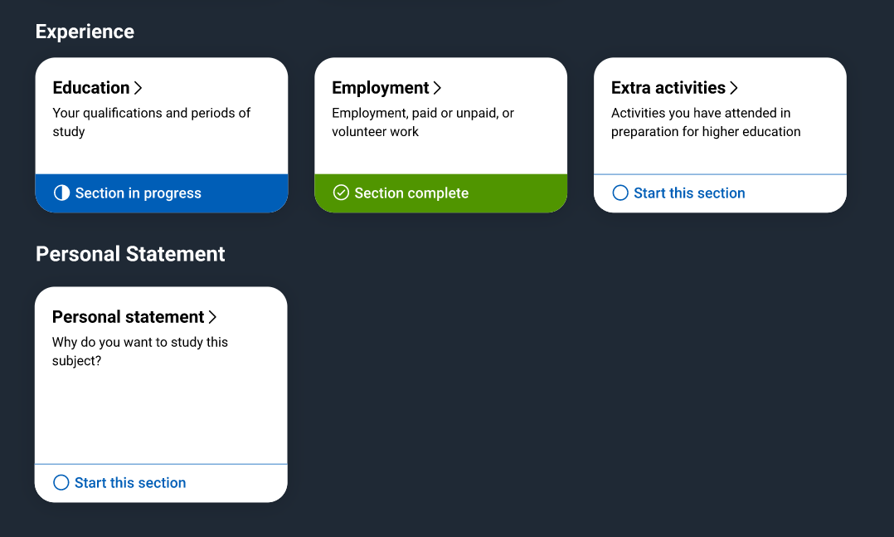
Application
Experiences:
Education
Employment
Extra activities*
Personal statement
Reference**
Add choices – up to five
* (for students with a UK home address)
**(not visible for students linked to their school/college)

Slide 19
The personal statement
The only section students have full control over
Students only chance to market themselves individually
UCAS’ similarity detection service:
every personal statement is run through software to check for plagiarism.
The same for all choices
A maximum of 4,000 characters, or 47 lines
A minimum of 1,000 characters
There isn’t a spelling or grammar check
No formatting is allowed
Security marking: PUBLIC
19 April 2022
| 19

Slide 20
Decisions
Universities and colleges will review the:
They may also ask for:
personal statement
admissions test
qualifications
interview
reference
portfolio/audition
Security marking: PUBLIC
19 April 2022
| 20

Slide 21
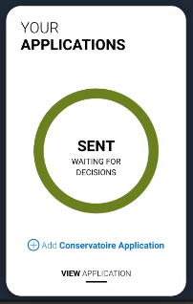
Tracking applications
Head to UCAS Hub to:
follow its progress 24/7
see choices and personal information
view offers
reply to offers online
One of three decisions will be made:
unconditional offer
conditional offer
unsuccessful
Security marking: PUBLIC
19 April 2022
| 21

Slide 22
Replies to offers
Once decisions have been made on all choices, two can be chosen:
one as a ‘firm’ acceptance – first choice
the other as an ‘insurance’ acceptance. This acts as a back-up if you do not get into your ‘firm’ choice
Any remaining offers must be declined.
Once all decisions and replies have been made, if you are not holding an offer, you may be able to use Extra or Clearing to find available places.
Security marking: PUBLIC
19 April 2022
| 22

Slide 23
Other options
Extra (23 Feb – 4 Jul)
Used all five choices and had no offers.
Add Extra choices for consideration one at a time.
Clearing (5 Jul – 17 Oct)
Apply after 30 June, receive no offers, decline all offers, not met conditions.
Find vacancies from 5 July and add a Clearing choice to your application.

Slide 24
What can students be doing?
research, research, research
attend open days and events – including online
extracurricular and supercurricular activities
work experience
volunteering
independent learning outside the curriculum
focus on this year’s studies
Security marking: PUBLIC
19 April 2022
| 24

Slide 25
How can you support them?
Research
Use the parents/guardians’ section of the UCAS website at www.ucas.com/parents.
Sign up
Sign up for parent updates from UCAS and get everything you need to know about the application process direct to your inbox.
Open days
Attend virtual events and open days – you may have a different perspective.
Be proactive
Make sure they carefully read everything that is sent to them and don’t book holidays at key times!
Security marking: PUBLIC
19 April 2022
| 25

Slide 26
Additional help
UCAS Customer Experience Centre:
0371 468 0 468
From outside the UK:
+44 330 3330 230
Monday to Friday, 08:30 – 18:00 (UK time)
Stay up to date online at:
facebook.com/ucasonline
twitter.com/UCAS_online
Security marking: PUBLIC
19 April 2022
| 26

Slide 27
Thank you
Security marking: PUBLIC
19 April 2022
| 27

