Slide 1
Making the right choices
Last updated April 2022

Slide 2
By the end of this presentation, you will be able to:
state the options available when you leave school or college
explain the different types of university and college courses
list what you need to do to apply to university or college

Slide 3
Choices available
Higher education
Apprenticeships
Studying abroad
Gap year
Getting a job
Register for the UCAS Hub to understand the options available and make choices that are right for you: ucas.com/hub
Security marking: PUBLIC
19 April 2022
| 3

Slide 4
Why higher education?
Essential for some career paths.
Develop new transferable skills and subject knowledge.
Increase confidence and independence.
Broaden experiences.
Meet new people.
Investment in the future.
Increased job prospects.
Higher earning potential.

Slide 5
Some higher education study options
Certificate of Higher Education (CertHE) and Diploma of Higher Education (DipHE): first and second year of a degree course.
Higher National Certificate (HNC) and Higher National Diploma (HND): HNC is a one-year industry specific course, and the HND is a two-year industry specific course.
Higher apprenticeships: provide an opportunity to gain Level 4 qualifications or above, e.g. HND, or foundation degree while you work. Can take from one to five years to complete, depending on the course level.
Foundation degree: flexible vocational qualification, combining both academic study and workplace learning. It usually takes two years to complete.
Bachelor’s or undergraduate degree: a three to four-year course which can also be available as a part-time option, allowing you to study and work.
Degree apprenticeships: enable you to gain a full undergraduate or master’s degree while you work. Degree apprenticeships take three to six years to complete, depending on the course level.

Slide 6
Apprenticeships
Check out ucas.com/apprenticeships to find out more, including:
different types of apprenticeships
degree apprenticeships
how to find and apply for apprenticeships
preparing for application and interview
our industry guides
Sign up at careerfinder.ucas.com to search for apprenticeship and internship vacancies.
Security marking: PUBLIC
19 April 2022
| 6

Slide 7
What’s right for you?
There are a number of things to consider when applying for higher education:
a course you enjoy – you are investing time, money, and effort
whether it’s right for your career path – check with employers and professional organisations
location – city or rural, transport links
a study and assessment style that suits you
extracurricular, clubs, and societies
finances

Slide 8
Starting your research
Register with the UCAS Hub to:
explore careers, subjects, places, and apprenticeships
find and favourite over 35,000 courses
search for open days, online events and virtual tours
turn predicted grades into UCAS Tariff points
speak to those in the know using Unibuddy
speak to career, higher education, and application specialists by attending the Hub lives
take the UCAS Quiz to find your career matches
start an application for 2023 entry (from May 2022)

Slide 9
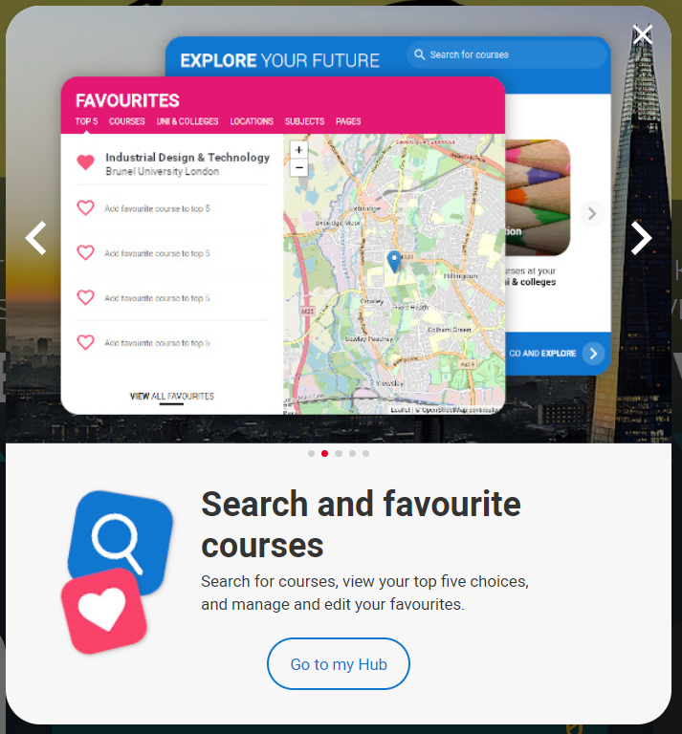
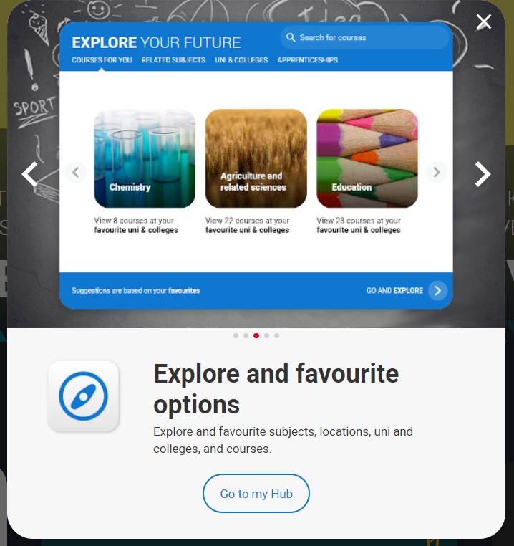
Tools to help
Tools to help

Slide 10
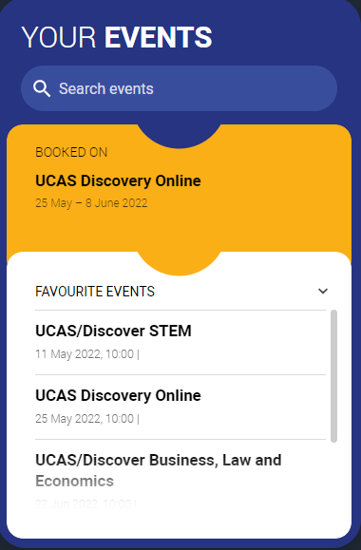
Tools to help
UCAS Hub lives
Join our live sessions hosted by expert panels.
Ask questions to help you make an informed decision.
UCAS Discovery
Talk to subject and admissions experts, discover apprenticeships, find advice on applying, and more!
Discover a world of opportunities.

Slide 11
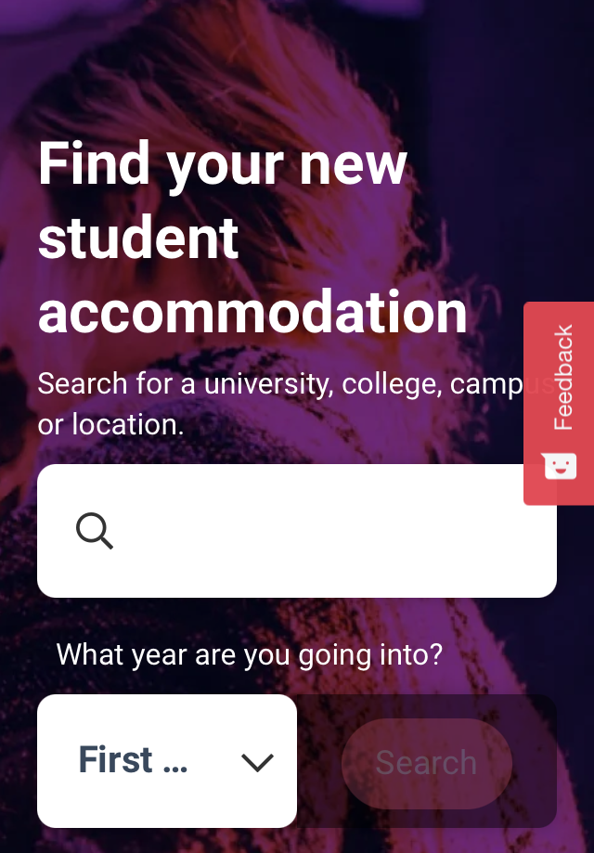
Tools to help
UCAS Quiz
Find job and career ideas matched to your personality.
Plus a list of courses previous students studied in order to get there.
Accommodation
High on the list when considering where to study, but it’s not always easy to compare what’s on offer.
Understand what options there are using our accommodation search.

Slide 12
Additional help
UCAS Customer Experience Centre:
0371 468 0 468
From outside the UK:
+44 330 3330 230
Monday to Friday, 08:30 – 18:00 (UK time)
Stay up to date online at:
facebook.com/ucasonline
twitter.com/UCAS_online
Security marking: PUBLIC
19 April 2022
| 12

Slide 13
Thank you
Security marking: PUBLIC
19 April 2022
| 13

