Slide 2
No peeking!
Write your name at the top of the paper.
Fold the paper over.
Pass on to a person at least three seats away.

Slide 3
And when you’ve received the folded paper…
Write your name.
Fold the paper over.
Pass on to a person at least three seats away.
Again, no peeking!

Slide 4
Then write where you met.
Choose from one of these future meeting places below.
Imagine you’re around 35 years old…
In a classroom on the top floor of an Arcology
Sharing a drone taxi
Collecting produce from a farmscraper (skyscraper)
In a space port waiting area
The foyer of an underwater hotel
Fold and pass

Slide 5
Write ‘I can’t believe that you’re a [blank].
How did that happen?’
Choose from the ‘future job’ options.
Self-driving car mechanic
Drone manager
Extinct species revivalist
Alternative energy consultant
Urban agriculturalist
3D food-printer engineer
Book-to-app converter
Social education specialist
Wind turbine repair technician
Plant psychologist
Earthquake forecaster
Gene programmer
Fold and pass

Slide 6
Choose and write down one of the ‘future career routes’ below.
I took a MOOC, and then my company sent me on a socialisation course.
I did an apprenticeship.
I did a blended course, part online and part at university.
I went to an ecological university.
Fold and pass

Slide 7
Write ‘Having had that discussion, they…’
You decide what to write here… so make up your own consequence!

Slide 8
Unwrap the Future Consequence.
Hand it to the person who is second on the list.
Ask them how they like their future job!

Slide 9
What are the current opportunities?
How can I find out what I don’t know?
Use the Explore tool in the UCAS Hub – ucas.com/hub.

Slide 10
Do you know what you want your future to look like?
NOW
2030
2040

Slide 11
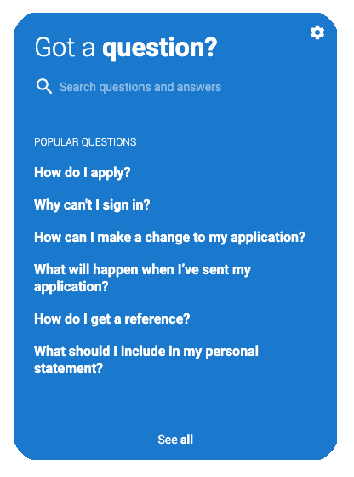
How else can I find out what I don’t know?
Check out the frequently asked questions.

