Slide 1
Applying to university through UCAS

Slide 2

Content
By the end of this presentation, you will:
know what resources are available to support you
understand how to apply
know when you need to submit your application
understand how to track your application and reply to offers
Security marking: PUBLIC
23 October 2020
| 2
Notes:
2

Slide 3
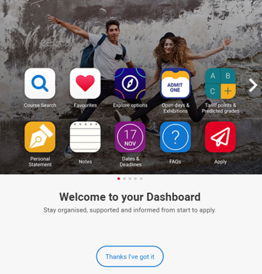
Before you apply…
Register in UCAS Hub to:
explore careers, subjects, universities and apprenticeships
find and favourite over 35,000 courses
search for virtual tours and online events
turn predicted grades into Tariff points
speak to those in the know using Unibuddy
speak to career, higher education, and application specialists by attending the Hub lives.
Security marking: PUBLIC
23 October 2020
| 3

Slide 4
‘I’m overwhelmed by all the choice…’
Get organised:
Tools to search, favourite, shortlist, reflect, diary, and build application.
Define what’s important:
Distance from home, teaching satisfaction, work experience options, job outcomes…
Make it yours:
Organise tools, remove the ones they don’t need, and tick off their to do list. It’s their space, and their future.
You might not have thought of…
Expand horizons by pushing options they might not have considered.
Security marking: PUBLIC
23 October 2020
| 4

Slide 5
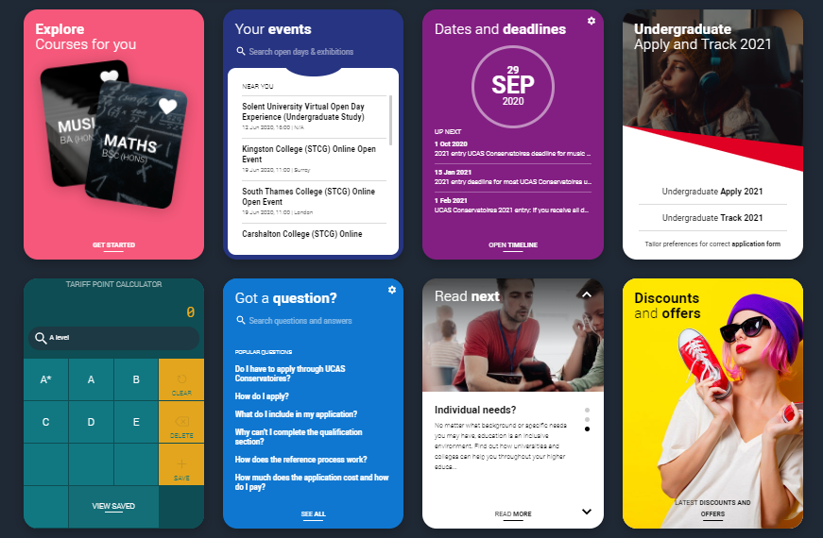


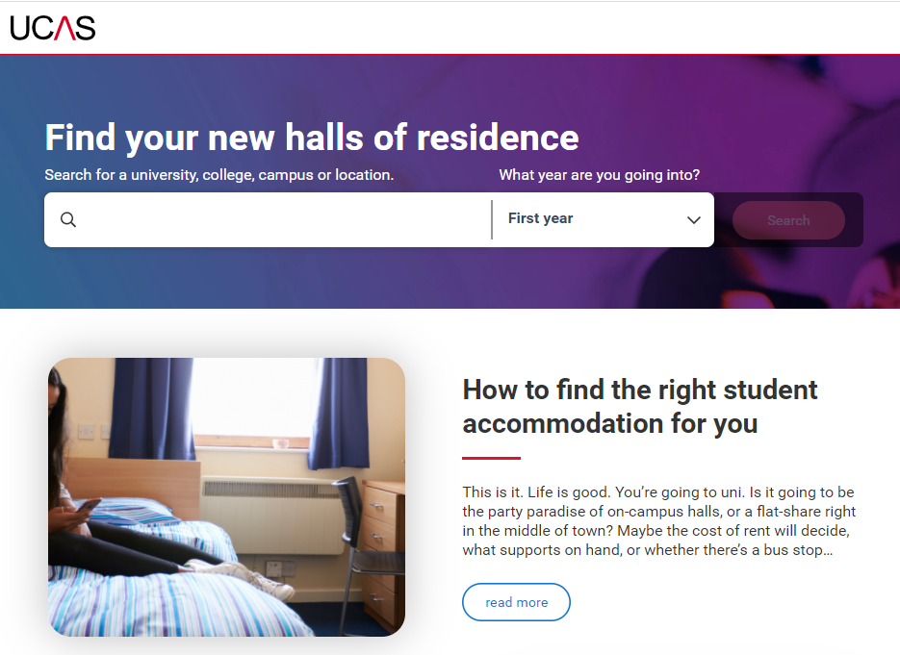

Research – it's free!
New - Accommodation Search- accommodation is high on the list when considering where you want to study, but it’s not always easy to compare what’s on offer. Understand what options there are using our new Accomodation search.
Join our UCAS Hub lives and Facebook lives -each live session is hosted by an expert panel to give you what you need to make an informed decision.
UCAS Futures - a chance to explore courses you're interested in and speak to universities and colleges from around the UK. You can talk to subject and admissions experts, discover apprenticeships, get advice on personal statements, applying through UCAS, and more.

Slide 6

Research – it’s free!
Learning from others – chat to uni students student videos and blogs.
Career options – use the job profiles to explore different career roles and pathways.
Take the Buzz quiz to find out more about individual strengths, and what roles may suit you.
The Career Finder tool is ideal for considering options after education, including searching for apprenticeships.
Security marking: PUBLIC
23 October 2020
| 6

Slide 7
Choosing the right university for you
Style – from the traditional, with a focus on subject-based courses and research, to modern universities, with a greater focus on vocational courses.
Location – some are based in large cities, others in smaller towns - a major influence on the environment and lifestyle.
Size – larger universities can have more than 20,000 students, whereas some of the smallest have only a few thousand.
Culture and facilities – influenced by a range of factors, including the diversity of students who attend.
What graduates do – all universities collect destination statistics. It can be interesting to find out the types of jobs or further study students go on to.
Tuition fees – can vary between course providers. Check if there are any scholarships or bursaries available.
Living costs – accommodation, transport, and food can vary enormously.
Security marking: PUBLIC
23 October 2020
| 7

Slide 8
Choosing the right course for you
What does the course cover?
Courses with the same title may be very different.
Look carefully at the core course content, and the range of optional studies/modules available.
Which modules are the most interesting and relevant to your career aspirations?
See if the course or university/college offers any internship, placement, or study abroad opportunities.
How is the course taught – structured teaching, or more independent research? How many lectures are there, and how much group work will be done in seminars?
How is the course assessed?
Security marking: PUBLIC
23 October 2020
| 8

Slide 9





Apply key facts
It’s an online application
Maximum of five choices.
Choice restrictions:
  medicine, veterinary, medicine/science, dentistry
  (maximum of four)
  Oxford or Cambridge
Simple application cost:
  one choice – £20
  two to five choices – £26
Equal consideration.
‘Invisibility’.
5
Security marking: PUBLIC
23 October 2020
| 9

Slide 10
When to apply for 2021 entry
19 May UCAS Undergraduate Apply opens for 2021 entry.
8 September First day for receipt of completed applications.
15 October* Application deadline for courses in medicine, veterinary medicine/science, and dentistry, and courses at Oxford or Cambridge.
15 January* Equal consideration application deadline.
25 February Extra opens.
30 June* Last date for applications before Clearing.
* 18:00 UK time
Security marking: PUBLIC
23 October 2020
| 10

Slide 11

Making a UCAS application
Begin at ucas.com/apply.
Sections to be completed:
Personal details
Choices – make up to five
Education
Employment
Personal statement
Reference
Security marking: PUBLIC
23 October 2020
| 11

Slide 12







The personal statement
The only section you have full control over
Your only chance to market yourself as an individual
UCAS’ similarity detection service:
every personal statement is run through software to check for plagiarism.
The same for all of your choices
A maximum of 4,000 characters, or 47 lines
A minimum of 1,000 characters
There isn’t a spelling or grammar check
No formatting allowed
Security marking: PUBLIC
23 October 2020
| 12

Slide 13

Start early
Include:
  academic achievements, past and present
  why you’re interested in the subject area
  your knowledge of the subject area
  your enthusiasm to go beyond the syllabus
  what you enjoy about studying
  details of your independent study skills
Security marking: PUBLIC
23 October 2020
| 13

Slide 14

Consider…
  Universities and colleges will ask:
  Have you chosen the right subject for the right reasons?
  Can you survive in an intense and pressured atmosphere?
  Do you have a range of interests and aptitudes?
  Do you have a depth of interest in the subject?
  Have you studied independently?
  Do you appear motivated and committed?
  Do you possess good numeracy and literacy skills?
Security marking: PUBLIC
23 October 2020
| 14

Slide 15



Decisions
Universities and colleges will review the:
And make one of three decisions:
They may also ask for:
personal statement
    Unconditional offer
Admissions test
qualifications
Interview
    Conditional offer
reference
    Unsuccessful
Portfolio/audition
Security marking: PUBLIC
23 October 2020
| 15

Slide 16
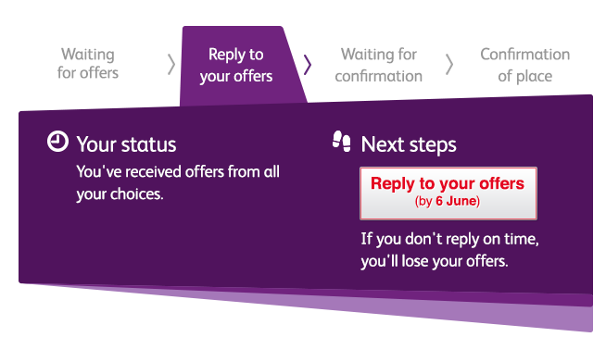

Tracking applications
Track allows applicants to:
follow the progress of their application 24/7
see their choices and personal information
view their offers
reply to offers online
In Track, a student can hold up to two offers:
  firm – if they meet the conditions of the offer they will be placed here
  insurance –if they are not placed with their firm choice, they may be placed with their insurance choice.
Security marking: PUBLIC
23 October 2020
| 16

Slide 17

Replies to offers
Once you have decisions on all your choices, you can hold a maximum of two offers:
  one as a ‘firm’ acceptance – your first choice
  the other as an ‘insurance’ acceptance. This acts as a back-up if you do not get into your ‘firm’ choice
You must then decline any remaining offers.
Once all your decisions and replies have been made, if you are not holding an offer, you may be able to use Extra or Clearing to find available places.
See www.ucas.com for more information.
Security marking: PUBLIC
23 October 2020
| 17

Slide 18

Other options
Extra (25 Feb – 4 Jul)
  Used all five choices and had no offers.
  Add Extra choices for consideration one at a time in Track.
Clearing (5 Jul – 19 Oct)
Apply after 30 June, receive no offers, decline all offers, not met conditions.
Find vacancies from July, and add one choice in Track.
Adjustment (up to five days in Aug)
Placed with firm choice, and did better than expected.
Register in Track, then find another university or college. The new university or college adjusts the record.
Security marking: PUBLIC
23 October 2020
| 18

Slide 19



Additional help
UCAS Customer Experience Centre
0371 468 0 468
From outside the UK:
+44 330 3330 230
Monday to Friday, 08:30 – 18:00 (UK time)
Stay up to date online at:
facebook.com/ucasonline
twitter.com/UCAS_online
Security marking: PUBLIC
23 October 2020
| 19

Slide 20
Thank you
Security marking: PUBLIC/INTERNAL USE ONLY/CONFIDENTIAL
23 October 2020
| 20

