Slide 1
Marketing on UCAS.com
Guide for content editors

Slide 2
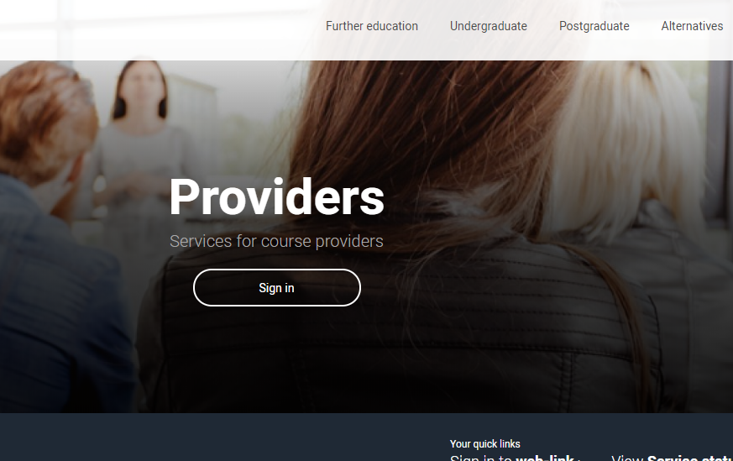
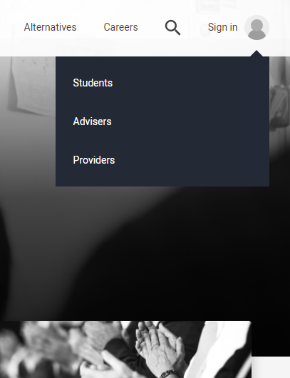
First thing
You need to sign-in to the ‘Providers’ section of UCAS.com. via either the key icon in the top right corner of the screen (1) or the provider landing page (2) at ucas.com/providers
If you do not have an account on UCAS.com, the admin user at your provider will need to add your email address and set ‘Marketing’ permission. You’ll then be able to register and log in.
2
1
Either from the sign in menu anywhere on the site (1) or the provider landing page (2) at ucas.com/providers

Slide 3
Once you’ve signed into the Provider section…
Click the link in the Site management area to “Manage access and open days”
2
1
If you manage more than one provider, then use this drop down (1) to choose the provider then use the link (2) to access the admin screen

Slide 4
Update to admin screens
We have made a small update to the tabs in the admin screen
You can continue to upload images on ucas.com but we have now renamed the “Gallery” tab to “Marketing” as this now enables some extra fields to be entered to promote your institution

Slide 5
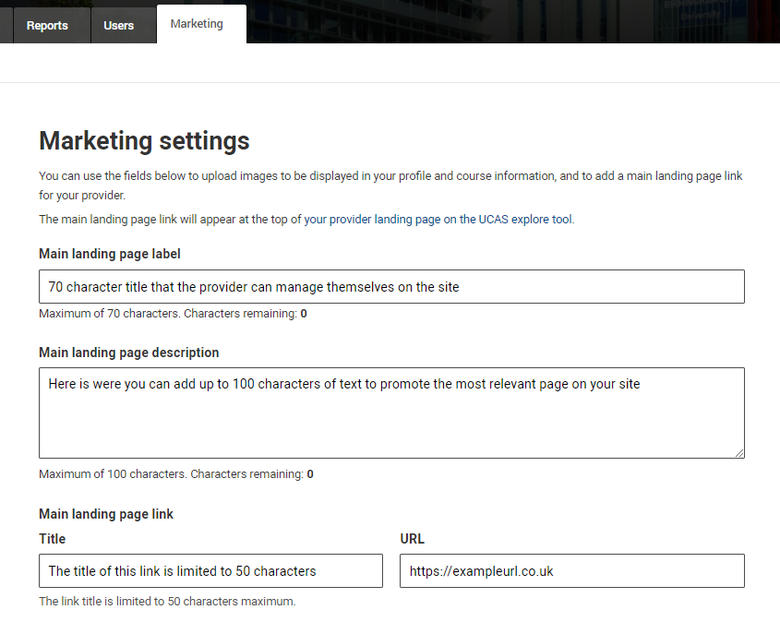
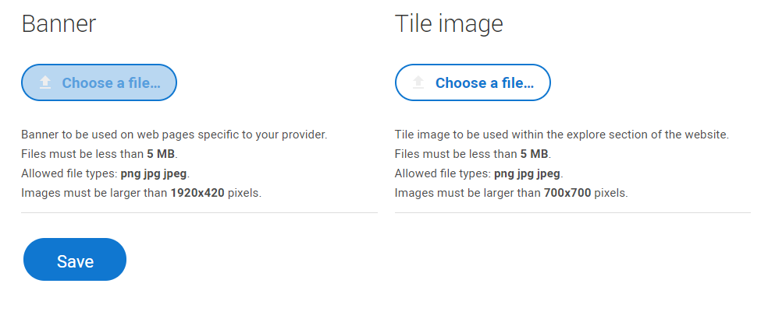
Update to admin screens
You can continue to upload images on ucas.com. To add the new information follow the steps below
Step 1. Update your details for the main landing page section
Step 2. Press save
Step 3. Click the highlighted link at the top of the page to check the listing
You can continue upload/update images for your page banner and course tile here

Slide 6
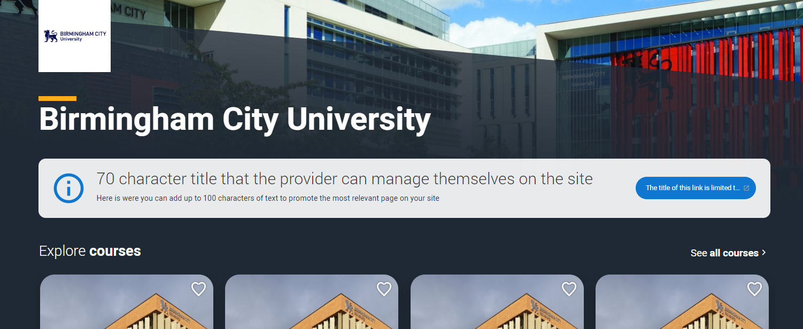
Update to your provider page
Completing the fields and pressing save on your admin screen will publish the details to your provider page, adding a clear call to action for users landing on your page to visit the link you deem most relevant at this current time.
You can find your page anytime by visiting:-
ucas.com/explore/unis and using the A-Z and filters to find your own provider page

Slide 7
For more information
and support
If you are unsure about any of the details on how to add, edit or publish open day events, upload images or edit the new main landing page link, then contact the Data Collection Team at UCAS on 01242 544 864
If you need help adding users or managing permissions, then contact the HEP team on 0384 984 1111

Slide 8
Thank you

